Slide 1
KRITERIJI KVALITETE ČASOPISA KAO KANALA ZNANSTVENE KOMUNIKACIJE
Jadranka Stojanovski
Sveučilište u Zadru / Institut Ruđer Bošković
Međunarodni znanstveno-stručni skup ZNANOST, ZNANSTVENA KOMUNIKACIJA I ČASOPISI
Sveučilište u Mostaru, 7. veljače 2020.

Slide 2
Zašto su lokalni/regionalni časopisi važni?
istraživanja od lokalnog (regionalnog) interesa - na tragu Leidenskog manifesta
kvalitetan rad uredništva s (prvenstveno mlađim) istraživačima
razvijanje vještina uredničkog i izdavačkog posla, posebno u digitalnom i umreženom okruženju
smanjivanje raskoraka između znanosti i primjene unutar zajednice, gospodarstva
koristi za znanstvenu i akademsku kulturu - etička pitanja znanstvenog izdavaštva i učenje o znanstvenoj čestitosti
građenje reputacije lokalne znanstvene zajednice
važnost i relevantnost teme neće se uvijek reflektirati u citatima (i IF časopisa)
manji troškovi objavljivanja obzirom na visoke Article Processing Charges (APC) velikih izdavača
olakšani pristup znanstvenoj zajednici (OA ili niže cijene)
očuvanje (znanstvene) kulture zajednice

Slide 3
Zašto je važno objavljivanje (i) na materinjem (hrvatskom) jeziku?
razvoj terminologije na hrvatskom jeziku
dostupnost sadržaja široj čitalačkoj publici (nema barijera stranog jezika)
komunikacija istraživanja relevantnih za lokalnu zajednicu na lokalnom jeziku
nužnost objavljivanja i na engleskom jeziku u SVIM znanstvenim područjima, uključujući društvene i humanističke znanosti!!!

Slide 4
Opća pitanja
“međunarodno” i „inozemno” vs. “domaće”. Kako ispraviti pogrešan pristup prema pitanju “međunarodne” vidljivosti i prema "domaćim" časopisima?
Što je to međunarodni/inozemni časopis (međunarodna recenzija, međunarodno uredništvo, inozemni izdavač/nakladnik/vlasnik...)?
Što je točno međunarodna vidljivost (prisutnost na Google Scholaru, indeksiranost u komercijalnim bazama podataka...)?
Trebali li kriterij “međunarodnosti” zamijeniti kriterijem kvalitete?
Kako jačati institucije, znanstvenike, časopise?
Treba li podupirati edukaciju članova uredništava?

Slide 5
Opća pitanja
dodatno vrednovanje rada urednika i recenzenata kroz sustave napredovanja
je li udio stranih autora prednost ili nedostatak? Jesu li časopisi koji većinom objavljuju radove stranih autora (bez udjela domaćih) bolji ili lošiji od onih koji objavljuju većinu radova hrvatskih autora? Treba li poticati i međunarodno, međuinstitucionalno koautorstvo? Treba li sankcionirati (pre)veliki udio autora iz jedne ustanove ili iz uredništva časopisa?
od udjela stranih/domaćih autora bitnije je smanjiti/ukloniti udio autora iz samo jedne ustanove i udio radova članova uredništva - za sve objavljene radove članova uredništva časopis mora javno i jasno deklarirati na koji je način osigurana nepristranost recenzijskog postupka.
kvaliteta rada uredništva prenosi se na poboljšanu kvalitetu radova i časopisa, bez obzira na udio afilijacija
kvalitetan časopis širi utjecaj ustanove i države u druge zemlje

Slide 6
Kvaliteta i transparentnost uređivačke politike
poticanje transparentnosti uređivačke politike časopisa i svih uključenih procesa
poticanje kvalitete i transparentnosti recenzijskih postupaka
javna dostupnost kvalitetnih dokumenata kao što su:
impresum(musthead)
upute za autore
etički kodeks
upute za recenzente (pored obrasca!)
autorskopravna pitanja - definirani uvjeti korištenja (npr. Creative Commons licencije), odnosi s autorima...
jasno definirane obveze uredništva, vlasnika, izdavača, financijera
svrha, obuhvat (scope)..i ostalo, sukladno međunarodnim izdavačkim standardima
upute za tehnično oblikovanje (najmanje važne, a najviše zastupljene)...

Slide 7
Sadržaj časopisa - kvaliteta i znanstveni udio
višejezičnost
znanstveni udio
koliko je znanstvenih/stručnih/popularnih radova u godištu objavljeno
koliko je ukupno zaprimljenih radova
koliko je od ukupno zaprimljenih radova odbijeno na uredničkom pregledu i
koliko je radova odbijeno nakon recenzentskoga postupka.
ispravna procjena voluminoznosti rada redakcije i kvalitete

Slide 8
Vidljivost i indeksiranost
Aplicirati za indeksiranje u različite baze podataka!
Ažurnost podataka na SHERPA/ROMEO.
Važeće poveznice iz WoSCC i Scopusa na cjelovite tekstove
selektivne i neselektivne baze podataka
popularne i relativno nepoznate baze podataka
predmetne i višedisciplinarne baze podataka
indeksiranost u međunarodnim bazama podataka (časopis bi prvenstveno trebao biti indeksiran u Directory of Open Access Journals, zatim u osnovnoj disciplinarnoj bazi podataka svog znanstvenog područja, a tek potom u višedisciplinarnim bazama podataka kao što su WoSCC i Scopus)
indeksiranost u DOAJ! Nužno (zahtjev Plana S).
vidljivost – prisutnost na istraživačkim društvenim mrežama (academia.edu; CiteSeerX, ResearchGate, Mendeley...)
indeksiranost u Scopusu i WoSCC razmatrati „sa zrnom soli”

Slide 9
Naprednije značajke u uredničkim/izdavačkim procesima
poticanje uvođenja što više elemenata suvremenog izdavaštva
primjena nekog od softvera kao sto je Open Journal System (OJS) npr. koji impliciraju dobro definirane procese uređivanja
kvalitetne web stranice i dodatne funkcionalnosti
otvoreni recenzijski postupak s javno dostupnim recenzijama
pohrana istraživačkih podataka (obavezna za H2020 projekate)
mogućnost komentiranja članaka
mogućnost dijeljenja članaka na društvenim mrežama
istaknuti metrijski (i altmetrijski) pokazatelji na web stranicama na razini rada
kvalitetan PRETRAŽIV/EDITABILAN PDF (s uključenim metapodacima), najbolje PDF/A
alternativni formati teksta i priloga (pored PDF) kao npr. XML, HTML, ePUB, LaTeX i dr.
implementacija različitih medija (grafika, audio, video...)

Slide 10
(Još) naprednije značajke u uredničkim/izdavačkim procesima
semantičko označivanje (uz razvoj ontologija)
RDF
linked data
interakcija s čitateljima
vizualizacija podataka
multimedijski materijali
audio
video
...

Slide 11
Metrijski pokazatelji
više metrijskih pokazatelja, a ne jedan!
za SJR i SNIP je dobro što su 'skalirani' prema području, IF je također moguće uspoređivati unutar područja
h-index nije skaliran, ali je jako dobar pokazatelj (unutar predmetne kategorije časopisa)
uvažavanje specifičnosti znanstvenih područja!!!
umjesto kvartila puno je bolje uvesti jednostavnije dodatno bodovanje za časopise koji su IZNAD medijana područja?

Slide 12
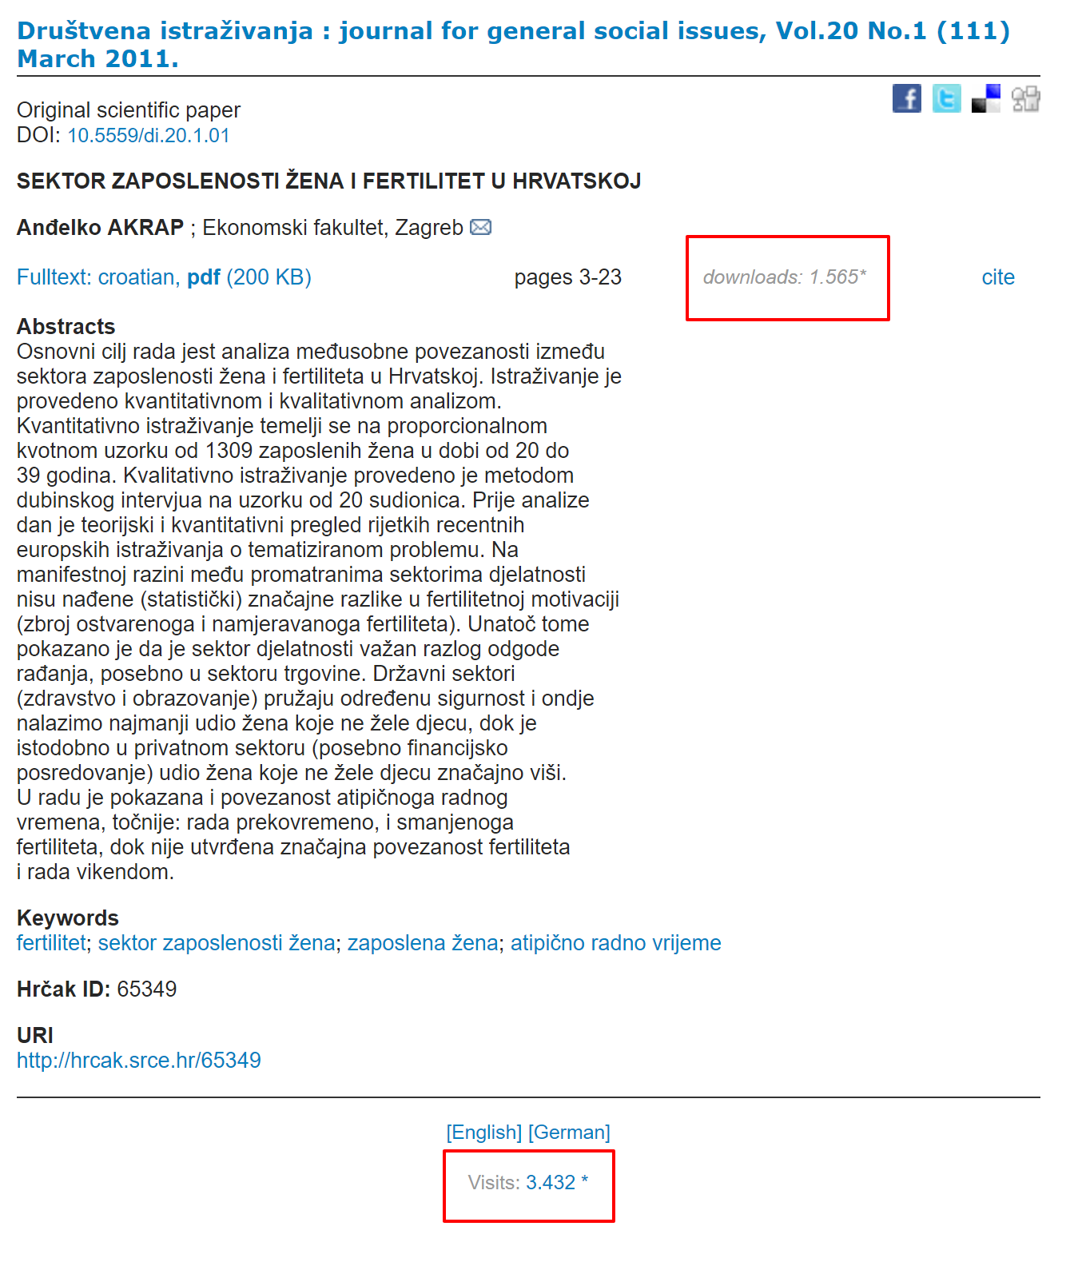
Altmetrija!
1 WoS citation
1565 downloads
3432 visits

Slide 13
Važno, a zanemareno
sustavna edukacija urednika, članstvo u uredničkim udrugama, prisustvovanje skupovima i sl.
kroz kriterije i dodatno financiranje motivirati uredništva da investiraju u svoje usavršavanje
poticati prisustvovanje radionicama
poticati prisustvovanje konferencijama (PUBMET2020, EASE Conference, ElPub, i dr.) koje se bave znanstvenim izdavaštvom

Slide 14
Transparentost financiranja
potpuna transparentnost financiranja časopisa (iz svih izvora: potpore ministarstava kulture, zdravstva, gospodarstva, javnih poduzeća, matične ustanove, sponzora itd.)
nužno je da časopisi jasno iskažu sve svoje prihode (tiskane pretplate, subvencije iz drugih izvora, APC) i da se onda iznos subvencije određuje, osim prema bodovima, i prema iskazanim očekivanim rashodima i prihodima
država treba opravdati višekratno financiranje istog sadržaja

Slide 15
Međunarodni kriteriji
Neophodno je pratiti razvoj globalni znanstvene publicistike

Slide 16
Pregled
DOAJ (Directory of Open Access Journals) – isključivo tehnički zahtjevi, ne gleda se kvaliteta sadržaja/objavljenih radova, standard za europske časopise, obaveza prema Planu S
Plan S – najnovija inicijativa europskih financijera znanstvenih istraživanja, novi zahtjevi za časopise
journalquality.info – izvrstan pregled kriterija za časopise, kako osnovnih, tako i onih naprednijih
Web of Science Core Collection
Scopus

Slide 17
DOAJ kriteriji
at least a third of the content should consist of peer reviewed original research and/or review papers
the full-text of a journal’s content must be openly accessible immediately upon publication—a requirement shared by Plan S
The number of research and review articles that the journal published in the last calendar year—a journal must publish at least 5 research articles per year to stay in the DOAJ
The digital archiving policy the journal uses (e.g. CLOCKSS, Portico, a national library)—while a digital archiving policy is not required by the DOAJ it is strongly recommended
URL where the journal’s digital archiving policy information can be found—this field is optional if you select “no policy in place”

Slide 18
DOAJ kriteriji
Journal Title—be sure to spell out the complete journal title to match the title registered with all official publication identifiers (e.g. ISSN)
Journal website URL—you must have a journal website to be included in the DOAJ, so if you’re starting a journal you’ll need to have it set up first (you’ll also need to publish at least five research articles before applying as noted below)
Journal ISSN (print version)—note this is required but only if you have a print ISSN otherwise leave it blank
Journal ISSN (online version)—the DOAJ notes this cannot be the same as the P-ISSN, “write the EISSN with the hyphen - e.g. 1234-4321”
Publisher—this is the organization that officially publishes the journal, whether it’s a press, learned society, or academic non-profit
Name and email address for the main contact for the journal—Make sure this is someone who will be available and responsive if the DOAJ needs to reach out with questions/next steps now or in the future
The country where the journal’s publisher is based (i.e. carries out the majority of its publishing activities)
Whether the journal has article processing charges (APCs)—yes or no response
URL to the page where all APC information can be found—this is required, so even if a journal charges no fees you’ll need a statement explaining that somewhere on the website
Whether the journal has an article submission charge
URL to the page where all article submission fee information can be found—this is required, so even if a journal charges no fees you’ll need a statement explaining that somewhere on the website

Slide 19
DOAJ kriteriji
The article identifiers the journal uses (e.g. DOI, Handles)—while article identifiers are not required for indexing they are strongly recommended
Whether the journal will provide or intends to provide article-level metadata to the DOAJ (providing metadata is not required but is strongly recommended)
Whether the journal provides individual article download stats—yes or no (This is not required but if “yes” you will need to provide a URL where that information can be found)
The first calendar year in which a complete volume of the journal’s articles were provided online in full-text—if the journal flipped to OA use the year it officially became OA
Full-text article formats available (PDF, HTML, ePUB, XML, Other)
Up to 6 keyword(s) that best describe the subject area of the journal (comma delimited)
The language(s) that the full text of articles is published in

Slide 20
DOAJ Seal – journals that adhere to best practices
To qualify for the Seal the journal must:
have an archival arrangement in place with an external party (Question 25). 'No policy in place' does not qualify for the Seal.
provide permanent identifiers in the papers published (Question 28). 'None' does not qualify for the Seal.
provide article level metadata to DOAJ (Question 29). 'No' or failure to provide metadata within 3 months do not qualify for the Seal.
embed machine-readable CC licensing information in article level metadata (Question 45). 'No' does not qualify for the Seal.
allow reuse and remixing of content in accordance with a CC BY, CC BY-SA or CC BY-NC license (Question 47). If CC BY-ND, CC BY-NC-ND, 'No' or 'Other' is selected the journal will not qualify for the Seal.
have a deposit policy registered in a deposit policy directory. (Question 51) 'No' does not qualify for the Seal.
allow the author to hold the copyright without restrictions. (Question 52) 'No' does not qualify for the Seal.

Slide 21
Plan S
Rights and licensing: The author or the author´s institution shall retain their copyright. Licenses to publish that are granted to a publisher must allow the author/institution to make either the Version of Record (VoR), the Author’s Accepted Manuscript (AAM), or both versions available under an open license (as defined below) via an Open Access repository, immediately upon publication.
4. Supporting Quality Open Access Journals and Platforms – zahtjevi za Hrčak
5. Transparency of Costs and Prices
Use of persistent identifiers (PIDs) for scholarly publications (with versioning, for example, in case of revisions), such as DOI (preferable), URN, or Handle.
Deposition of content with a long-term digital preservation or archiving programme (such as CLOCKSS, Portico, or equivalent).
High-quality article level metadata in standard interoperable non-proprietary format, under a CC0 public domain dedication. Metadata must include complete and reliable information on funding provided by cOAlition S funders (including as a minimum the name of the funder and the grant number/identifier).
Machine-readable information on the Open Access status and the license embedded in the article, in standard non-proprietary format.
Jasno naznačena autorska i srodna prava i uvjeti korištenja (CC BY 4.0)
Uredni podaci na SHERPA/ROMEO!

Slide 22
Plan S
Strongly recommended additional criteria for all publication venues:
Support for PIDs for authors (e.g., ORCID), funders, funding programmes and grants, institutions, and other relevant entities.
Registering the self-archiving policy of the venue in SHERPA/RoMEO.
Availability for download of full text for all publications (including supplementary text and data) in a machine-readable community standard format such as JATS XML.
Direct deposition of publications (in a machine-readable community standard format such as JATS XML, and including complete metadata as described above) by the publisher into author designated or centralised Open Access repositories that fulfil the Plan S criteria.
OpenAIRE compliance of the metadata.
Linking to data, code, and other research outputs that underlie the publication and are available in external repositories.
Openly accessible data on citations according to the standards by the Initiative for Open Citations (I4OC).

Slide 23
journalquality.info – novi naslovi
The journal is published within the JOL country or region (the publishing, peer review management, business development and production is all handled in-country).
The journal publishes original research (in addition to other content).
The journal has a clearly-stated aim, focus and scope.
The masthead (“about the journal” information) includes:
The journal title.
The ISSN, registered with the ISSN International Centre.
The name of the publisher, institution and/or society by which the journal is published (with all relevant contact details, including physical address, phone numbers, email addresses and website address). Journals are encouraged to use official or institutional email addresses rather than Yahoo or gmail email addresses.
The copyright statement
The licensing statement (if the journal is Open Access, it needs to have selected an official licensing statement, for example the Creative Commons licence).
Details of the Editor and an Editorial Board with identifiable members. All details about the Editor and Editorial Board must be up to date and accurate. Names and titles should be written out in full, and all persons listed should be actively and verifiably involved with the journal.
Accurate publishing frequency, which is clearly stated (number of issues published per year, or an explanation of the process if the journal is publishing article-by-article).

Slide 24
journalquality.info – novi naslovi
The journal provides clear and comprehensive instructions to authors, including:
An explanation of the types of manuscript that a journal will consider.
A detailed style guide (that includes referencing style).
A description of how to submit an article.
A functional and frequently-checked contact email address for the journal.
Basic information displayed on the front page of each article, whether print or online, includes:
The article title.
The name(s) of the author(s).
The abstract (or summary, in the case of some humanities journals).
All articles relate to the focus and scope of the journal.
Each article includes complete bibliographic information for all cited references.
The journal sends the JOL (or another appropriate platform in the future) digital, English-language (and any other language, in addition) titles, abstracts, article keywords and PDFs of the full text of each issue in a timely manner, immediately after publication (or loads its own content, if trained to do so).

Slide 25
journalquality.info – jedna zvjezdica
The journal has an established publishing track record (of at least two years).
The journal publishes at least one issue per year, and/or at least five articles per year, and publishes issues on time, according to the stated publishing frequency.

Slide 26
journalquality.info – dvije zvjezdice
The journal has an editorial policy statement (including an accurate and detailed explanation of the validity of the peer-review and the quality-control processes applied to all manuscripts or authors’ texts submitted for publication).
The masthead (“about the journal” information) includes:
An eISSN for the online version of the journal registered with the ISSN International Centre.
As well as the Editorial Board member information, any other oversight body involved with the journal, for example, an International Advisory Committee, named with up to date and accurate information. Names and titles are written out in full, and all persons listed are actively and verifiably involved with the journal; the list also includes the primary and up to date institutional affiliation (or connection with a larger organization, for example a society or university) of each person listed. NOTE: The JOL requires applicant and partner journals to provide accurate contact details, including institutional (and other) email addresses for ALL persons listed on the masthead, as part of our review process. These contact details will not be made publicly available by the JOL unless we are instructed to do so by the journal/publisher.
The journal provides clear and comprehensive instructions to authors, including:
Information about copyright (please note the importance of telling authors whether the journal will be the copyright holder after publication of an article, or whether copyright remains with authors).
If the journal charges readers subscription fees, or charges authors or authors’ institutions any handling fees, publication fees or similar, the amount/s should be clearly stated and publicly available on the JOL website as well as on the journal’s own website (if it has one) and in the journal’s hard copy (if it has one).

Slide 27
journalquality.info – dvije zvjezdice
Basic information displayed on the front page of each article includes:
The journal title; volume and issue number; page numbers.
Article keywords.
The article DOI (digital object identifier, which is a string or set of numbers that uniquely identifies a published article).
The journal publishes at least one issue per year and/or at least eight articles per year, and publishes issues on time, according to the stated publishing frequency.
The journal has a publicly-available, accurate and detailed description of its peer-review process
Language and copy editing provide clarity for readers; layouts are consistent; tables, graphs and images are of good quality; and the same style is consistently used throughout the journal.
The cover of the journal looks professional or competent (no clip art or pre-made pictures, or low-quality images).
If the journal or publisher has its own website or is included on websites other than the JOL (for example, on a university website), the website quality is good (having a professional and functional or well-working site design with no garish or over-decorated, flashing images), and the journal content is up to date. Recommendations
The journal is strongly recommended to have clear and comprehensive instructions to peer reviewers

Slide 28
journalquality.info – tri zvjezdice
The journal includes copyright and licensing information on the first page of each article.
The journal includes author ORCIDs (for at least the corresponding author, but preferably for all authors). See orcid.org for more information on ORCIDs.
The journal includes funding acknowledgements by authors is displayed on the first page of each article (but may be on the last page).
Submission, acceptance and publication dates are included on the first page of each article.
The DOIs of referenced articles are included in the bibliographic references of each article.
Information about subscription fees, handling fees, publication fees or similar are included in the author instructions. If there are no fees, then this should be stated.
If the journal has its own website then the primary institutional affiliations of its full Editorial Board as well as of any other governance committees, such as advisory committees are included.
The Editorial Board (and any supporting committees) is institutionally and, geographically diverse (or varied) and ideally with a good gender balance.

Slide 29
journalquality.info – tri zvjezdice
The journal has a clearly-stated policy on authors’ permissions to deposit the article in a personal, institutional, thematic and/or other Open Access repository, including whether the permission is for the post-publication version or pre-publication version of the article.
The journal implements, and publicly and transparently shares, its policies on publication ethics (codes of moral and correct publishing conduct) and publishing malpractice including plagiarism, copyright violations, errata, retractions, data sets, gender, racial and language policies.
The journal has an archival, digital preservation arrangement with an external party, for example CLOCKSS (a joint venture or project between certain publishers and research libraries to create a reliable global archive or place where documents are stored).
The journal has a full back file of archival content available online
At least one issue and/or 10 articles are published per year (preferably more). Recommendations
It is recommended that journals include contact email addresses and/or a link to each Board member’s primary affiliation
Membership of COPE (the Committee on Publication Ethics) and/or OASPA (the Open Access Scholarly Publishers Association) (for Open Access journals) is strongly encouraged.
to provide evidence that they meet the DOAJ technical requirements and DOAJ Seal Qualifiers (see doaj.org/application/new).

Slide 30
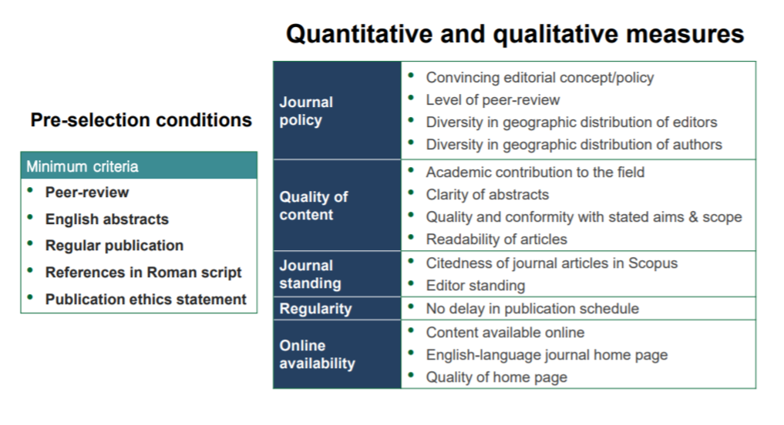
Scopus kriteriji

Slide 31
Scopus – JOURNAL POLICY
Convincing editorial policy
Diversity in geographical distribution of editors
Diversity in geographical distribution of authors
Type of peer-review
Cited references in Roman script
English language abstracts
Očekivano vrijeme od zaprimanja do objave rada jasno deklarirano u Uputama za autore!

Slide 32
Scopus - CONTENT
Preporuka: Strukturirani sažetak (posebno za pojedina područja)
Academic contribution to the field
Clarity of abstracts
Conformity with the journal’s stated aims and scope
Readability of articles
Preporuka: Jasno deklariran i opisan obuhvat časopisa - scope (ne povijest časopisa!)

Slide 33
Scopus – JOURNAL STANDING
Citedness of journal articles in Scopus
Editor standing (documents, citations, h-index)

Slide 34
Scopus - REGULARITY
No delay in the publication schedule
By 4 or more issues delayed
By 2-3 issues delayed
By 1 issue delayed
Published on time

Slide 35
Scopus – ONLINE AVAILABILITY
Online content available
English language journal home page available
Quality of journal home page

Slide 36
Scopus – poor quality
Editors and authors from the same institution
Plagiarism
Poor figures
Bad grammar
Flawed science
Uneven quality
Poor homepage
Lack of journal focus

Slide 37
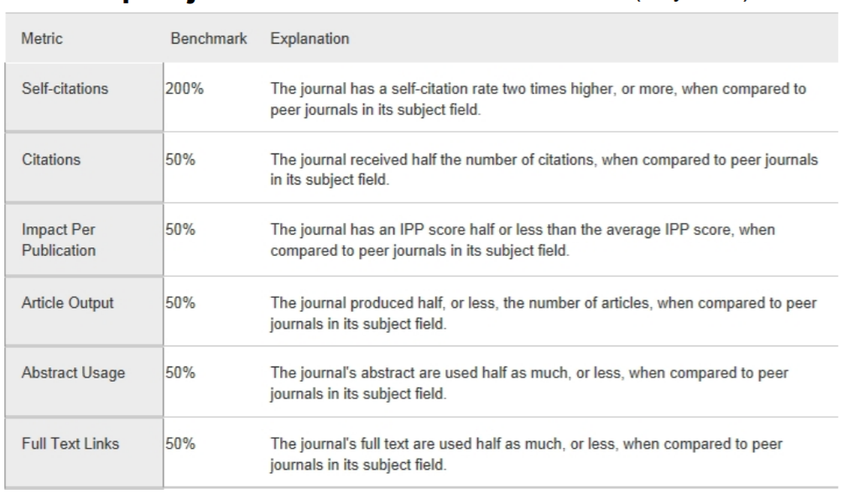
Scopus – re-evaluacija

Slide 38
Etički standardi
Preporuka: Dodatno bodovati etičke standarde, dodatno bodovati kvalitetan opis postupaka pri plagiranju, fabriciranju, falsificiranju, sukobu interesa i dr.!!!
plagiranje, fabriciranje, falsificiranje
suradnja
originalnost
CoI
časopisi bez osporenih (retracted) radova, bez korekcija, ispravaka…
brisanje osporenih radova???
mijenjanje već objavljenih radova (nakon nekoliko mjeseci ili godina)???
rejection vs retraction
Preporuka: Bodovi za postotak odbijenih radova

Slide 39
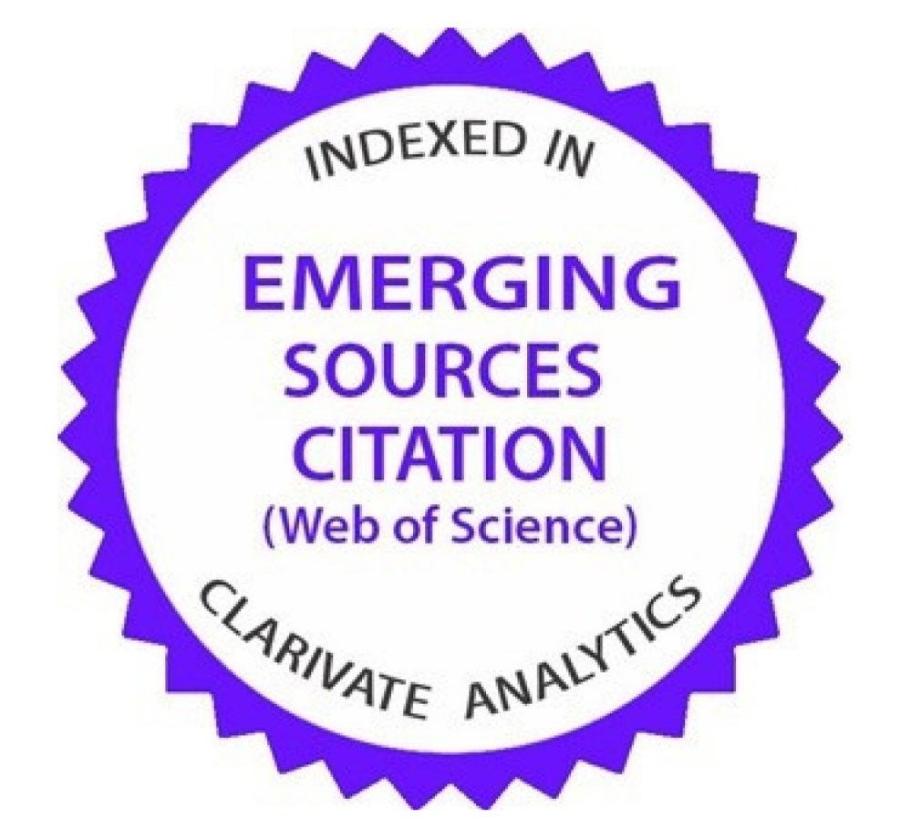

WoS (razlike između citatnih indeksa i ESCI)
Primjer Ekonomskog fakulteta u Zagrebu pokazuje nerazumijevanje

Slide 40






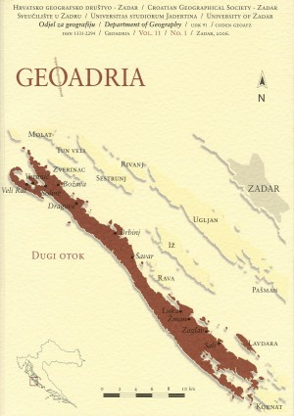


Hrvatski časopisi
Notes:
časopis se izlaže javnosti, prosudbi, kritici...
slično kao recenzijski postupak
vidljivost
„mjerenje” kvalitete
lakša dostupnost

Slide 41
Što je dobro?
financiranje časopisa
kriteriji koji se razvijaju i unaprjeđuju
otvoreni pristup
uvažavanje višejezičnosti (nedovoljne potpore paralelnom objavljivanju na više jezika)
uvažavanje razlika između znanstvenih područja/polja/grana
nenaplaćivanje autorima
vrednovanje (volonterskog) uredničkog rada

Slide 42
Što nije dobro?
manjkavi recenzijski postupak (isključivo domaća recenzija, „urednička recenzija”, površna recenzija…)
prevelik broj malih časopisa u istim znanstvenim područjima koji objavljuju nekoliko znanstvenih radova godišnje – motivirati objedinjavanje časopisa iz istih područja/polja/grana
objavljivanje članova uredništva u „vlastitom” časopisu
nedovoljna „brzina” usvajanja globalnih uređivačkih kriterija (posebno EU)
forsiranje tiskanog koncepta časopisa
nezadovoljavanje osnovnih tehničkih zahtjeva
nedovoljna transparentnost uređivačkih politika

Slide 43
Što treba unaprijediti u Kriterijima za financijsku potporu znanstvenim časopisima (Hrvatska)?
Preporuke

Slide 44
Nužni uvjeti za dobivanje financijske potpore:
TRANSPARENTNOST UREĐIVAČKE POLITIKE
javna dostupnost dokumenata kao što su
impresum
upute za autore
etički kodeks
upute za recenzente (dodatno: obrazac za recenzente)
autorskopravna pitanja - jasno definirani uvjeti korištenja (npr. Creative Commons licencijama), odnosi s autorima...
jasno definirane obveze uredništva, vlasnika, izdavača/nakladnika, financijera
svrha, obuhvat, djelokrug (eng. scope)
upute za tehnično oblikovanje

Slide 45
„Proširiti” priznate troškove objavljivanja časopisa
Preporuka:
priprema tekstova (lektura, korektura, prijevod, DOI, uređivanje bibliografije, ugradnja grafike, audia, videa, vizualizacije podataka
obrada (prijelom) – ukoliko se od autora ne traži camera-ready rukopis – smanjiti udio pripreme za tisak u odnosu na pripremu za online korištenje
priprema kvalitetnog pretraživog PDF formata rada s pripadajućim metapodacima
priprema drugih formata rada (XML, HTML, ePUB, i dr.)
digitalizacija starih brojeva, izdrada/održavanje mrežne stranice ili elektroničkog sustava za uređivanje časopisa
sustavi za otkrivanje plagijata
uredski pribor, alati za uređivanje, honorari...

Slide 46
U priznate troškove objavljivanja časopisa trebaju ući i naprednije funkcionalnosti
Preporuka:
pohrana istraživačkih podataka (raw data, underlying data...)
organiziranje otvorene recenzije
objedinjavanje recenzentskih pool-ova za tematski srodne časopise
vizualizacija podataka, multimedija
druge napredne značajke znanstvenog izdavaštva

Slide 47
Čimbenici
Preporuka:
Čimbenik opsega: arke zamijeniti brojem zaprimljenih/odbijenih/recenziranih/prihvaćenih radova (radovi su ujednačene duljine, opseg u arcima nije mjera kvalitete...)
Čimbenik težine teksta: revidirati, procijeniti angažman uredništva i ustanoviti u kojoj mjeri autor dostavlja priređen tekst, dodati ugradnju grafike visoke rezolucije, audia, videa, multimedije i alata za vizualizaciju podatka
Čimbenik naklade – tisak smanjiti na minimum, tiskanu razmjenu treba financirati ustanova koja time nadopunjava fond knjižnica
nikako ne bi trebalo sankcionirati/diskriminirati časopise koji nemaju tiskanu nakladu!!!

Slide 48
Indeksiranost i citiranost (1)
revidirati utjecaj i značaj pojedinih komercijalnih baza podataka
Web of Science Core Collection uključuje više baza podataka koje imaju različite razine selektivnosti:
Science Citation Index Expanded, Social Science Citation Index, Arts and Humanities Citation Index, Emerging Source Citation Index, Current Chemical Reactions i Index Chemicus (ne navodim baze podataka koje uključuju knjige i zbornike skupova)
ovaj popis podložan je promjenama sukladno tržišnim kriterijima tvrtke Clarivate Analytics
također Science Citation Index više nije moguće izdvojiti iz Science Citation Index Expanded

Slide 49
Metrika
ukupna citiranost časopisa iz raspoloživih baza podataka
h-index
citiranost radova objavljenih u prethodnoj godini
gledati je li časopis iznad ili ispod prosjeka područja, razina kvartila je nepotrebna
dodavanje altmetrijskih pokazatelja

