Slide 1



Observational parameters in a braneworld inflationary scenario
Milan milošević
Department of Physics
Faculty of Sciences and Mathematics
University of Niš, Serbia
In collaboration with
N. Bilić (Zagreb), G. Djordjević (Niš),
D. Dimitrijević (Niš) and M. Stojanović (Niš)
Ruđer Bošković Institute, Zagreb, Croatia, 2 November 2018

Slide 2
Outline
Introduction
  Standard Cosmological Model
Inflationary models
  Tachyon Inflation
  Randall - Sundrum (RS) Model
  Extended RS model
Numerical results
Conclusion

Slide 3

Introduction
The inflation theory proposes a period of extremely rapid (exponential) expansion of the universe during the very early stage of the universe.
Inflation is a process in which the dimensions of the universe have increased exponentially at least $e^{60}≈{10}^{26}$ times.
Although inflationary cosmology has successfully complemented the Standard Model, the process of inflation, in particular its origin, is still largely unknown.

Slide 4
Introduction
Over the past 35 years numerous models of inflationary expansion of the universe have been proposed.
The simplest model of inflation is based on the existence of a single scalar field, which is called inflaton.
Recent years - a lot of evidence from WMAP and Planck observations of the CMB
The most important ways to test inflationary cosmological models is to compare the computed and measured values of the observational parameters.

Slide 5

standard cosmological model
Dynamics of an expansion of a homogeneous and isotropic universe
  A. Fridman (A. Einstein, W. de Siter, G. Lemaître)
From the basic postulates GTR -> The Einstein field equation
$$R_{μν}−\frac{1}{2}g_{μν}R=\frac{8πG}{c^{4}}T_{μν}.$$
Friedmann–Robertson–Walker metric
$$ds^{2}=c^{2}dt^{2}−a^{2}(t)\left[\frac{dr^{2}}{1−kr^{2}}+r^{2}\left(dθ^{2}+\sin^{2}θdφ^{2}\right)\right],$$
where $R_{μν}$ are components of Ricci tensor, $R$ – Ricci scalar, and $T_{μν}$ are components of energy–momentum tensor

Slide 6
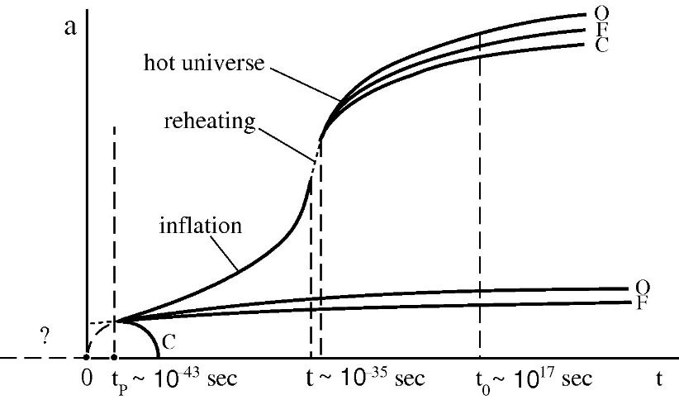


standard cosmological model
Friedmann equations
$$\begin{matrix}H^{2}≡{\left(\frac{\dot{a}}{a}\right)}^{2}=\frac{8πG}{3}ρ−\frac{kc^{2}}{a^{2}} \\ \frac{\ddot{a}}{a}=−\frac{4πG}{3}\left(ρ+\frac{3p}{c^{2}}\right)\end{matrix}$$
A reliable model for ${10}^{−10}s$ old universe and energy of the particles $<1TeV$
SCM: about 15 problems, the most
important
  The flatness problem
  The horizon problem
Solution – inflation?!
(A. Guth, K. Sato, 1981)
$$k=−1$$
$$k=0$$
$$k=1$$
Why do we need inflation?
A. Linde, Particle Physics and Inflationary Cosmology, (2005) 270.

Slide 7


„Standard“ Inflation
The simplest models - standard single scalar field inflation, a field $φ$ - inflaton
A condition for inflation (from the Friedmann equations)
$$\frac{d}{dt}{\left(aH\right)}^{−1}<0 ⇔ \frac{d^{2}a}{dt^{2}}>0 ⇔ ρ+3p<0$$
The dynamics of the classical real scalar field
$S=−\frac{1}{16πG}\int{\sqrt{−g}}Rd^{4}x+\int{\sqrt{−g}}ℒ(X,φ)d^{4}x$,
w$here \left.ℒ(X,φ\right)$ is the Lagrangian, with kinetic term $X≡\frac{1}{2}∂_{μ}φ∂_{ν}φ$
Energy density and preassure
A negative pressure runs inflation
$$ρ≡ℋ=\frac{1}{2}{\dot{φ}}^{2}+V(φ)$$
$$p≡ℒ=\frac{1}{2}{\dot{φ}}^{2}−V(φ)\begin{matrix} \\ \end{matrix}$$

Slide 8
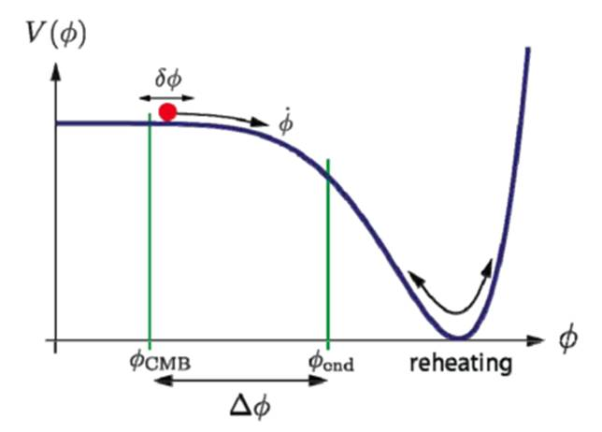

„Standard“ Inflation
Time evolution of homogeneous scalar field, for FRW metric → the Klein–Gordon equation
$$\ddot{φ}+3H\dot{φ}+V^{′}=0, V^{′}≡\frac{∂V}{∂φ}$$
The Friedmann equation
$$H^{2}=\frac{8πG}{3}\left(\frac{1}{2}{\dot{φ}}^{2}+V(φ)\right)$$
Slow-roll condition
$${\dot{φ}}^{2}≪V(φ)⇒\left\{\begin{aligned}H^{2}≈\frac{8πG}{3}V(φ) \\ \begin{matrix} \\ 3H\dot{φ}+V^{′}≈0\end{matrix}\end{aligned}\right.$$
In order for inflation to last long enough

Slide 9
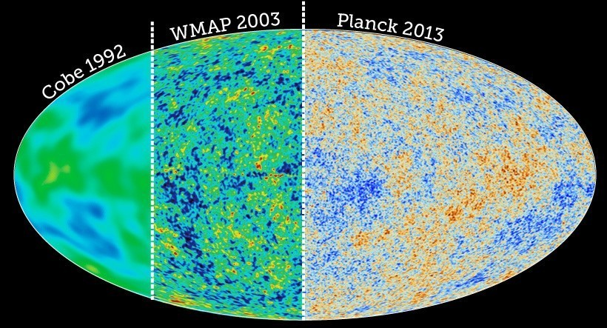
Observational parameters
Last 20 years → observational results can be used to validate teoretical models
Inflation - explains fluctuations in the early universe
Independently S.W. Hawking, A. Starobinsky i A. Guth
Beginning and End of the Universe, http://www.as.utexas.edu/~gebhardt/u303f16/cos3.html
W.H. Kinney, Cosmology, inflation, and the physics of nothing, (2003)
Notes:
Diagrams of virtual particles in a Minkowski space, near the horizon of a black hole, and in an inflationary space. Like the radiation created by one of the virtual pair being lost behind the horizon, virtual particles in inflation are swept out of each others’ horizon before they can recombine.
In a normal Minkowski space, vacuum fluctuations are interpreted as pairs of virtual particles appearing and then immediately annihilating as a consequence of the Heisenberg uncertainty principle. One qualitative explanation of Hawking radiation at the event horizon of a black hole is that one of the two virtual particles is trapped by the horizon, leaving the other to escape as apparently thermal radiation. A similar process holds in an inflationary spacetime: in inflation, the expansion is so rapid that pairs of virtual particles get “swept up” in the spacetime and are inflated to causally disconnected regions. In essence, they can no longer find each other to annihilate, and the quantum fluctuations become classical modes of the field.

Slide 10



Observational parameters
Hubble expansion rate
at an arbitrarily
chosen time
Hubble hierarchy (slow-roll) parameters
$$ε_{i+1}≡\frac{dln|ε_{i}|}{dN}, i≥0, ε_{0}≡\frac{H_{∗}}{H}$$
Duration of inflation $ε_{i}≪1$
$$N=ln\frac{a_{end}}{a}=\int_{t}^{t_{end}}{Hdt}$$
The end of inflation $ε_{i}(φ_{end})≈1$
Three independent observational parameters: amplitude of scalar perturbation $A_{s}$, tensor-to-scalar ratio $r$ and scalar spectral index $n_{s}$
$$\begin{matrix}r=16ε_{1} \\ n_{s}=1−2ε_{1}−ε_{2}\end{matrix}$$
$$ε_{1}=−\frac{\dot{H}}{H^{2}},$$
$ε_{2}=2ε_{1}+\frac{\ddot{H}}{H\dot{H}}$.
At the lowest order in parameters $ε_{1}$ and $ε_{2}$

Slide 11
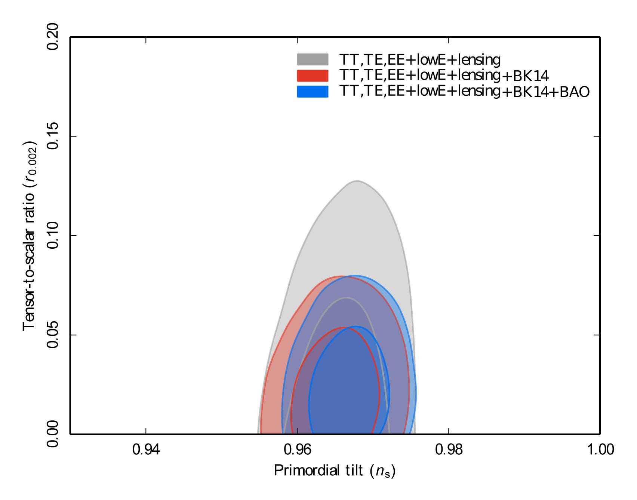
Observational parameters
Satellite Planck
(May 2009 – October 2013)
Planck Collaboration
  Latest results are published
  in year 2018.
Planck 2018 results. X Constraints on inflation, arXiv:1807.06211 [astro-ph.CO]

Slide 12
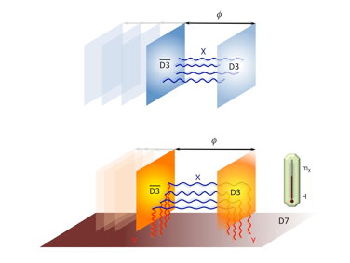
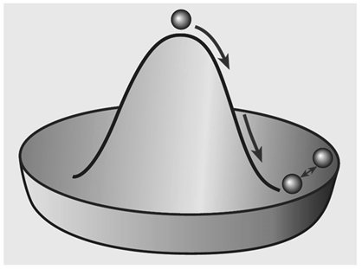
Tachyons
Traditionally, the word tachyon was used to describe a hypothetical particle which propagates faster than light.
In modern physics this meaning has been changed:
  The effective tachyonic field theory was proposed by A. Sen
  String theory: states of quantum fields with imaginary mass (i.e. negative mass squared).
  However it was realized that the imaginary mass creates an instability and tachyons spontaneously decay through the process known as tachyon condensation.
  Quanta are not tachyon any more, but rather an ”ordinary” particle with a positive mass.
Notes:
Sen, Gibons (2002)
Kofman, Linde
Steer, Vernizzi (2004)

Slide 13

Tachyon inflation
Properties of a tachyon potential
$$V(0)=\text{const}, V^{′}(θ>0)<0, V(|θ|→∞)→0.$$
The corresponding Lagrangian and the Hamiltionian are
$$p≡ℒ(X,θ)=−V(θ)\sqrt{1−2X}=−V(θ)\sqrt{1−{\dot{θ}}^{2}}$$
$$ρ≡ℋ=\frac{\left.V(θ\right)}{\sqrt{1−{\dot{θ}}^{2}}}$$
The Friedmann equation
$$H^{2}≡{\left(\frac{\dot{a}}{a}\right)}^{2}=\frac{8πG}{3}ℋ=\frac{8πG}{3}\frac{\left.V(θ\right)}{\sqrt{1−{\dot{θ}}^{2}}}$$
M. Milosevic, D.D. Dimitrijevic, G.S. Djordjevic, M.D. Stojanovic, Dynamics of tachyon fields and inflation - comparison of analytical and numerical results with observation, Serbian Astronomical Journal. 192 (2016)
D. Steer, F. Vernizzi, Tachyon inflation: Tests and comparison with single scalar field inflation, Phys. Rev. D. 70 (2004) 43527.

Slide 14

Dynamics of inflation
The energy-momentum conservation equation
$\left.\dot{ℋ}=−3H(ℒ+ℋ\right)$.
The Hamilton’s equations
$$\begin{matrix}\dot{θ}=\frac{∂ℋ}{∂π_{θ}}, & \end{matrix}$$
$${\dot{π}}_{θ}+3Hπ_{θ}=−\frac{∂ℋ}{∂θ},$$
$π_{θ}=\frac{∂ℒ}{∂\dot{θ}}$ is the conjugate momentum and the Hamiltonian $ℋ=\dot{θ}π_{θ}−ℒ$

Slide 15

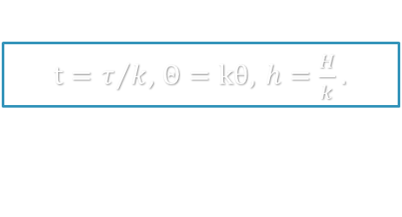
Tachyon inflation
$t=τ/k$, $Θ=kθ, h=\frac{H}{k}.$
Dimensionless equations
$$\frac{\ddot{θ}}{1−{\dot{θ}}^{2}}+3h\dot{θ}+\frac{1}{V}\frac{∂V}{∂θ}=0$$
$$h^{2}=\frac{κ^{2}}{3}ρ=\frac{κ^{2}}{3}\frac{V}{\sqrt{1−{\dot{θ}}^{2}}}$$
Dimensionless constant $κ^{2}=8πGλk^{2}$, a choice of a constant $σ$ (brane tension) was motivated by string theory
$$σ=λk^{2}=\frac{M_{s}^{4}}{g_{s}{\left(2π\right)}^{3}}.$$

Slide 16

ConditionS for tachyon inflation
General condition for inflation
$$\frac{\ddot{a}}{a}≡{\tilde{H}}^{2}+\dot{\tilde{H}}=\frac{κ^{2}}{3}\frac{\tilde{V}\left.(Θ\right)}{\sqrt{1−{\dot{Θ}}^{2}}}\left(1−\frac{3}{2}{\dot{Θ}}^{2}\right)>0.$$
Slow-roll conditions
$$\ddot{Θ}≪3\tilde{H}\dot{Θ}, {\dot{Θ}}^{2}≪1.$$
Notes:
- eliminiše problem beskonačnosti i kompleksnih rešenja

Slide 17
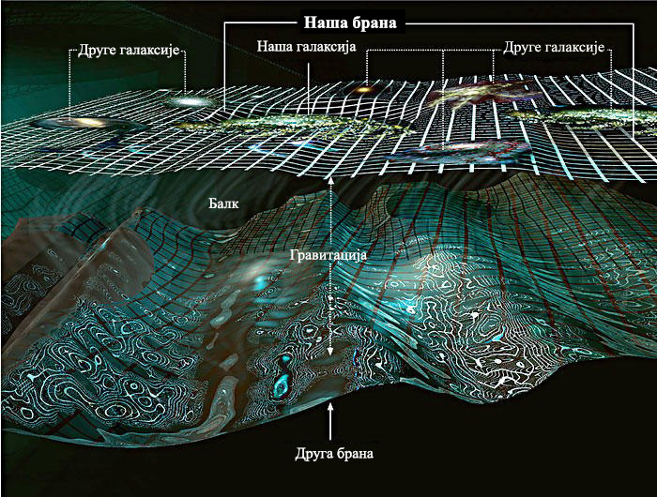
Braneworld cosmology
Braneworld universe is based on the scenario in which matter is confined on a brane moving in the higher dimensional bulk with only gravity allowed to propagate in the bulk.
One of the simplest models - Randall-Sundrum (RS)
Two branes with opposite tensions are placed at some distance in 5 dimensional space
N. Bilic, D.D. Dimitrijevic, G.S. Djordjevic, M. Milosevic, Tachyon inflation in an AdS braneworld with back-reaction, International Journal of Modern Physics A. 32 (2017) 1750039.
N. Bilic, G.B. Tupper, AdS braneworld with backreaction, Cent. Eur. J. Phys. 12 (2014) 147–159.

Slide 18

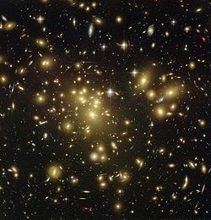
THE RSII Model
  RSII model – observer is placed on the positive tension brane, 2nd brane is pushed to infinity
N. Bilic, “Braneworld Universe”, 2nd CERN – SEENET-MTP PhD School, Timisoara, December 2016

Slide 19

THE RSII model
The space is described by Anti de Siter metric
$$ds_{\left(5\right)}^{2}=e^{−2ky}g^{μν}dx^{μ}dx^{ν}−dy^{2},$$
where $k=\frac{1}{𝓁}$ is the inverse of AdS₅ curvature radius
The Lagrangian and the Hamiltonian
$$ℒ≡p=\frac{1}{2}g^{μν}φ_{,μ}φ_{,ν}−\frac{λψ^{2}}{θ^{4}}\sqrt{1−\frac{g^{μν}θ_{,μ}θ_{,ν}}{ψ^{3}}},$$
$$ℋ≡ρ=\frac{1}{2}g^{μν}φ_{,μ}φ_{,ν}+\frac{λψ^{2}}{θ^{4}}{\left(1−\frac{g^{μν}θ_{,μ}θ_{,ν}}{ψ^{3}}\right)}^{−1/2},$$
where $ψ=1+θ^{2}η$ and $η=\sinh^{2}\left(\sqrt{4/3 πG}φ\right)$.
One additional 3-brane moving in the AdS₅ bulk behaves effectively as a tachyon with the potential $V\left(θ\right)∝θ^{−4}$

Slide 20


THE RSII model
The Hamilton’s equations
The conjugate momenta: $π_{φ}^{μ}≡\frac{∂ℒ}{∂φ_{,μ}}, π_{θ}^{μ}≡\frac{∂ℒ}{∂θ_{,μ}}.$
The modified Friedman equations
$H≡\frac{\dot{a}}{a}=\sqrt{\frac{8πG}{3}ℋ\left(1+\frac{2πG}{3k^{2}}ℋ\right)}$,
$$\dot{H}=−4πG(ℋ+ℒ)\left(1+\frac{4πG}{3k^{2}}ℋ\right)$$
$$\dot{φ}=\frac{∂ℋ}{∂π_{φ}},$$ | $${\dot{π}}_{φ}+3Hπ_{φ}=−\frac{∂ℋ}{∂φ},$$
$$\dot{θ}=\frac{∂ℋ}{∂π_{θ}},$$ | $${\dot{π}}_{θ}+3Hπ_{θ}=−\frac{∂ℋ}{∂θ}.$$
Notes:
Combining with a continuity equation $\dot{ℋ}+3H(ℋ+ℒ)=0$ it leads to the second Friedman equation

Slide 21

Initial conditions for rsII model
Initial conditions – from a model without radion field
“Pure” tachyon potential $V(Θ)=\frac{λ}{Θ^{4}}$
Hamiltonian $ℋ=\frac{λ}{Θ^{4}}\sqrt{1+Π_{Θ}^{2}{Θ^{8}}/{λ^{2}}}.$
Dimensionless equations

Slide 22
Extended RSII Model
The RSII model is extended to include matter in the bulk.
The presence of matter modifies the warp factor which results in two effects:
  a modification of the RSII cosmology
  a modification of the tachyon potential.
N. Bilić, S. Domazet, G.S. Djordjevic, Particle Creation and Reheating in a Braneworld Inflationary Scenario, Physical Review D, 96 (2017), 083518
N. Bilić, S. Domazet, and G. S. Djordjevic, Tachyon with an inverse power-law potential in a braneworld cosmology, Class. Quantum Gravity 34, 165006 (2017).

Slide 23


Extended RSII Model
Similar setup as the RSII model, however a more general tachyon potential:
$$V\left(Θ\right)=\frac{σ}{χ^{4} (Θ)}$$
The modified Friedmann equations
$$h=\sqrt{\frac{κ^{2}}{3}ρ\left(χ_{,φ}+\frac{κ^{2}}{12}ρ\right)}$$
$$\dot{h}=−\frac{κ^{2}}{2}(ρ+p)\left(χ_{,θ}+\frac{κ^{2}}{6}ρ\right)+\frac{κ^{2}ρ}{6h}χ_{,θθ}\dot{θ}.$$
$$χ_{,θ}=\frac{∂χ}{∂θ}$$

Slide 24
numerical Computation
Calculation:
  Programming language: C/C++
  GNU Scientific Library
Visualization and data analysis
  Programming language: R

Slide 25


Observational parameters
Scalar spectral index $n_{s}$ and tensor-to-scalar ratio $r$ for all models up to the second order
$$\begin{matrix}r=16ε_{1}\left(1+Cε_{2}−2αε_{1}\right), \\ n_{s}=1−2ε_{1}−ε_{2}−\left[2ε_{1}^{2}+\left(2C+3−2α\right)ε_{1}ε_{2}+Cε_{2}ε_{3}\right].\end{matrix}$$
$C≃−0,72$,
$α=\frac{1}{6}$ for tachyon inflation in standard cosmology,
$α=\frac{1}{12}$ for Randall-Sundrum cosmology
Planck results ($Planck \text{TT}\text{,}\text{TE}\text{,}\text{EE}\text{+}\text{lowW}\text{+}\text{lensing}\text{+}\text{BK}\text{14}$)
$$\begin{matrix}n_{s}=0.9665±0.0038\text{ (68\% }\text{CL}\text{),} \\ {\text{r}}_{0.002}<0.064\text{ (95\% }\text{CL}\text{).}\end{matrix}$$

Slide 26

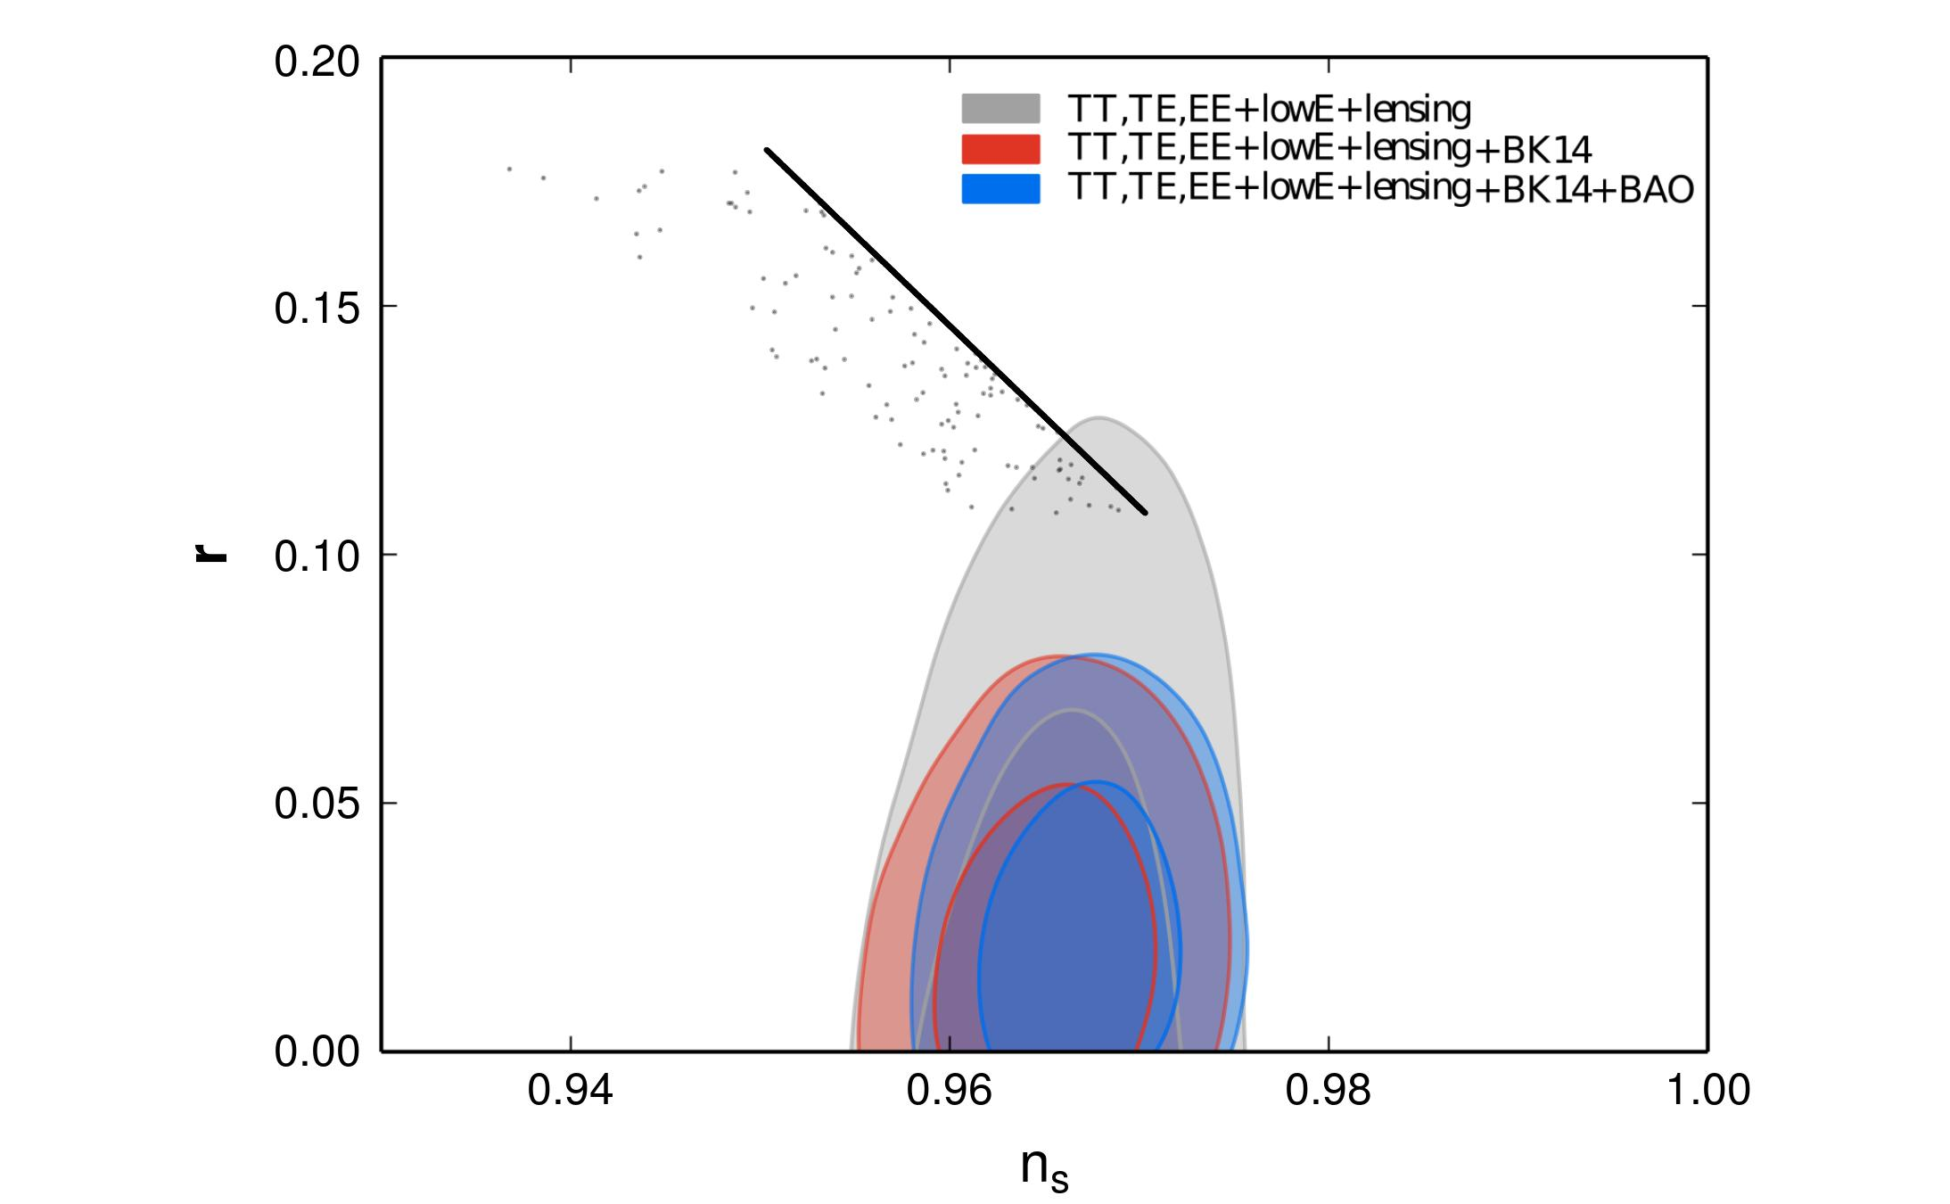
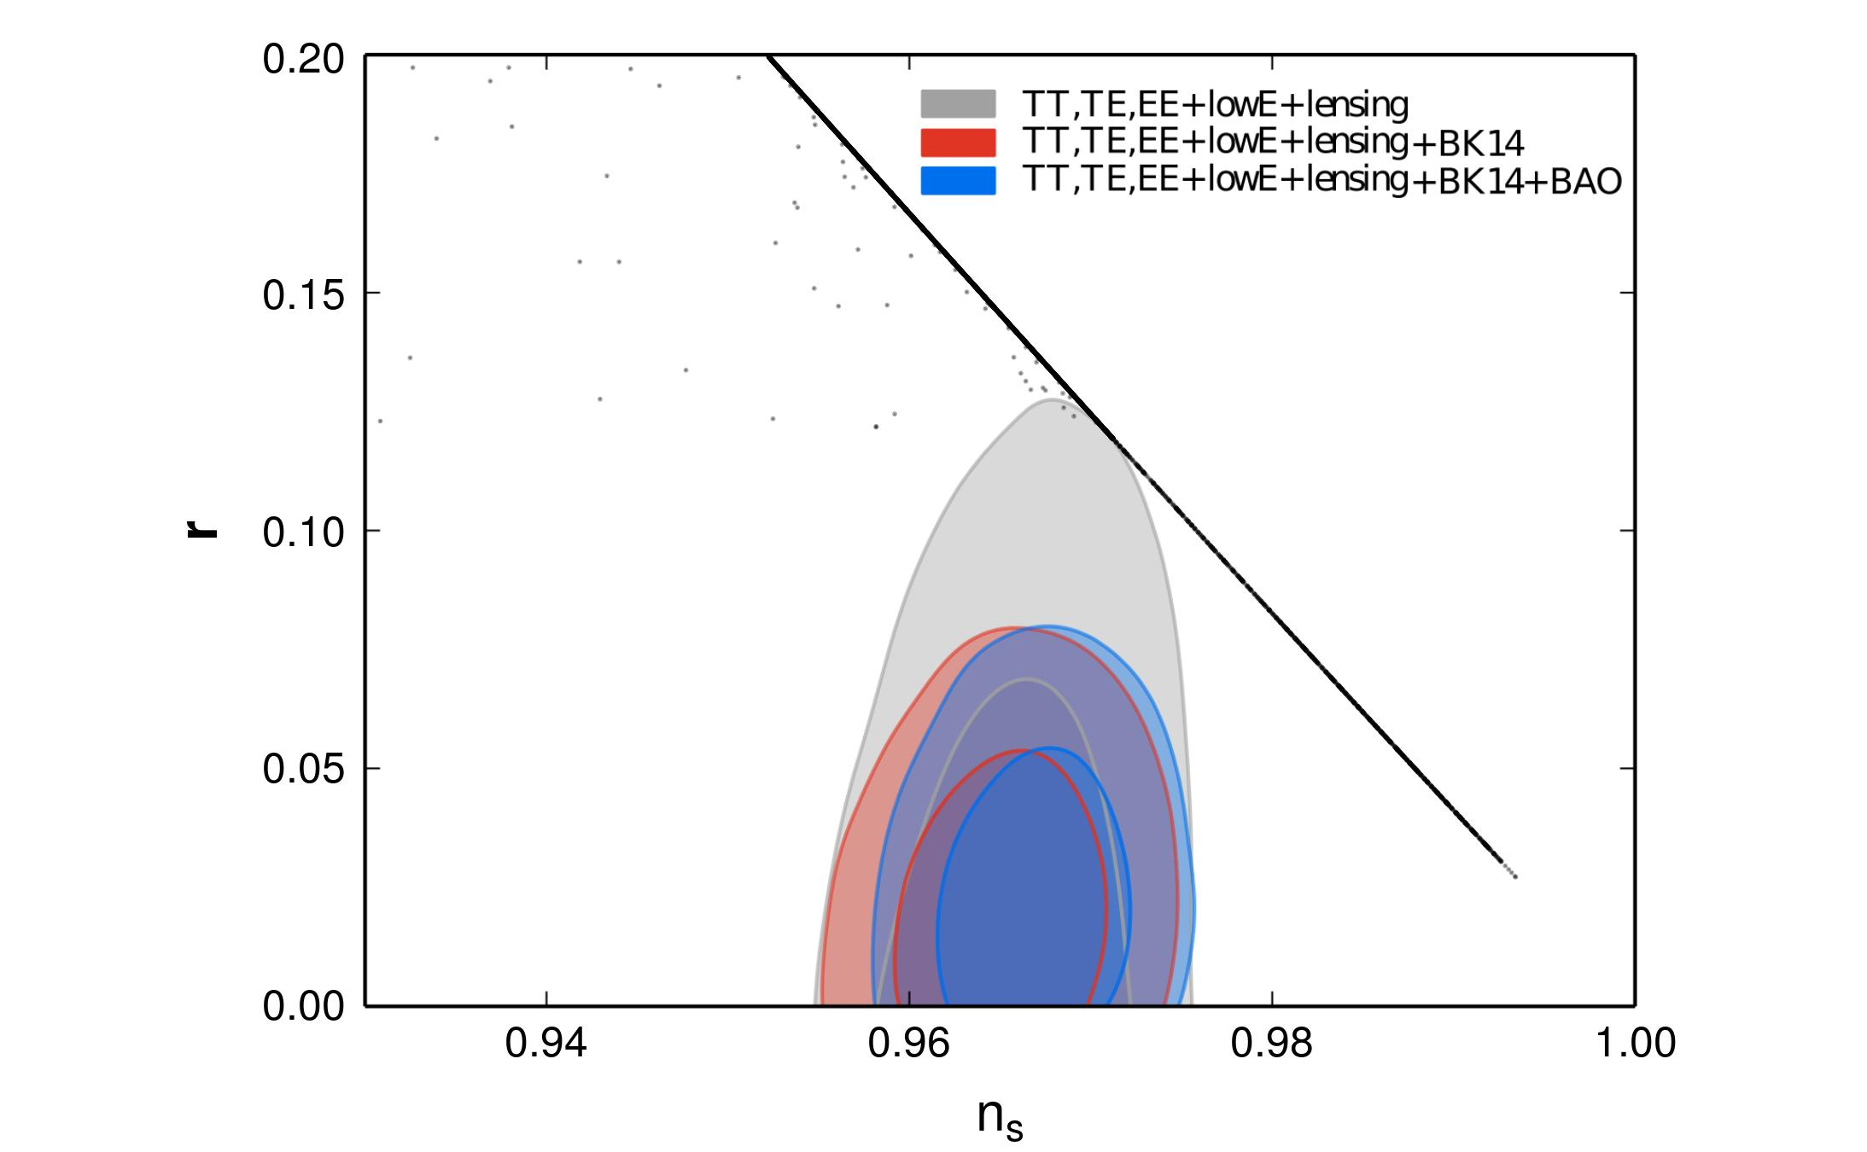



The Tachyion potential $V\left(θ\right)=e^{−θ}$
$$h=\sqrt{\frac{κ^{2}}{3}ρ}$$
$$h=\sqrt{\frac{κ^{2}}{3}ρ\left(1+\frac{κ^{2}}{12}ρ\right)}$$
45 ≤ N < 75, 1 ≤ κ < 10
Notes:
Skloniti bar

Slide 27
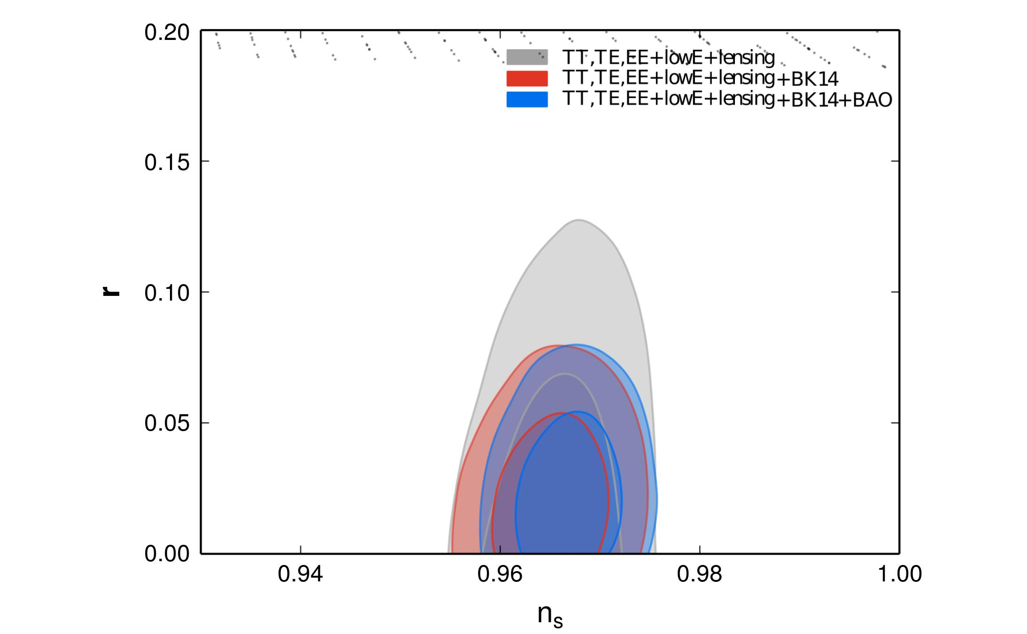
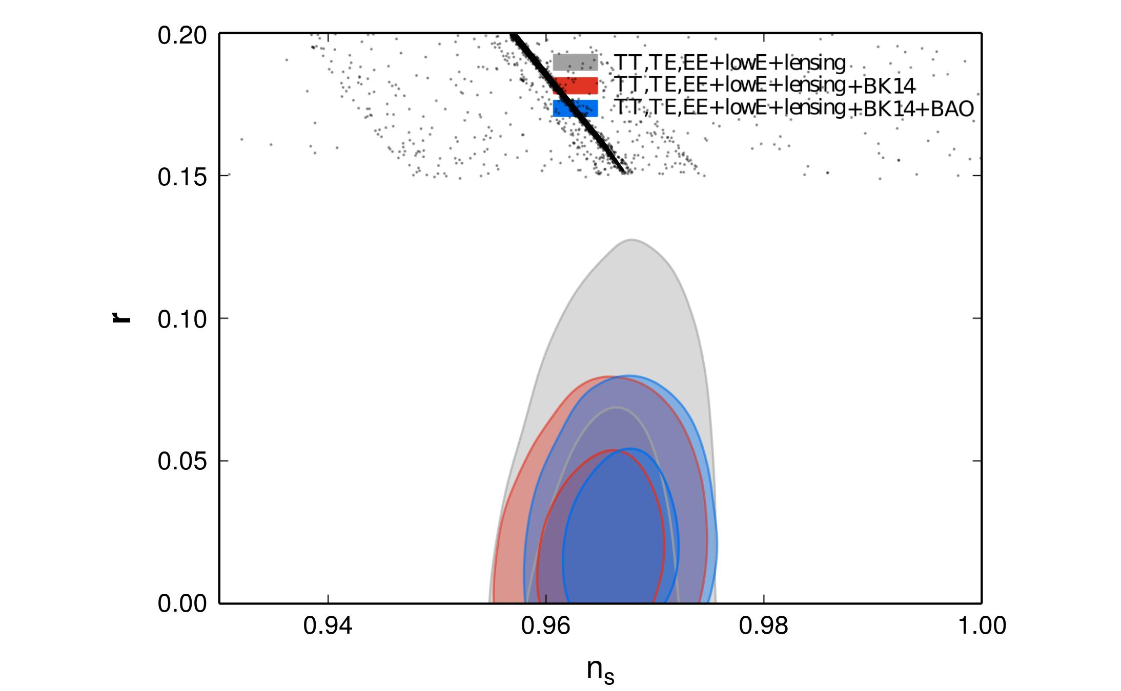

The Tachyion potential $V\left(θ\right)=\frac{1}{θ^{4}}$
$$h=\sqrt{\frac{κ^{2}}{3}ρ}$$
$$h=\sqrt{\frac{κ^{2}}{3}ρ\left(1+\frac{κ^{2}}{12}ρ\right)}$$
45 ≤ N < 90, 1 ≤ κ < 10
45 ≤ N < 75, 1 ≤ κ < 10

Slide 28
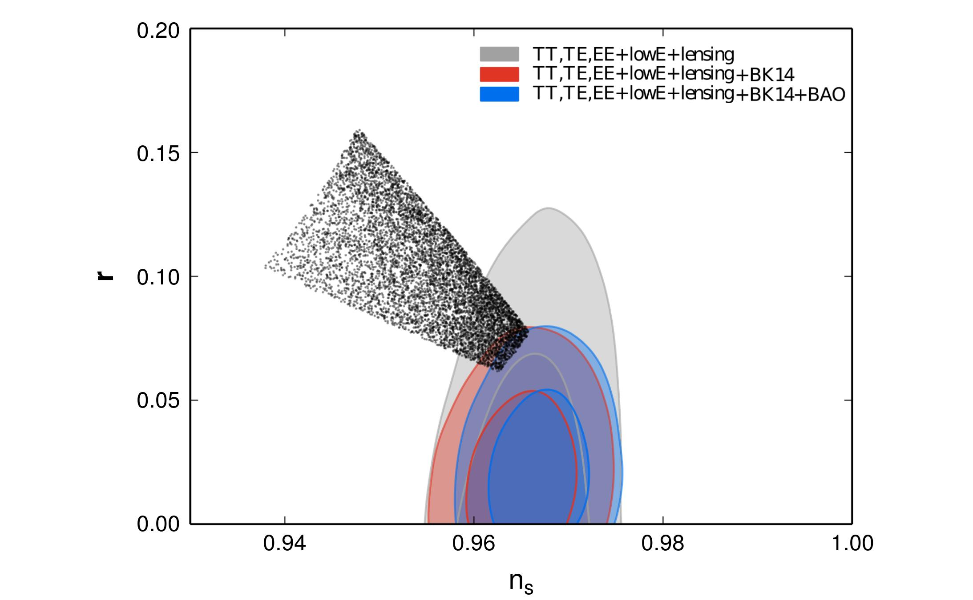
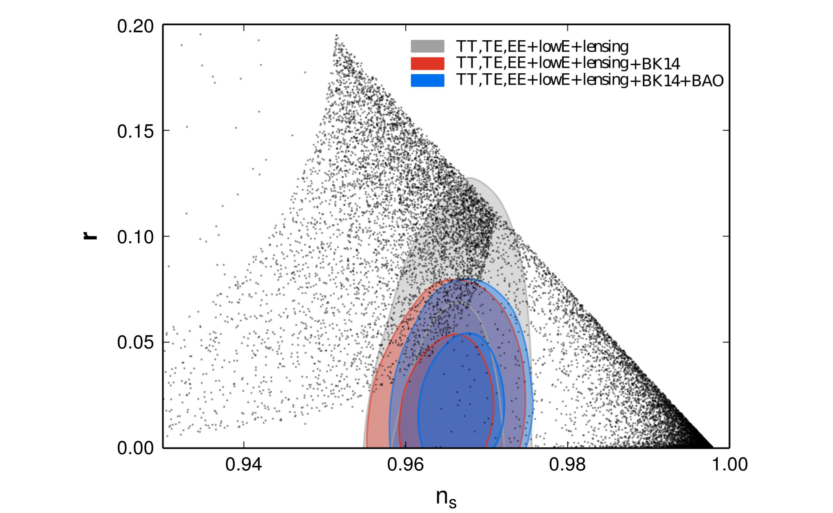

The Tachyion potential $V\left(θ\right)=\frac{1}{cosh θ}$
$$h=\sqrt{\frac{κ^{2}}{3}ρ}$$
$$h=\sqrt{\frac{κ^{2}}{3}ρ\left(1+\frac{κ^{2}}{12}ρ\right)}$$
45 ≤ N < 75, 1 ≤ κ < 10

Slide 29
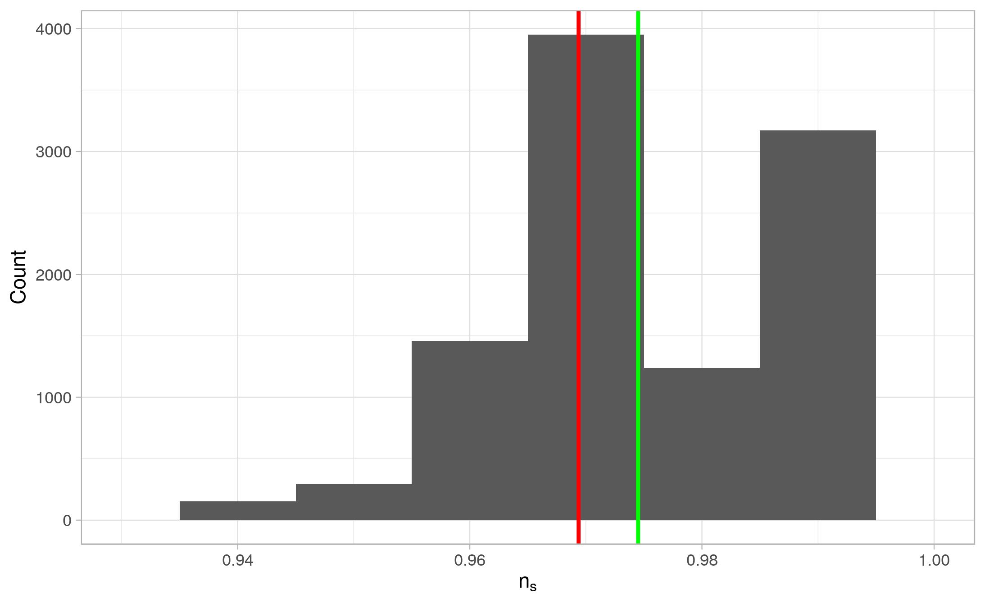
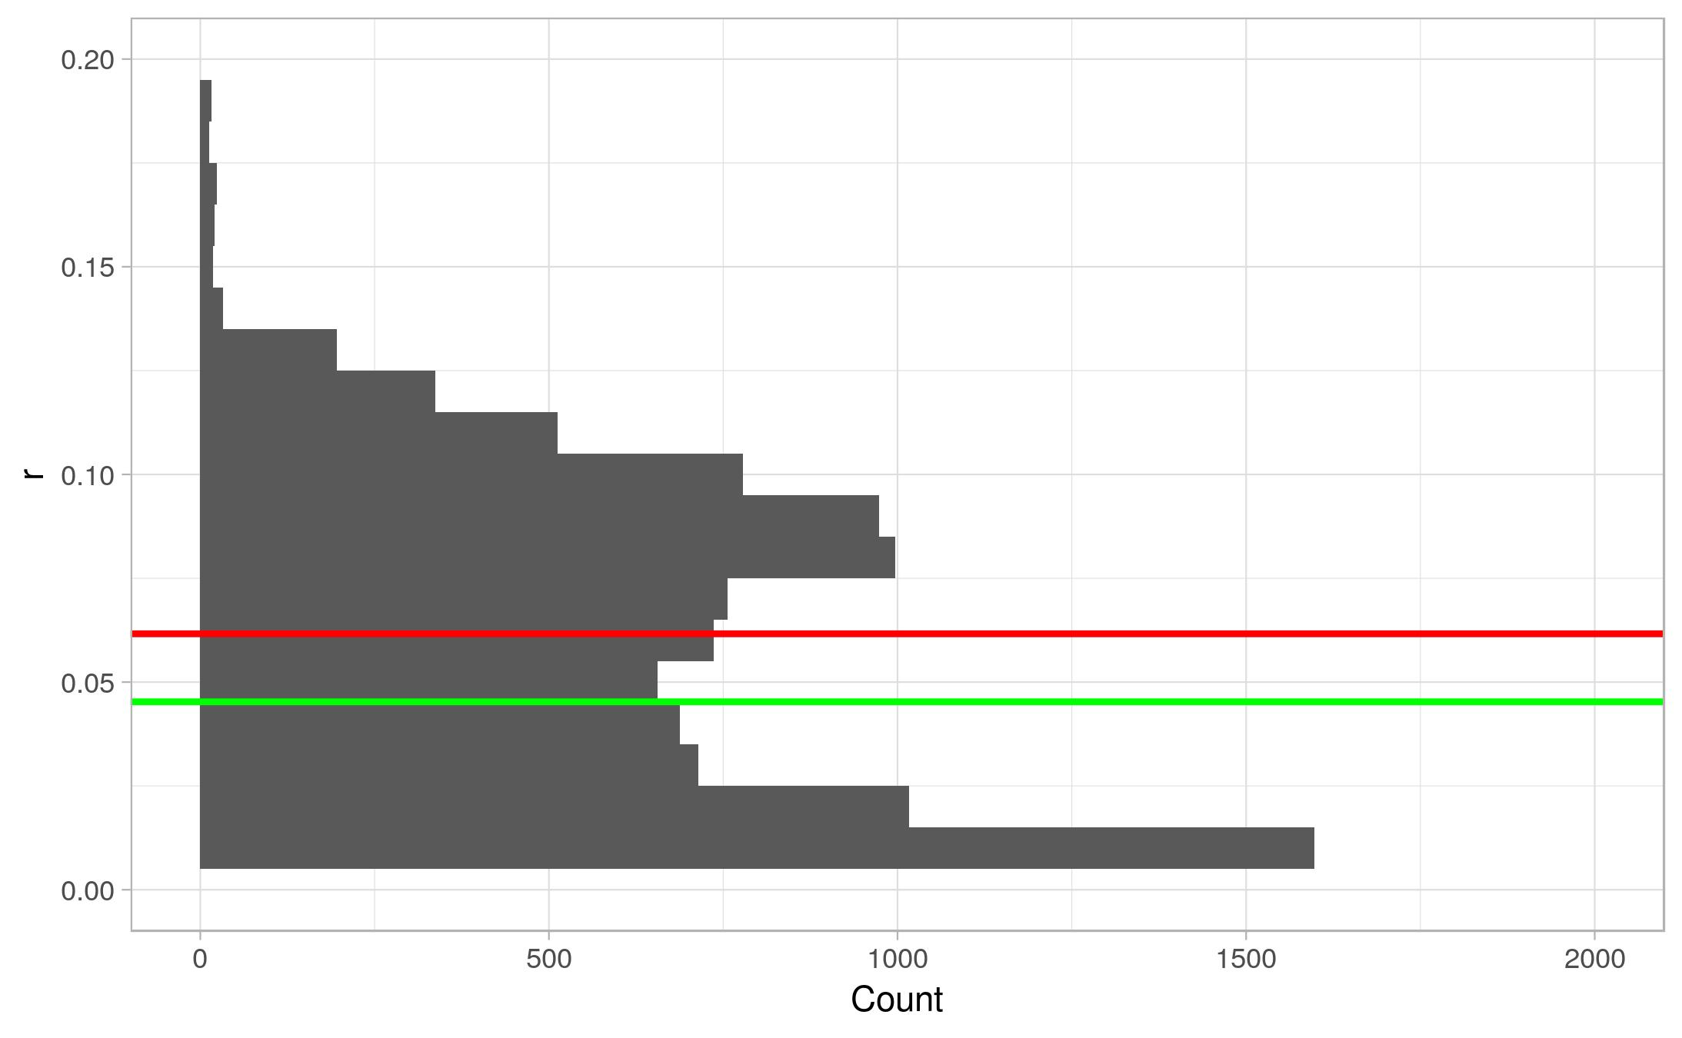




The best results: $V\left(θ\right)=\frac{1}{cosh θ}$
$$h=\sqrt{\frac{κ^{2}}{3}ρ\left(1+\frac{κ^{2}}{12}ρ\right)}$$
45 ≤ N ≤ 75, 1≤ κ ≤ 10
Mean (red)
$$μ\left(n_{s}\right)=\text{0.9694}$$
$$μ(r)=0.062$$
Median (green)
$${\tilde{n}}_{s}=0.9745$$
$$\tilde{r}=0.045$$

Slide 30



RSII model, $V\left(θ\right)=\frac{1}{θ^{4}}$
$$h=\sqrt{\frac{κ^{2}}{3}ρ\left(1+\frac{κ^{2}}{12}ρ\right)}$$
45 ≤ N ≤ 75, 1 ≤ κ ≤ 10

Slide 31
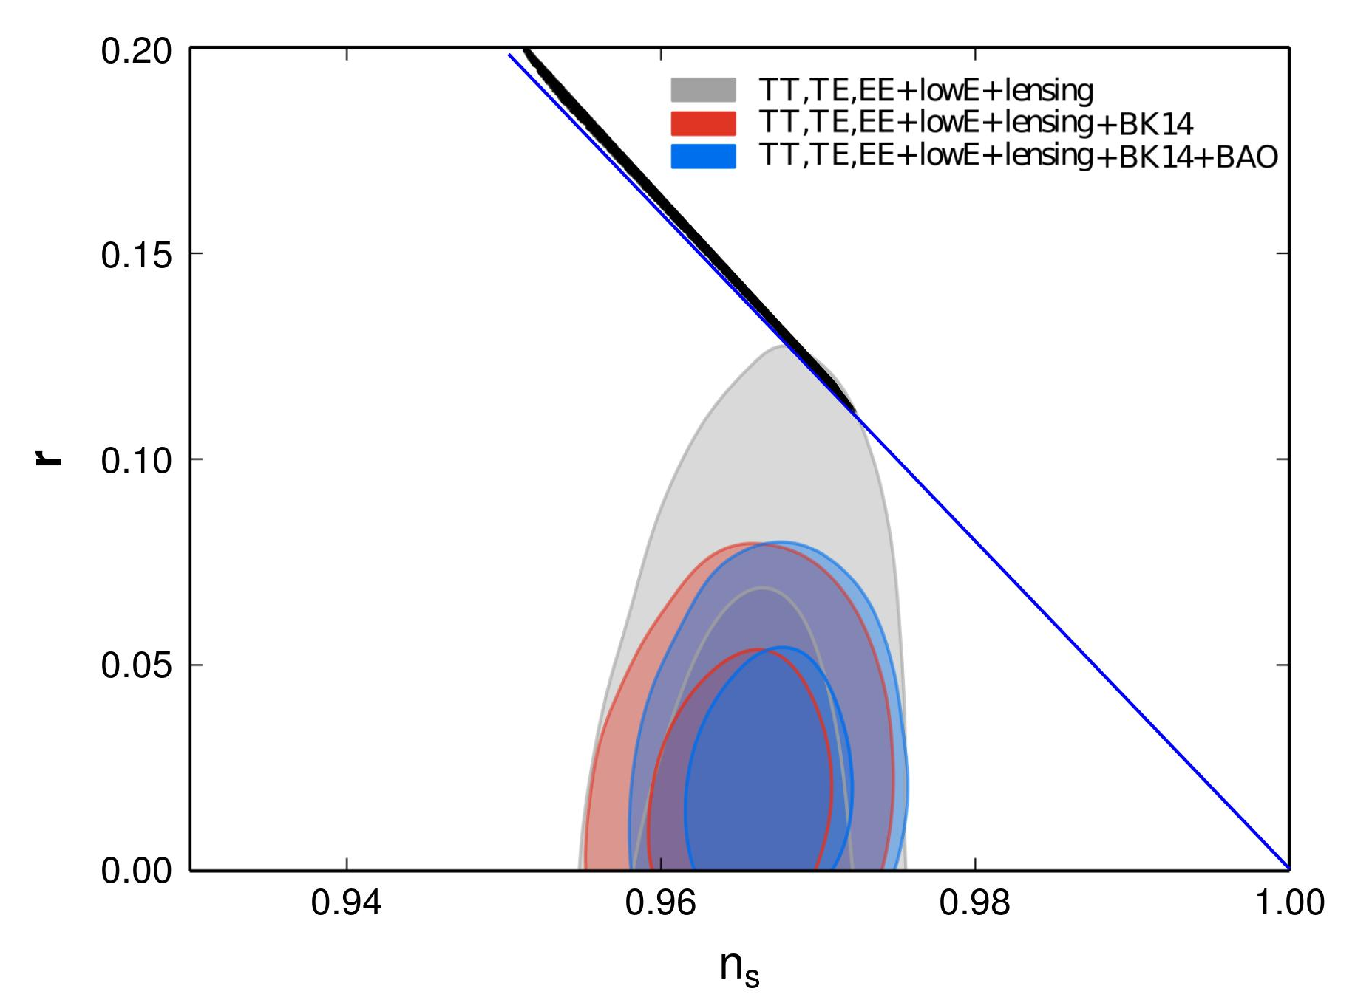


Extended RSII, $V\left(θ\right)=e^{−θ}$
$$h=\sqrt{\frac{κ^{2}}{3}ρ\left(\frac{∂χ}{∂θ}+\frac{κ^{2}}{12}ρ\right)}$$
45 ≤ N < 75, 1 ≤ κ < 10

Slide 32
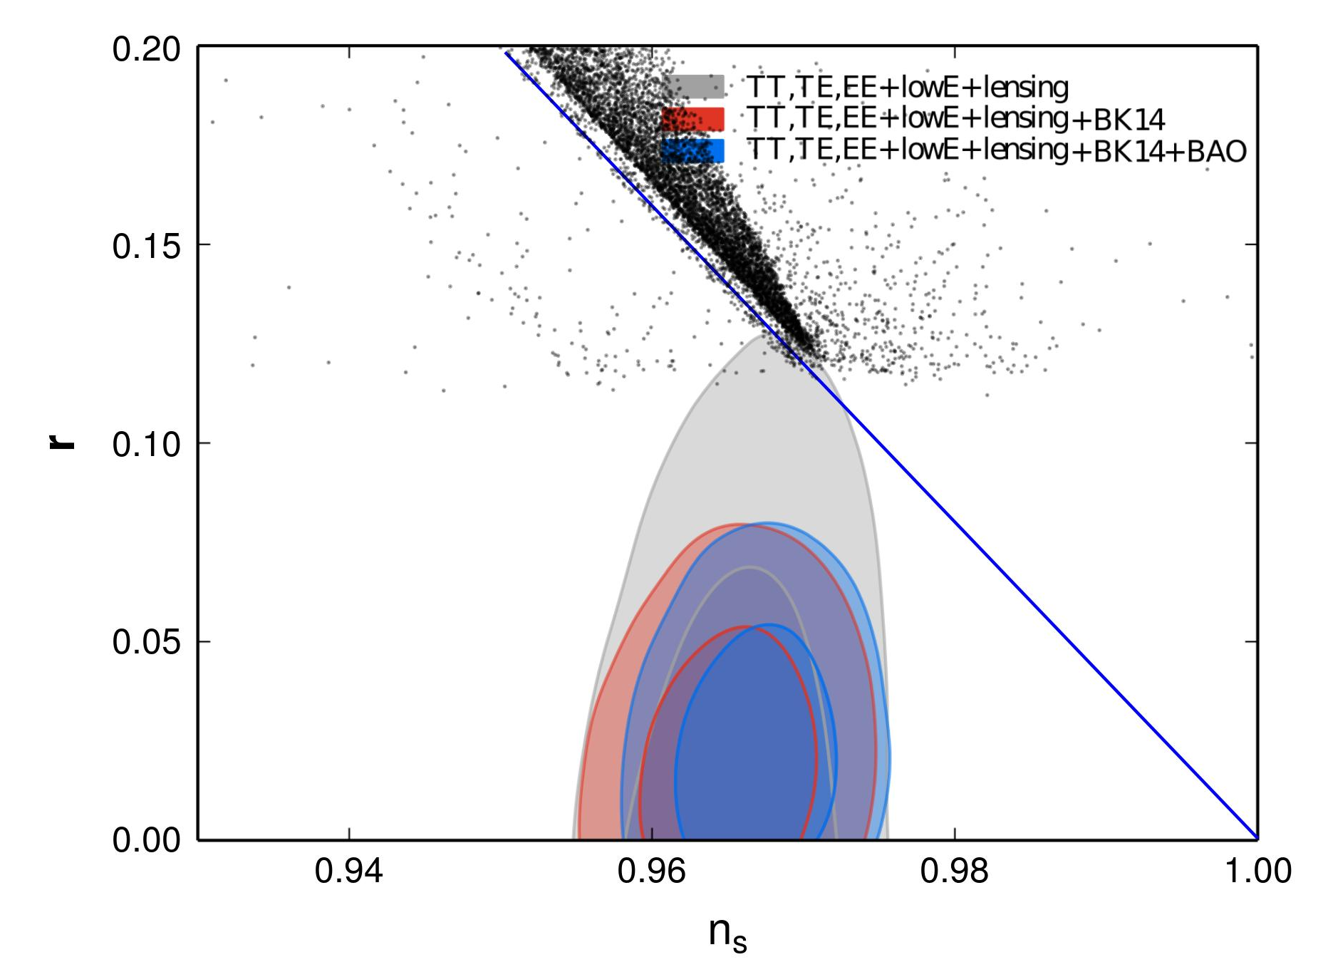


Extended RSII, $V\left(θ\right)=\frac{1}{θ^{4n}}$
$$h=\sqrt{\frac{κ^{2}}{3}ρ\left(\frac{∂χ}{∂θ}+\frac{κ^{2}}{12}ρ\right)}$$
45 ≤ N < 75, 1 ≤ κ < 10,
$$0.5≤n<5$$

Slide 33
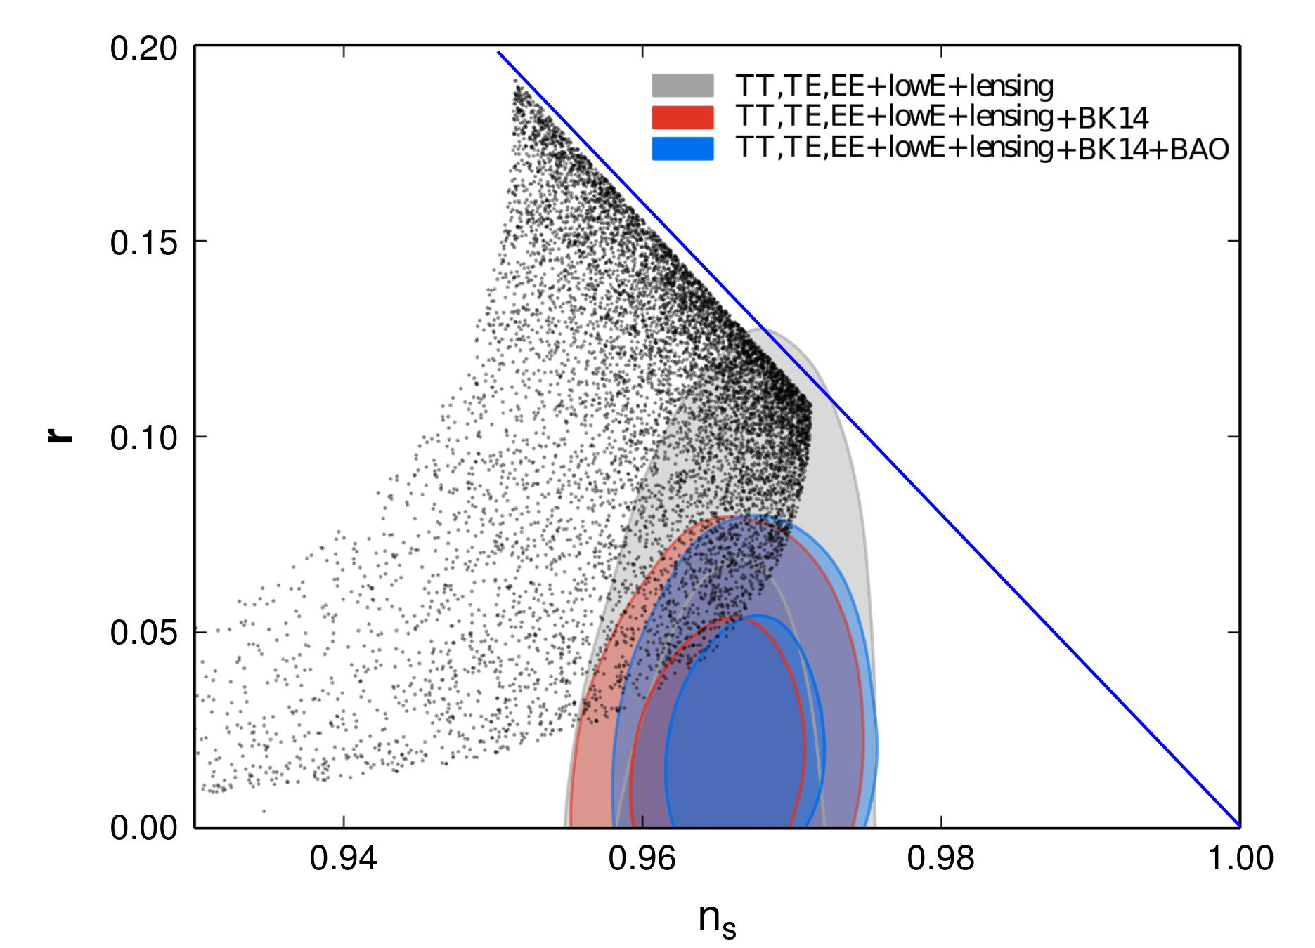
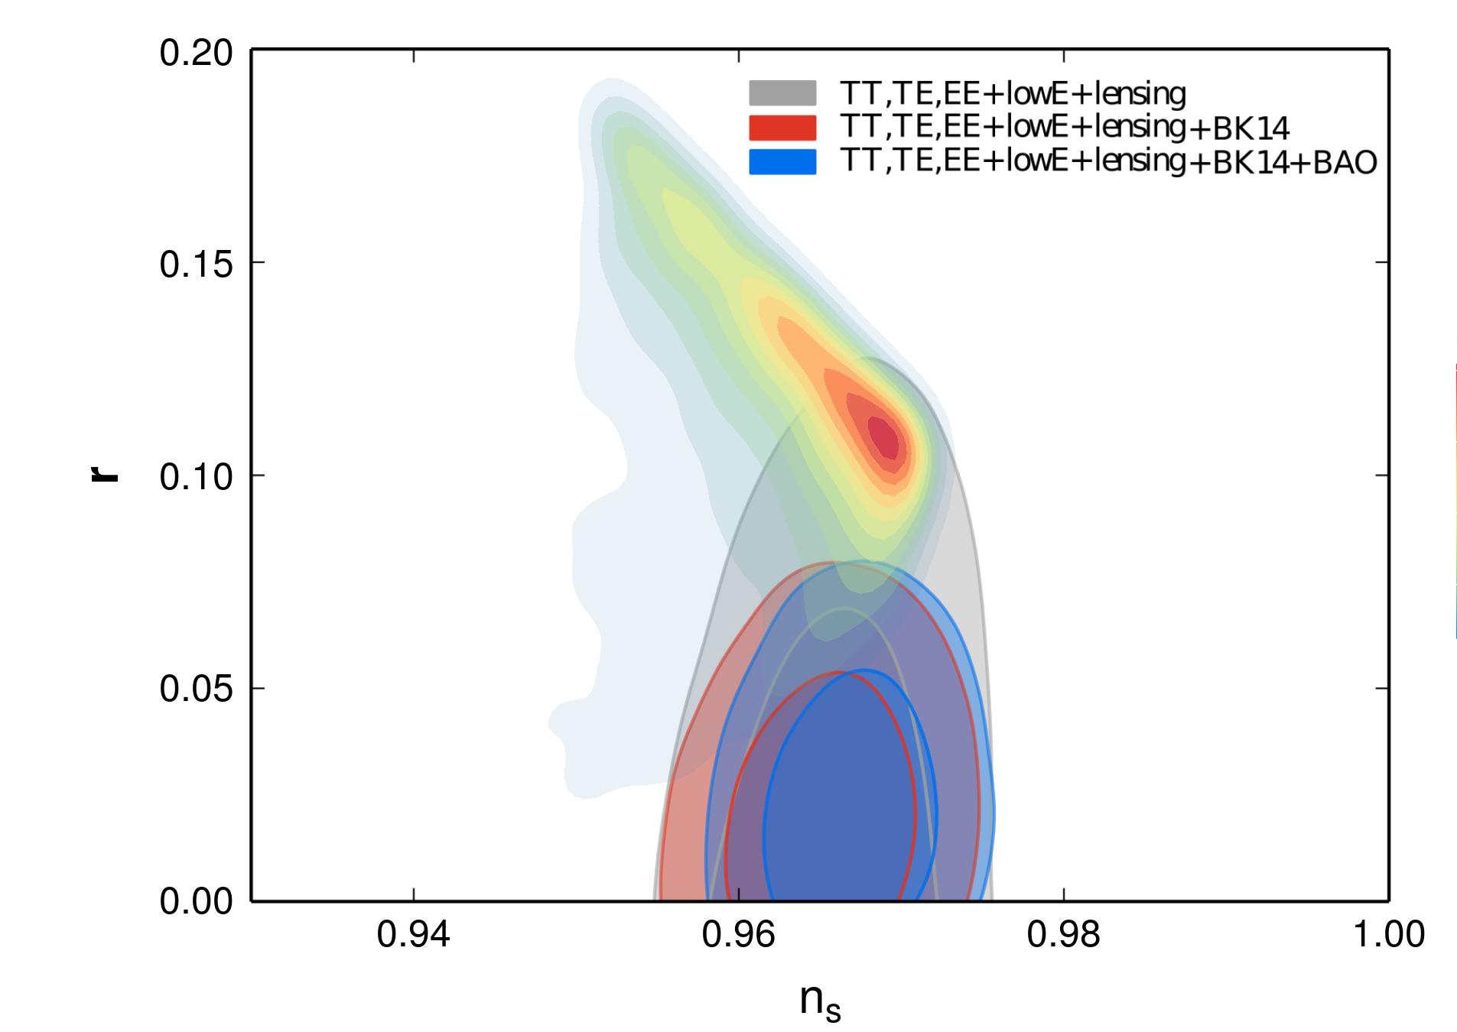


Extended RSII, $V\left(θ\right)=\frac{1}{cosh θ}$
$$h=\sqrt{\frac{κ^{2}}{3}ρ\left(\frac{∂χ}{∂θ}+\frac{κ^{2}}{12}ρ\right)}$$
45 ≤ N < 75, 1 ≤ κ < 10

Slide 34

Conclusions
The simplest tachyon model that originates from the dynamics of a D3-brane in an AdS₅ bulk yields an inverse quartic potential.
The same mechanism leads to a more general tachyon potential if the AdS₅ background metric is modified by the presence of matter in the bulk, e.g. in the form of a minimally coupled scalar field with self-interaction.
The software is written in such a way that its only inputs are the Hamilton’s and Friedmann equations, with relevant parameters.
The program can readily be used for a much wider set of models.
The best fitting result is obtained for $V\left(θ\right)=\frac{1}{\cosh{θ}}$.
Our preliminary results indicate an opportunity for further research based on various potentials in the contest of the RSII model and holographic cosmology.

Slide 35
Thank you for your attention
The financial support of the Serbian Ministry for Education and Science,
Project OI 176021 is acknowledged.
Research partially supported by STSM CANTATA-COST grant and
by the SEENET-MTP Network under the ICTP grant NT-03

Slide 36
Our references
N. Bilić, D.D. Dimitrijević, G.S. Djordjević, M. Milošević, & M. Stojanović, Tachyon inflation in the holographic braneworld, arXiv:1809.07216 [gr-qc]
D.D. Dimitrijevic, N. Bilić, G.S. Djordjevic, M. Milosevic & M. Stojanović, Tachyon Scalar Field in a Braneworld Cosmology, in International Journal of Modern Physics A, (submitted 2018)
M. Milošević, N. Bilić, D.D. Dimitrijević, G.S. Djordjević & M. Stojanović, Numerical Calculation of Hubble Hierarchy Parameters and Observational Parameters of Inflation. in AIP Conference Proceedings of the BPU10 (submitted 2018).
D. D. Dimitrijevic, N. Bilić, G. S. Djordjevic & M. Milosevic, Tachyon scalar field in DBI and RSII cosmological context, in SFIN (submitted 2018).
N. Bilić, S. Domazet & G.S. Djordjevic, Particle Creation and Reheating in a Braneworld Inflationary Scenario, Physical Review D, 96 (2017), 083518
N. Bilić, S. Domazet & G. S. Djordjevic, Tachyon with an inverse power-law potential in a braneworld cosmology, Class. Quantum Gravity 34, 165006 (2017).
N. Bilic, D.D. Dimitrijevic, G.S. Djordjevic & M. Milosevic, Tachyon inflation in an AdS braneworld with back-reaction, International Journal of Modern Physics A. 32 (2017) 1750039.
N. Bilic, D.D. Dimitrijevic, G.S. Djordjevic, M. Milosevic & M. Stojanović, Dynamics of tachyon fields and inflation: Analytical vs numerical solutions, in AIP Conf. Proc. (2016), p. 050002.

Slide 37
The most important references
Planck 2018 results. X Constraints on inflation, arXiv:1807.06211 [astro-ph.CO] (2018)
N. Bilic, G.B. Tupper, AdS braneworld with backreaction, Cent. Eur. J. Phys. 12 (2014) 147–159.
D. Steer, F. Vernizzi, Tachyon inflation: Tests and comparison with single scalar field inflation, Phys. Rev. D. 70 (2004) 43527.
L. Randall, R. Sundrum, Large Mass Hierarchy from a Small Extra Dimension, Physical Review Letters. 83 (1999) 3370–3373.
L. Randall, R. Sundrum, An Alternative to Compactification, Physical Review Letters. 83 (1999) 4690–4693.

Slide 38

Notes:
ostaje

Slide 39
SEENET-MTP – a regional story
15 Years of the Network (2003 – 2018)
Hoping for bridging the gap between Southeastern and Western European scientific community, the participants of the UNESCO sponsored BALKAN WORKSHOP BW2003 "Mathematical, Theoretical and Phenomenological Challenges Beyond the Standard Model: Perspectives of Balkans Collaboration" (Vrnjacka Banja, Serbia, August 29 - September 3 2003) came to a common agreement on the Initiative for the SEENET-MTP NETWORK
The Network was a natural extension of the WIGV initiative (Wissenschaftler in globaler Verantwortung) launched by J. Wess in 1999
Structure Development
  23 institutions from 11 countries in the region joined the Network
  13 partner institutions all over the world
  about 400 individual members

Slide 40
Main Objectives and Aims
Provide a regional framework for the institutional capacity-building in Mathematical and Theoretical Physics
Strengthening of close relations and cooperation among faculties of science, research institutions and groups, including individual scientists in South-East Europe
Joint scientific and research activities in the region and fostering interregional collaboration, foremost in a European context, but also with a strong worldwide dimension
Support capacity building in physics, mathematics and other sciences and technology by initiating new approaches to teaching physics and sciences
Promote the exchange of students and encourageing communication between gifted pupils
Promote physics and science in general
Support the establishment of local and regional centres of excellence in physics and mathematics

Slide 41

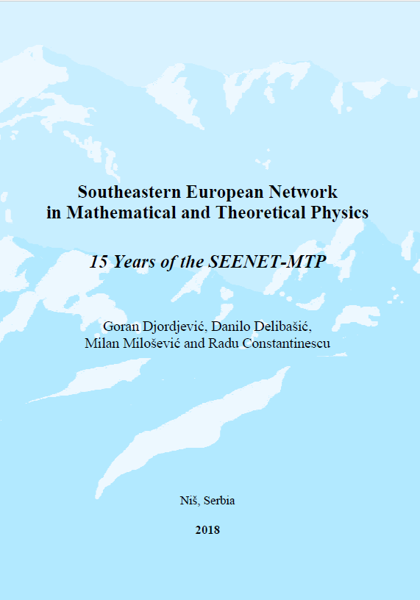
Web portal: www.seenet-mtp.info
booklet

