Slide 1







Cloud Computing, Open Science, Data Analytics
Towards new research paradigms for Bavarian dialectology in using advanced research infrastructures
DARIAH – Competence Centre in a nutshell
Eveline Wandl-Vogt, Amelie Dorn, Roberto Barbera & Davor Davidovic
Methods in Dialectology XVI, Tokyo, Japan
07.-11.08.2017

Slide 2
Cloud Computing, Open Science, Data Analytics
Towards new research paradigms for Bavarian dialectology in using advanced research infrastructures
DARIAH – Competence Centre in a nutshell
Eveline Wandl-Vogt, Amelie Dorn, Roberto Barbera & Davor Davidovic
Methods in Dialectology XVI, Tokyo, Japan
07.-11.08.2017

Slide 3
Outline
Introduction
cultural diversity & European research infrastructures
EGI ENGAGE & the DARIAH Competence Centre (CC)
tools, services & resources
Towards joint understanding & collaboration
workflows & processes
4. Outlook
organisational design, experimental spaces & future infrastructures

Slide 4
Introduction
Cultural and language diversity & biodiversity
UNESCO – Declaration of Cultural Diversity 2001
linguistic, cultural & biological diversity: manifestations of
diversity of life
local and indigenenous communities
→ complex classification systems reflect understanding
of natural environment
→ traditional knowledge maintained in language

Slide 5
Introduction
Policies, strategies & infrastructures
UNESCO
OPEN INNOVATION
OPEN SCIENCE
cultural diversity
curiosity driven collaboration
EGI ENGAGE & DARIAH competence centre

Slide 6
Introduction
Exploitation of advanced research infrastructures to discover cultural diversity
→ DARIAH CC & EGI ENGAGE
(Engaging the research communities with open science commons
→ example
non-standard language resource:
collection of Bavarian dialects in Austria (DBÖ)

Slide 7


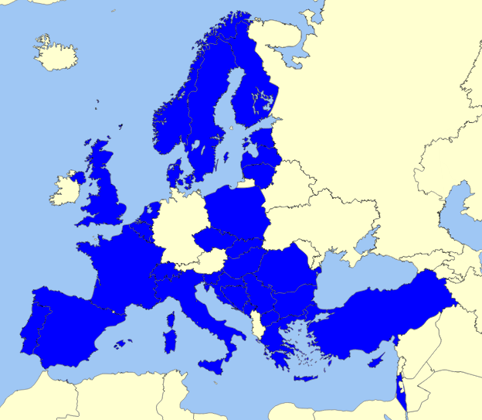
EGI – European Grid Infrastructure
Federated e-Infrastructure →
advanced computing services for research and innovation
32 European countries (National grid initiative)
> 300 data centres & cloud providers
compute power, storage, applications, clouds etc.
EGI-Engage Project
accelerate implementation of Open Science Commons → expanding capabilities of a European backbone of federated services
https://www.egi.eu/

Slide 8

DARIAH – Digital Research Infrastructure for Arts and Humanities
in ~ 17 countries: connecting scholars & research facilities
supporting digital research → digital tools, sharing data and know-how
DARIAH Science Gateway
EGI-service within the EGI-Engage project
target group: Digital Humanities community
http://www.dariah.eu/

Slide 9
DARIAH Competence Centre (CC) I
1 of 8 competence centres established during EU H2020 project EGI-Engage
contact point
between EGI & DARIAH communities → advise on infrastructural needs
customised e-Infrastructure services
for Arts & Humanities → access to EGI FedCloud resources
https://wiki.egi.eu/wiki/Competence_centre_DARIAH

Slide 10
DARIAH Competence Centre (CC) I
demonstrator applications for the Arts & Humanities
show capabilities/possibilities with the use of EGI
raise awareness
within scientific Arts & Humanities community on benefits of using e-Infrastructure technologies
https://wiki.egi.eu/wiki/Competence_centre_DARIAH

Slide 11
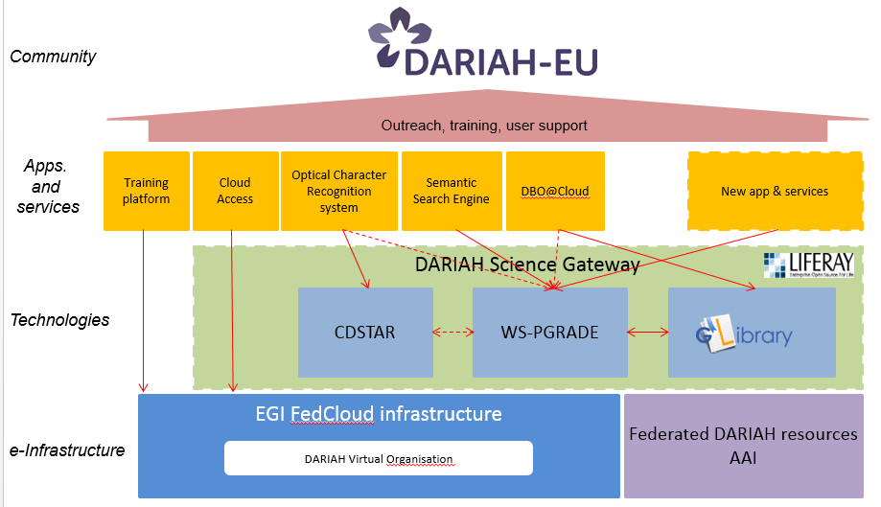
DARIAH Competence Centre (CC) II
Architecture

Slide 12
DARIAH Science Gateway
Applications (open access)
Semantic Search Engine
Simple Semantic Search Engine (SSE)
Parallel Semantic Search Engine (PSSE)
DBO@Cloud
Services (authentication required)
Cloud Access
Workflow Development
File transfer

Slide 13
(Simple) Semantic Search Engine I
Division of Catania of the National Institute of Nuclear Physics (INFN)
Semantically enriches the metadata of the resources included in the Knowledge Base
Queries in more than 110 languages possible
Results connected to Google Scholar and Altmetric if available
Uses LODLive API to explore the Linked Data graph
Extension: Parallel Semantic Search Engine (PSSE)
https://dariah-gateway.lpds.sztaki.hu/web/guest/psse

Slide 14
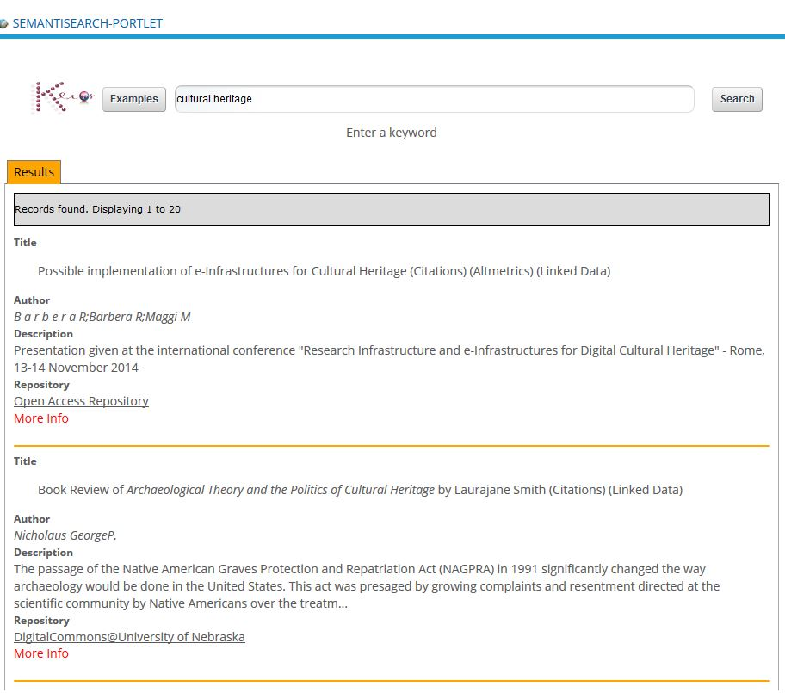


Semantic Search Engine II
Explore repositories
keyword(s) for searching
result list of data entries

Slide 15
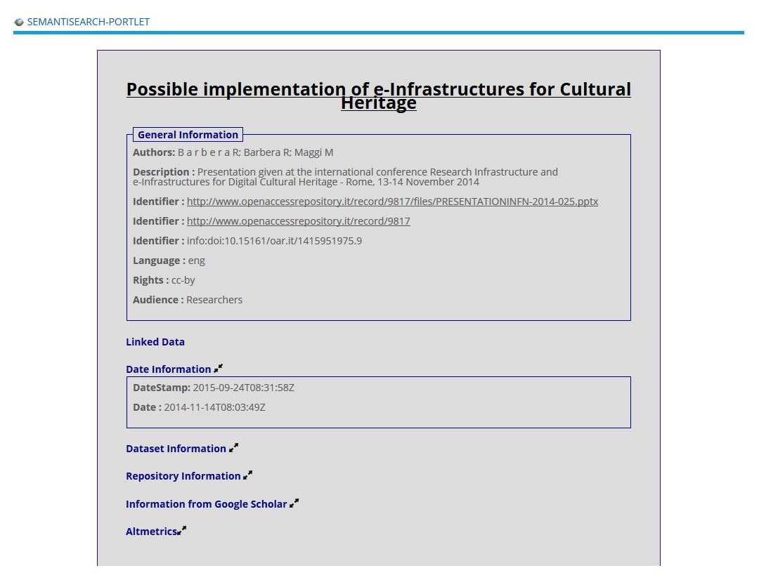
Semantic Search Engine III
Detailed information of the selected record from the result list

Slide 16
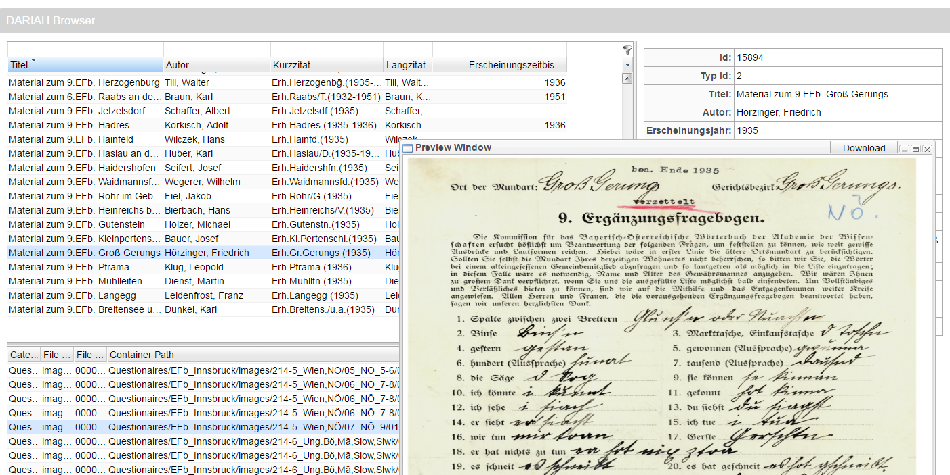
DBO@Cloud
data originally collected for a project at the Austrian Academy of Sciences (Dictionary of the Bavarian Dialects in Austria)
> 20 000 records with metadata can be browsed
https://dariah-gateway.lpds.sztaki.hu/web/guest/dbo-portlet
Filter options and customizing of the display
Images from the original questionnaires available

Slide 17
Workflows & Processes
Towards joint understanding & collaboration
Multidisciplinarity
communication & knowlege exchange processes
Multilinguality /Multiculturality
collaboration in a European team with different cultures
Modularity

Slide 18
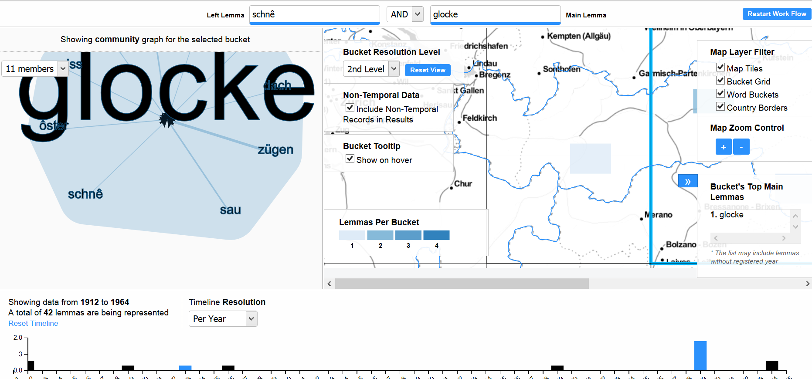
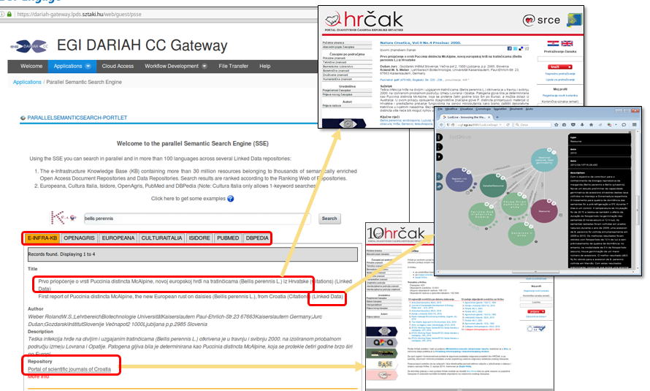
DARIAH CC – added value for cultural lexicography supporting cultural diversity documentation & research

Slide 19
Outlook
Organisational design, experimental spaces & innovation
virtual, open collaboration
common goals and passion
designing workflows, opening up
innovation networks
ecosystem centric

Slide 20
Bibliography
DARIAH Competence Center EGIWiki
https://wiki.egi.eu/wiki/Competence_centre_DARIAH (accessed 10.08.2017)
EGI ENGAGE Mainpage
https://wiki.egi.eu/wiki/EGI-Engage:Main_Page (accessed 10.08.2017)
EGI DARIAH CC Gateway
https://dariah-gateway.lpds.sztaki.hu/ (accessed 10.08.2017)
Chesbrough, H.W., Vanhaverbeke, W. & West, J. (Eds) (2006) Open Innovation: Researching a New Paradigm. Oxford University Press.
Wandl-Vogt, E., Barbera, R., La Rocca, G., Calanducci, A., Carrubba, C., Inserra, G., Kalman, T., Sipos, G., Farkas, Z.& Davidović, D. (2016) Furthering the Exploration of Language Diversity and Pan-European Culture: The DARIAH-CC Science Gateway for Lexicographers. Proceedings of EURALEX2016, Tbilisi, Georgia. pp.284-290

