Slide 1




Observation of gravitational waves from a binary black hole coalescence
Damir Buškulić
For the LSC – LIGO Scientific Collaboration – and Virgo collaboration
Seminar at the Institut Ruđer Bošković
April 11, 2016

Slide 2
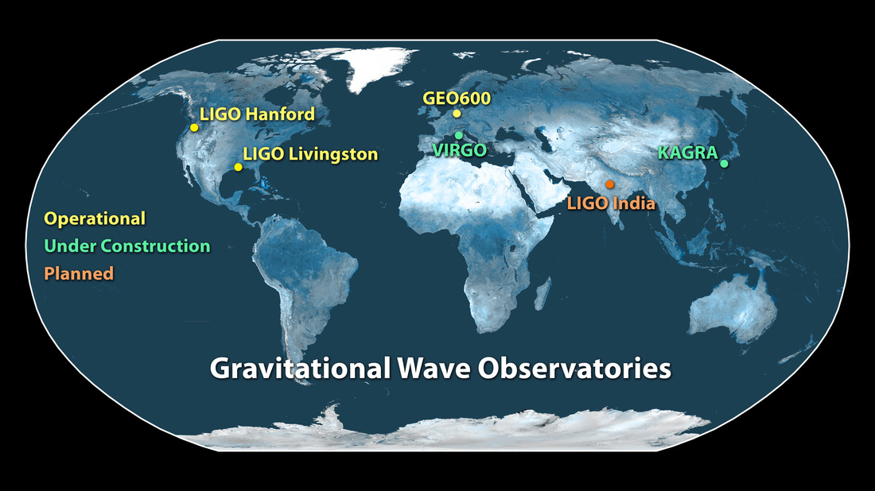
First detection of a gravitational wave
By the network of interferometric detectors Advanced LIGO – Advanced Virgo
Detectors: LIGO Hanford (H1) and LIGO Livingston (L1)
Data analysis: LSC (LIGO Scientific Collaboration) + Virgo
LSC : ~900 members ~80 institutions
from ~15 countries
Virgo : ~200 members
19 laboratories
from 5 countries

Slide 3
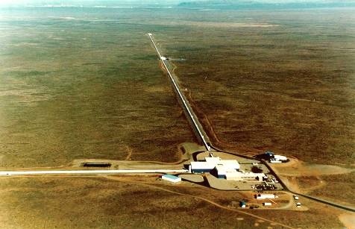
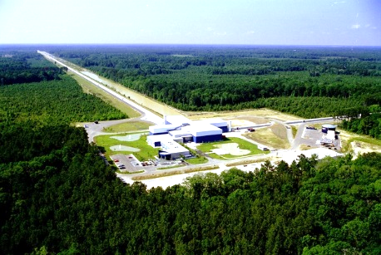
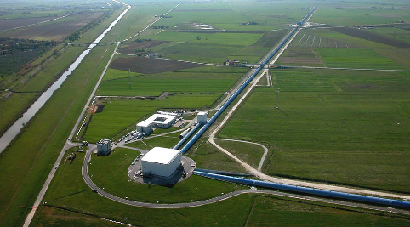
A network of observatories
LIGO Hanford (H1)
LIGO Livingston (L1)
Network structured in 2007 (agreement btw LSC and Virgo)
LVC
(LIGO-Virgo Collaboration)
Advanced LIGO (2015)
Advanced Virgo (2016)
Virgo

Slide 4
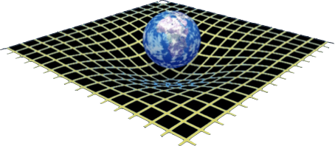
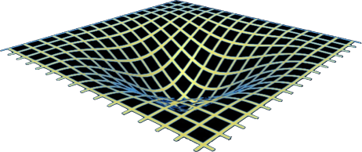
Gravitational waves
Consequence of the theory of General Relativity (GR)
Einstein 1916 – 1918
Geometric theory of gravitation
Describes the curvature of space-time
“Energy-matter tells space-time how to curve, space-time tells matter and energy how to move”
Notes:
Prostorvrijeme

Slide 5
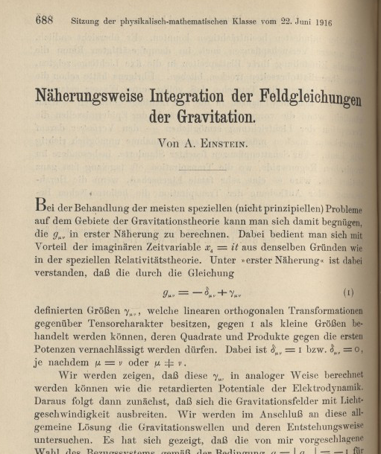

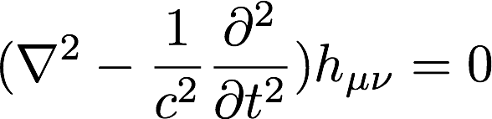
Gravitational waves
Start from a flat space-time
-> described by a Minkowski metric
Add a perturbation
Weak field limit
Choice of gauge
“Transverse Traceless” (T T)
Obtain a wave equation
Notes:
Addition : zbrajanje
Mouvement : gibanje
Ò

Slide 6
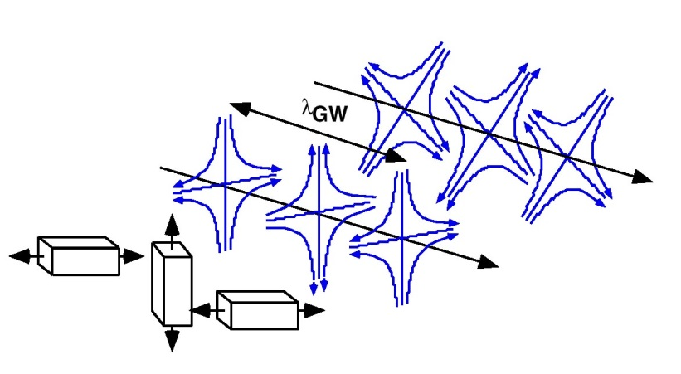
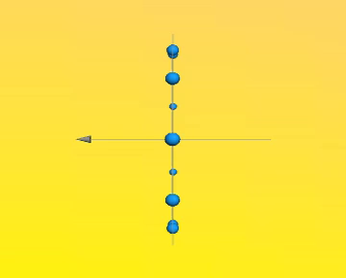
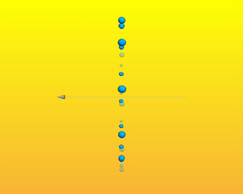
Gravitational waves
In vacuum
Plane wave
Speed = c (speed of light)
2 polarizations
Rotated by 45° one vs the other
Effect on a set of (free) “test” masses

Slide 7
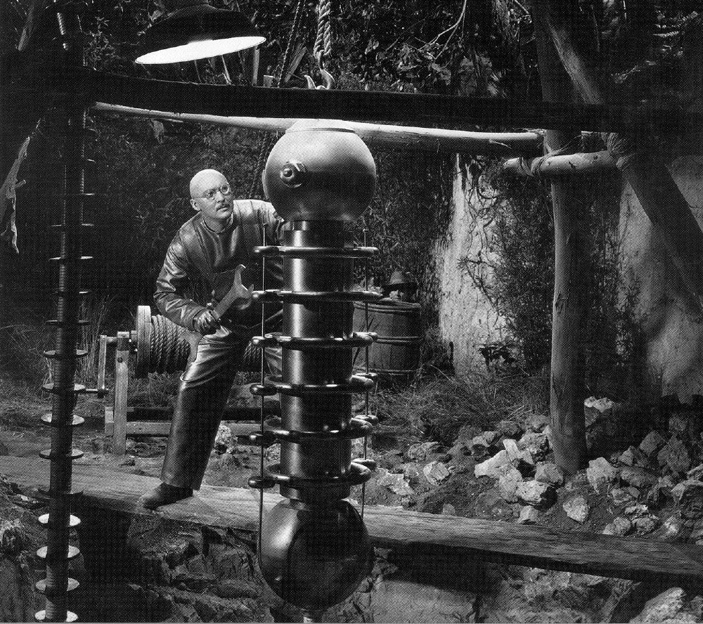
Gravitational waves
Production :
Acceleration of masses
Distribution of masses : acceleration of quadrupolar moment
Examples
M = 1000 kg, R = 1 m, f = 1 kHz, r = 300 m h ~ 10⁻³⁵
M = 1.4 M⦿ , R = 20 km, f = 400 Hz, r = 10²³ m (15 Mpc = 48,9 Mlyr ) h ~ 10⁻²¹

Slide 8
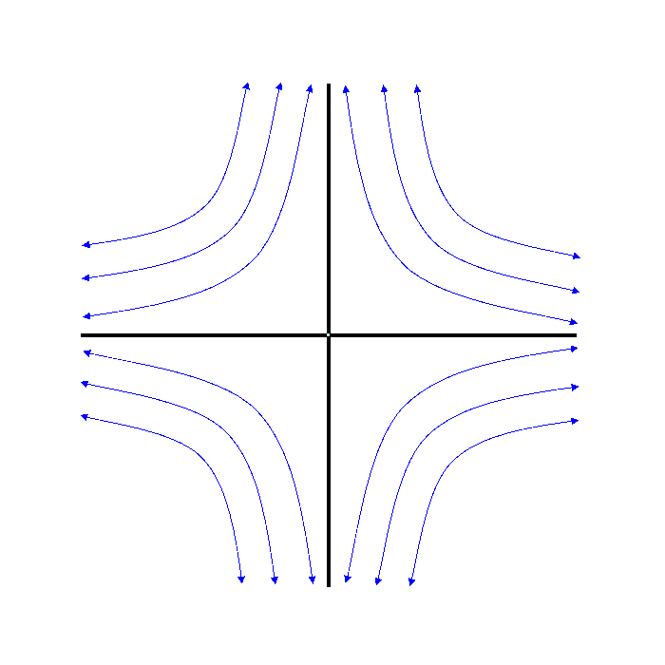
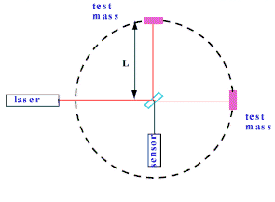
Michelson interferometer : a gravitational waves “sensor”

Slide 9
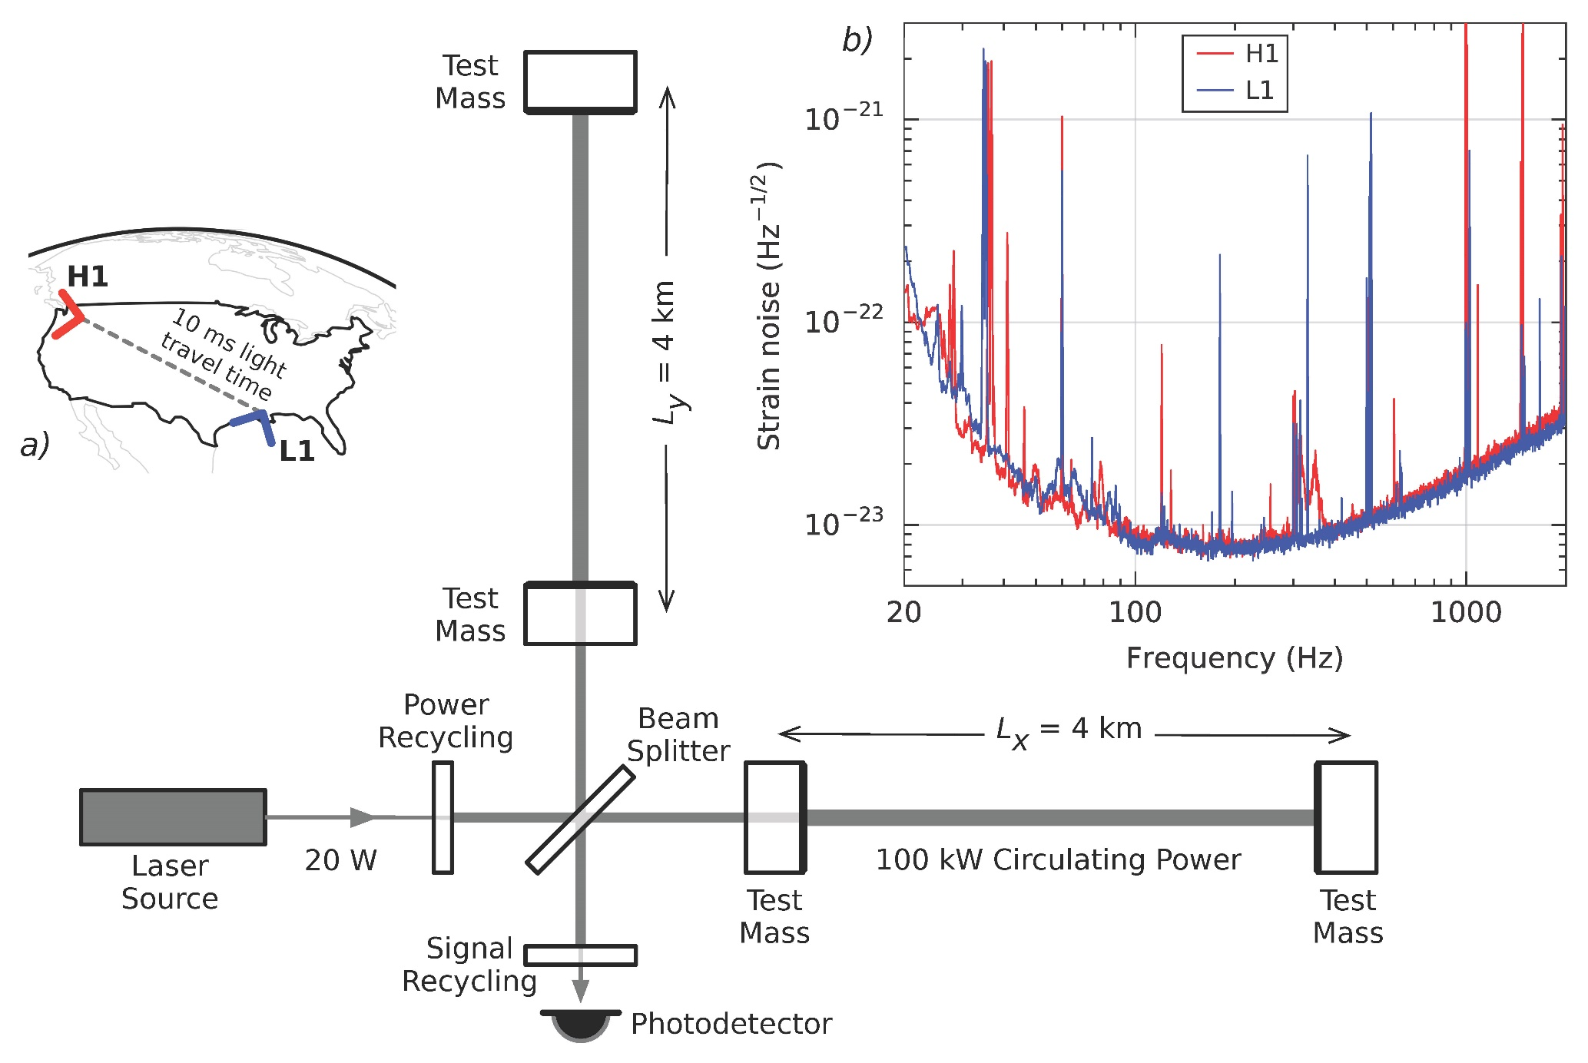
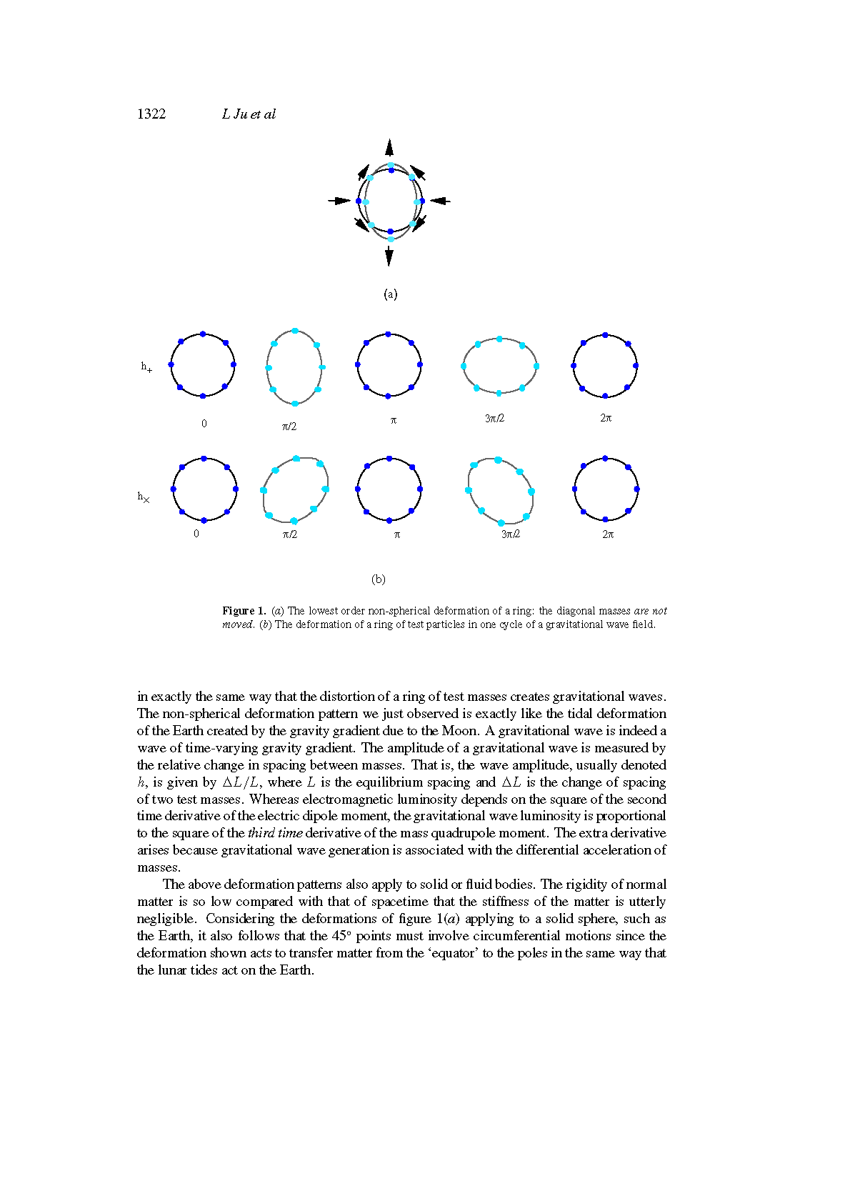
Michelson interferometer : a gravitational waves “sensor”
time

Slide 10
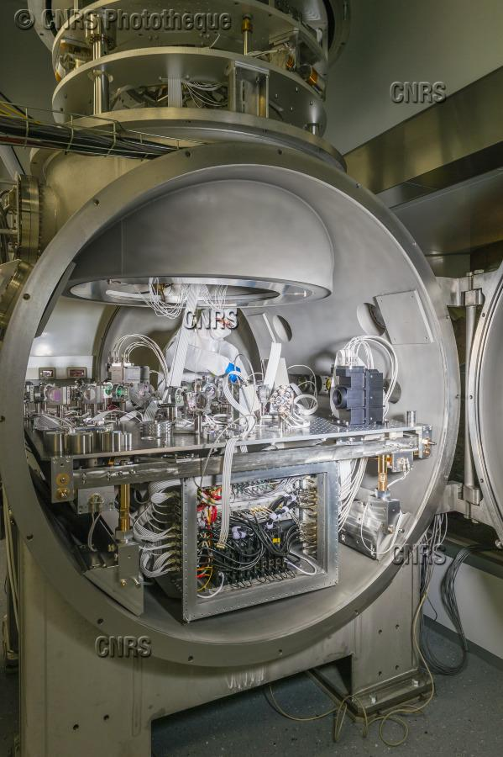
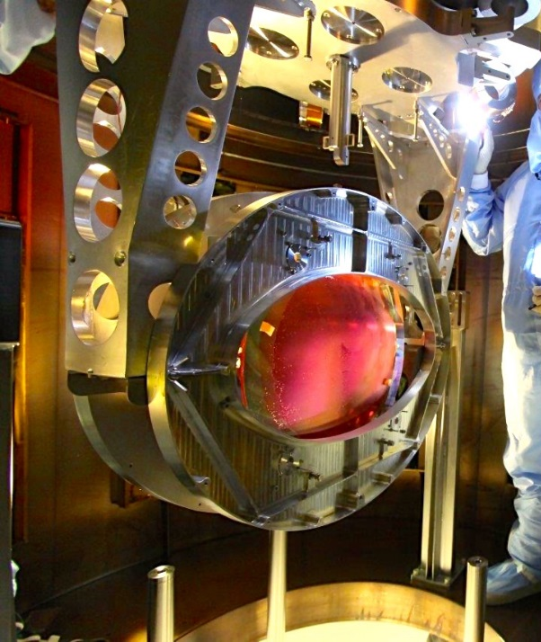
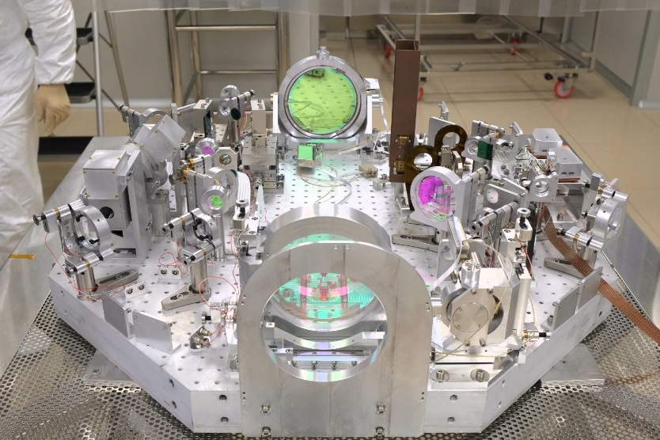
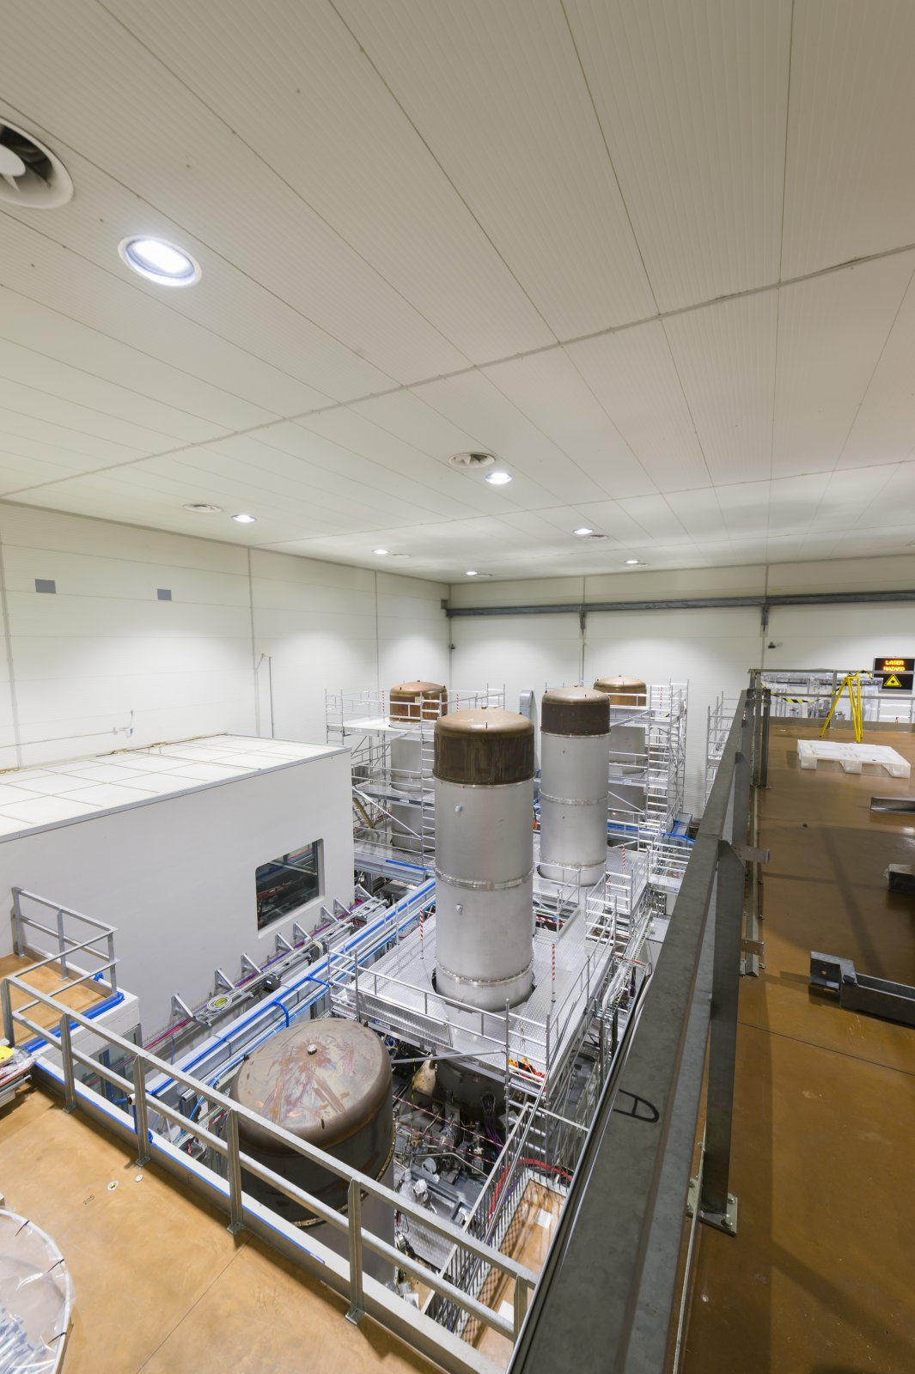
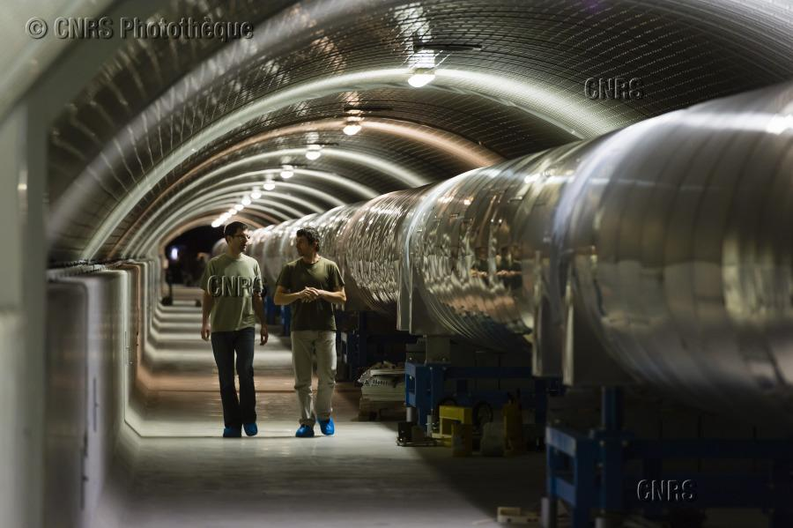
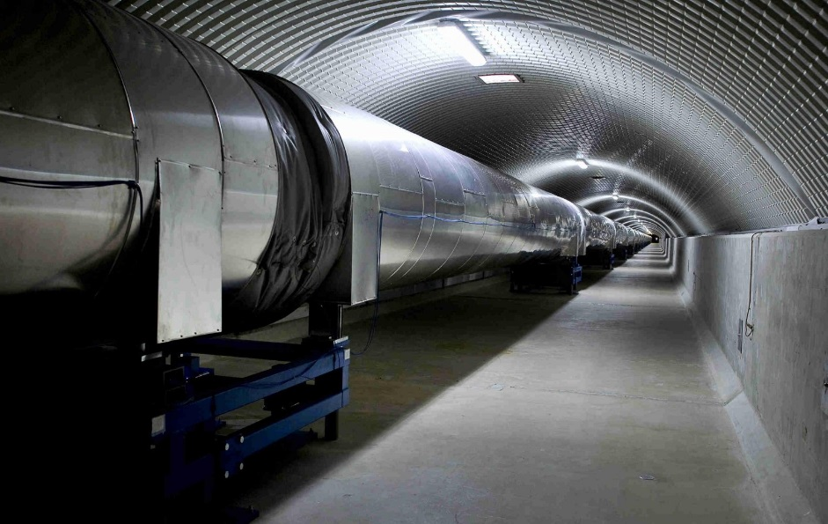
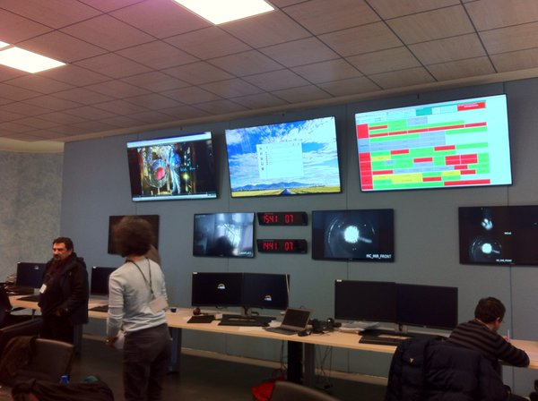
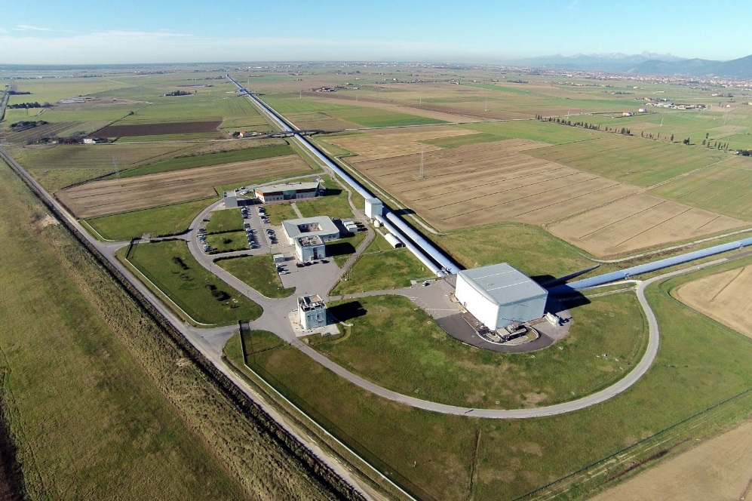
What does Virgo look like ?

Slide 11
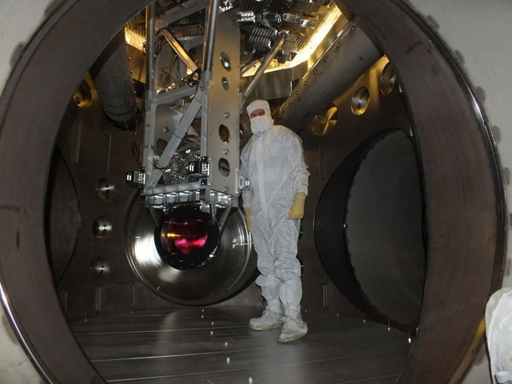
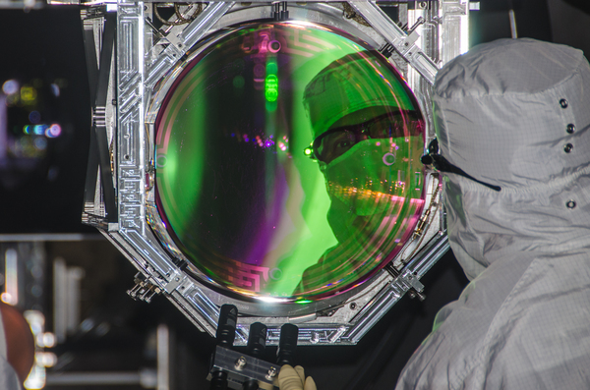
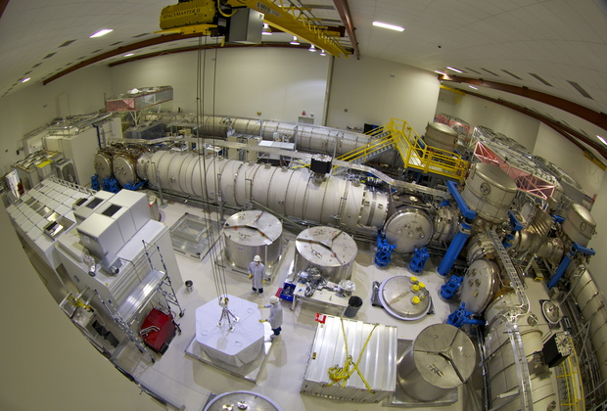
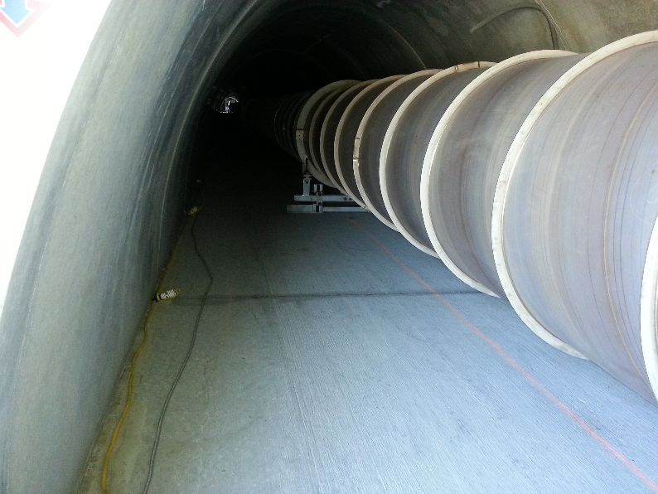
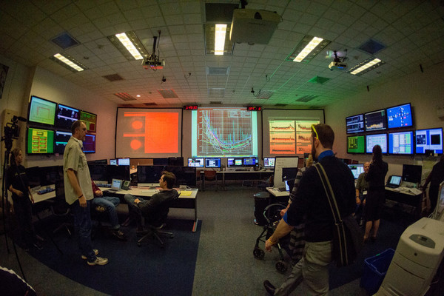
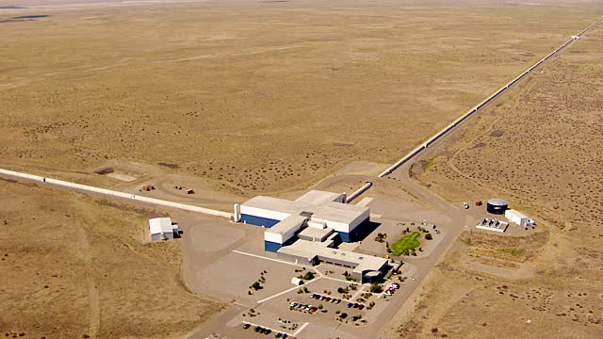
What does LIGO look like ?

Slide 12
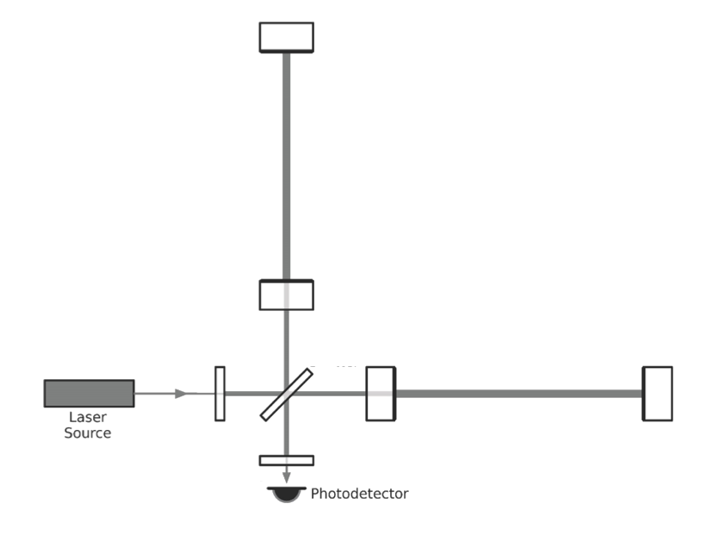
Interferometers : main noise sources
Seismic noise
Residual gas diffusion
Quantum noises
Radiation pressure
Thermal (brownian) noise
Wavelength and amplitude fluctuations
Shot noise

Slide 13
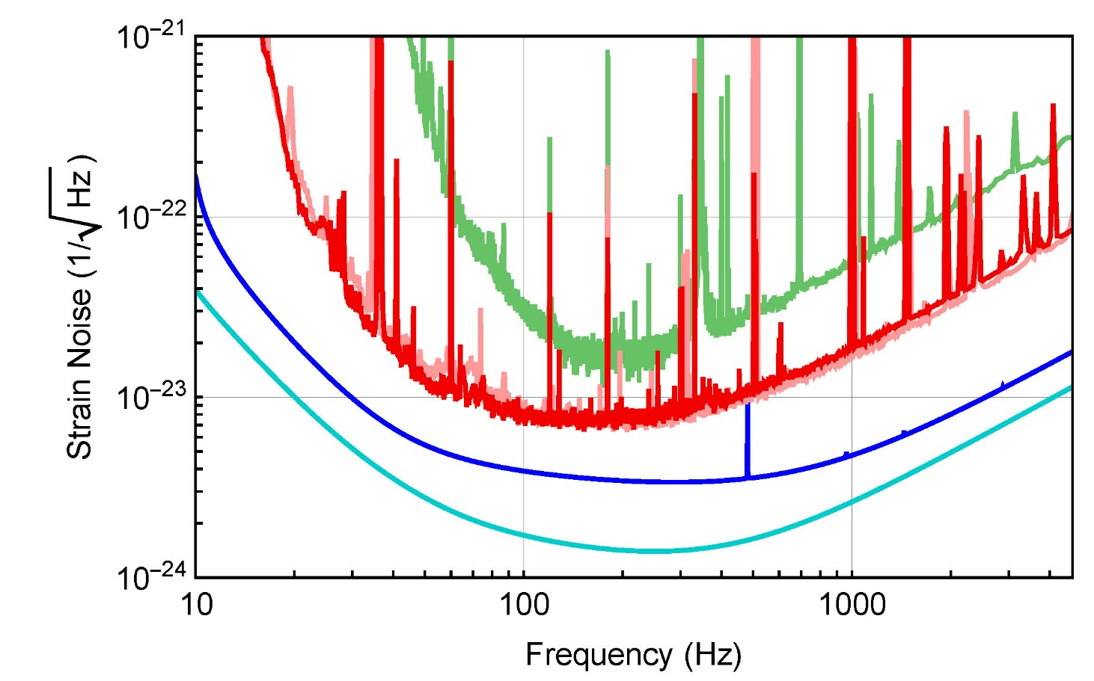
From one generation to the next (I)
Seismic noise
Improved seismic isolation
S6
O1
aLIGOdesign
Future upgrade
Thermal noise
Monolithic suspensions
Improved mirror coatings
Larger beam size
Quantum noise
Higher laser power
Thermal compensation
Signal recycling
DC detection

Slide 14
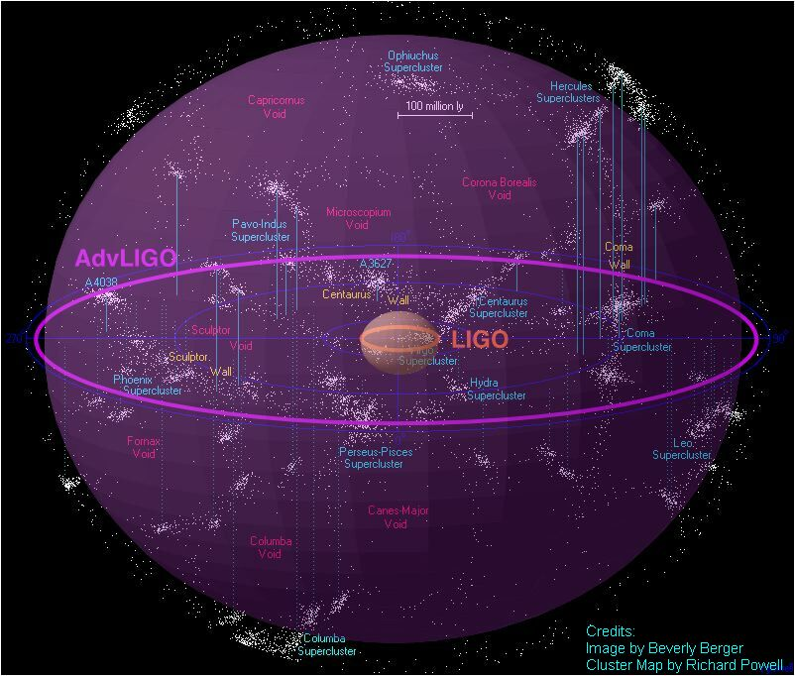
Horizon = distance at which a reference compact body coalescence gives a SNR (Signal over Noise Ratio) of 8 in the detectors
Picture : reference = 2 x 1.4 M⦿ neutron star coalescence, average orientation
Sensitivity x 10 ⬄ Sensitive volume x 10³

Slide 15
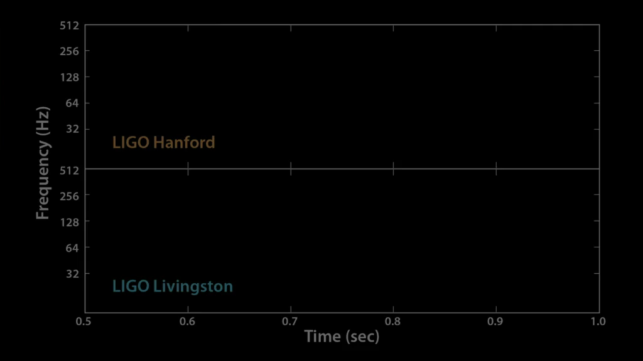
I N T R O D U C I N G
G W 1 5 0 9 1 4
09.14.15 | 09:50:45 UTC | 29 +36 M, SNR 24 | proud parents, LIGO & Virgo Collaborations

Slide 16
O1 run
September 2015 – January 2016
Preceded by engineering run ER8 – from Aug 17
Stable data taking from Sep 12
O1 scheduled to start on Sep 18
When fully ready with calibration / hardware injections / EM follow-up alerts / computing
Results on period Sep 12 – Oct 20
Detectors maintained in same configuration
Duty cycle: H1 70%, L1 55%, H1 + L1 48%
H1 = LIGO Hanford, L1 = LIGO Livingston
16 days of coincident data

Slide 17
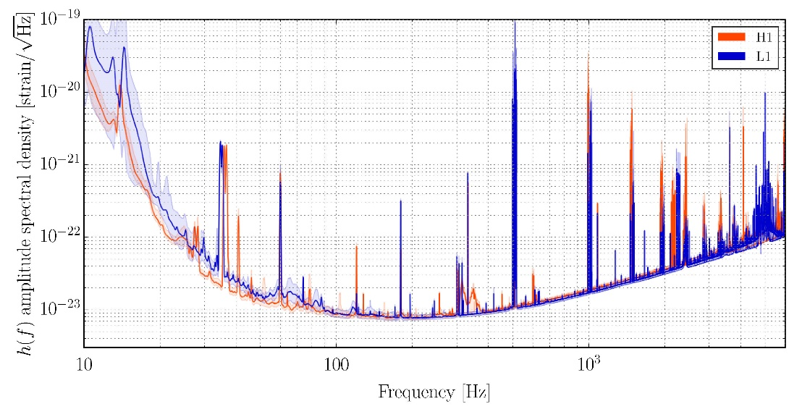
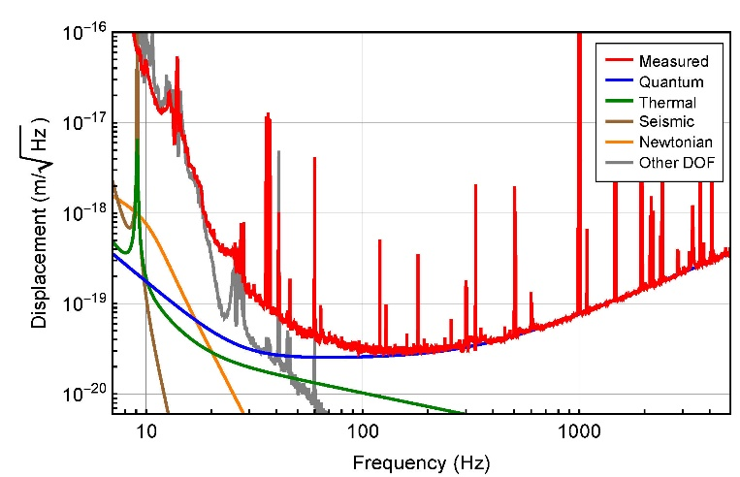
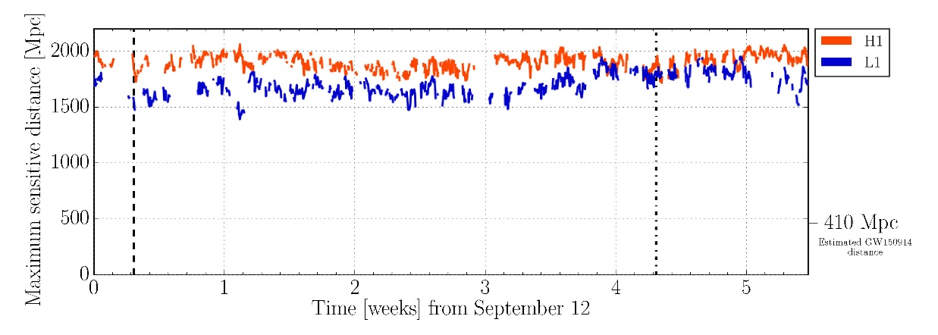
Detector operation
Strain sensitivities for H1 and L1 : similar
10⁻²³/√Hz @ 100 Hz
3-4 times better than in 2010 in 100 Hz – 300 Hz band
Sum of known noise ~ most of observed sensitivity curve
Excess noise in 20 Hz – 100 Hz band
Homogeneous data taking on Sep 12 – Oct 20 period
Around the time of GW150914 : “observation” mode
~30 min pour H1, > 1h pour L1

Slide 18
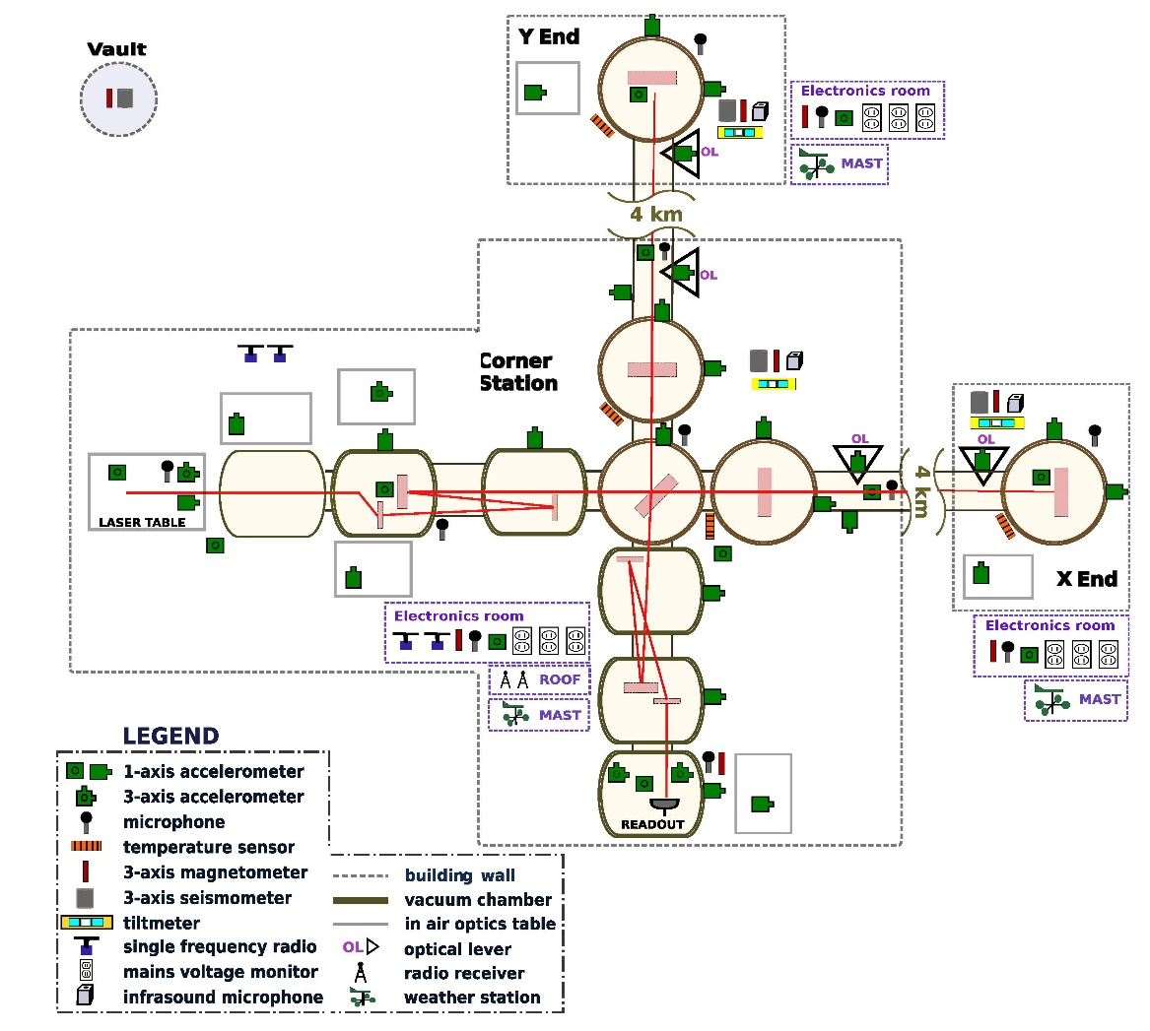
Environment vetting
Detectors physical environment -> Monitoring by array of sensors
Seismometers, accelerometers, microphones, magnetometers, radio receivers, weather sensors, AC-power line monitors, cosmic ray detector
~10⁵ channels for each detector
Identify and characterize couplings
Veto transient disturbances
Special attention to correlated sources of noise
Ex : global electromagnetic noise
GW150914 : ruled out environmental origin
Auxiliary channels :
excess power too small by factor > 17
Does not match signal morphology

Slide 19
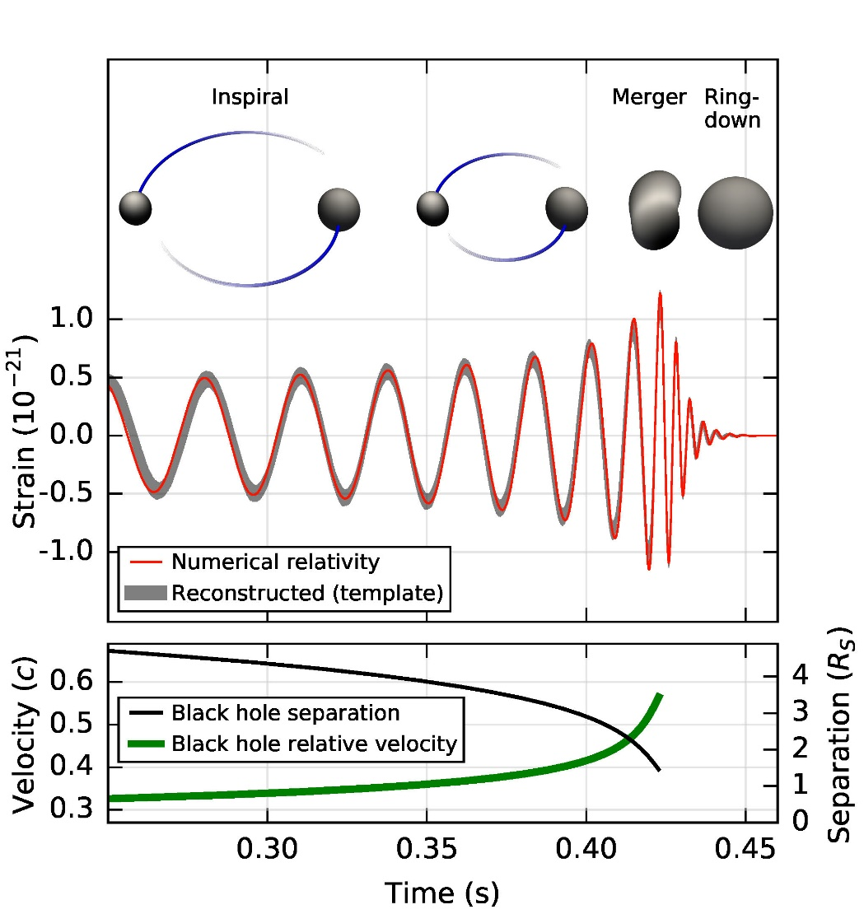
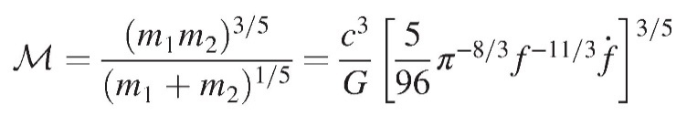
Searching for the coalescence of a binary system of compact objects (CBC)
Target: Signals from the coalescence of a binary system of compact objects
Neutron stars (BNS), Neutron Star + Black Hole (NS-BH), Binary Black Hole (BBH)
Phases of the coalescence:
Inspiral
Masses m₁ and m₂ orbiting around each other
Emitting GW
frequency ↗︎, amplitude ↗
Waveform characterized by « chirp mass »
Merger : numerical relativity computation
Ringdown : decompose in quasi-normal modes
Time

Slide 20
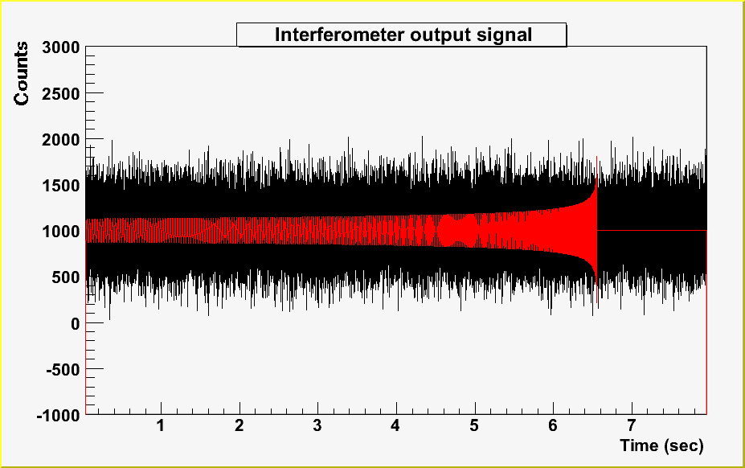
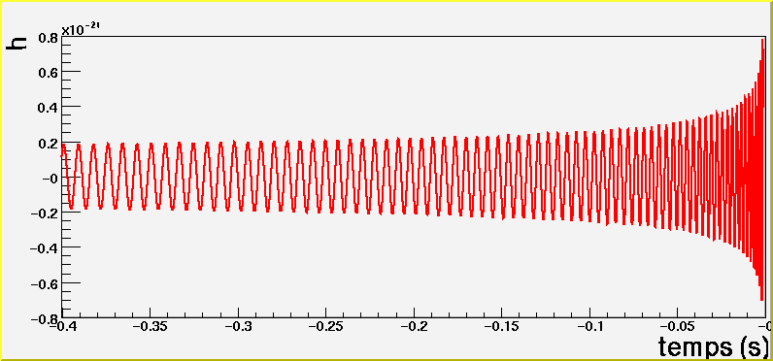
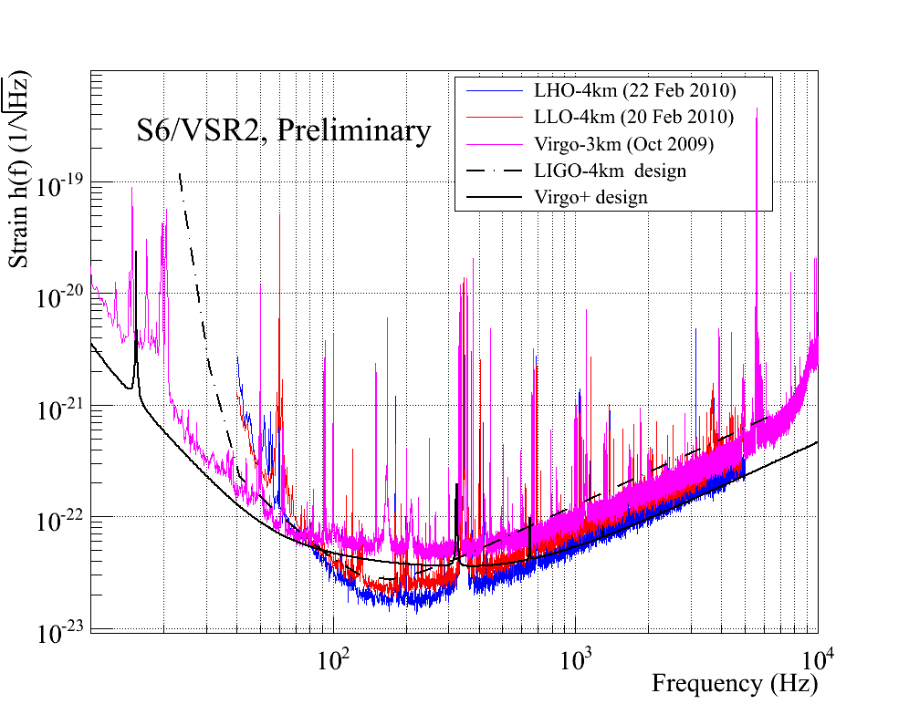
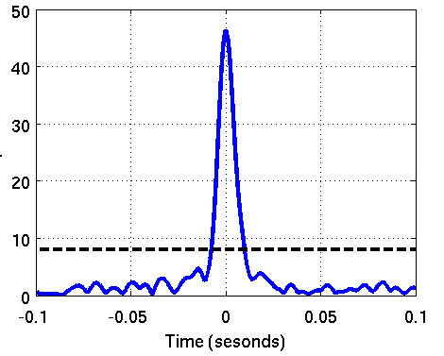
Searching for the coalescence of a binary system of compact objects (CBC)
Analysis principle
Production of a bank of templates (theoretical waveforms)
Matched filtering = weighted intercorrelation signal/template
Template
Detectors noise spectral density
Signal embedded in the noise
⊗
/
Result of the matched filtering : ρ(t)
Candidate event
Threshold

Slide 21
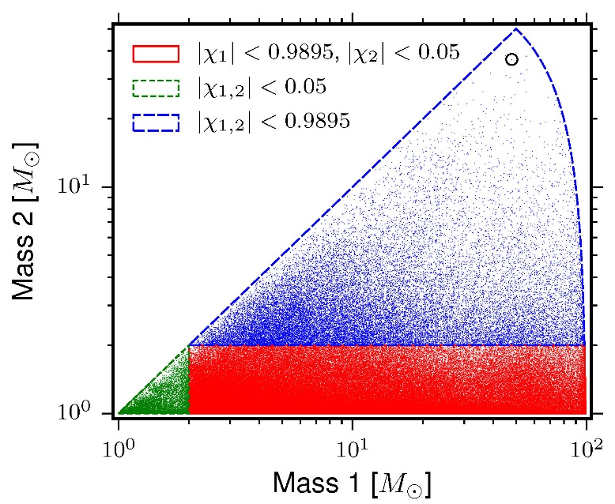
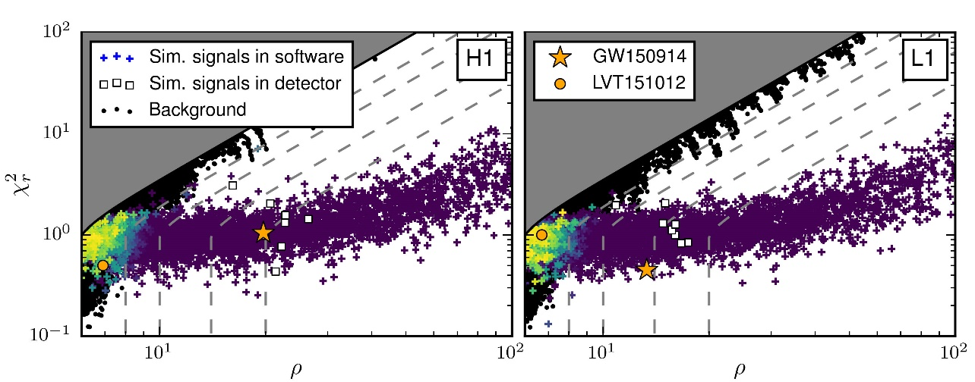
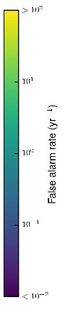


Searching for the coalescence of a binary system of compact objects (CBC)
Intrinsic parameters
masses, spins (aligned) drive
the system dynamics
the waveform evolution
4-D parameter space scanned with ~250,000 templates
Extrinsic parameters
Orientation of the binary, initial phase,… impact
Arrival time of the signal
Global amplitude and phase
Maximized over
Extract the maxima in the signal=to=noise time series
Calculate to test consistency with template
Extract triggers coincident in both detectors
Apply data quality vetoes

Slide 22
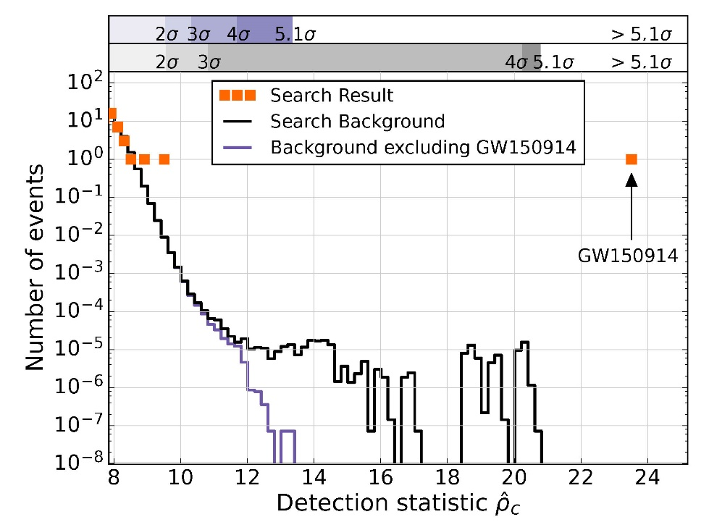

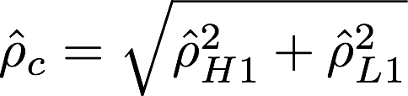


CBC BBH search result
Statistic
Significance
GW150914 is the loudestevent in the search, = 23.6
Individual triggers in L1 and H1 (forming GW150914): highest in each detector
Coincidences between single detector triggers from GW150914 and noise in other detector
Background excluding contribution from GW150914 (gauge significance of other triggers)
Notes:
Encore visible deux fois plus loin
Vérifier SNR S6

Slide 23
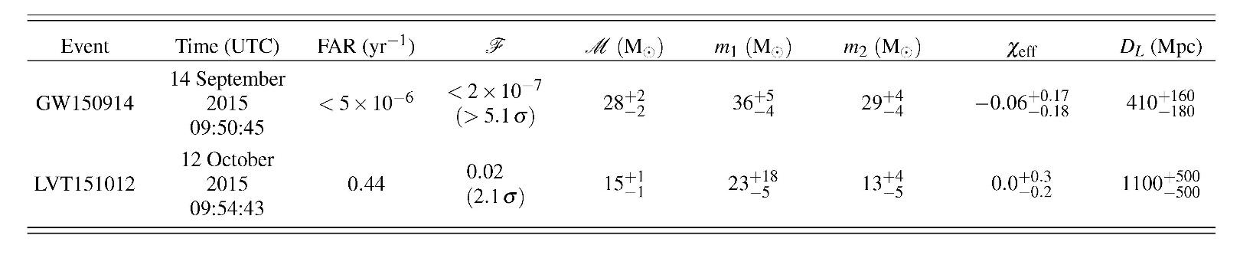
Résultat de la recherche CBC BBH
False alarm rate
Measured from background estimated on data
Time shifts by N x 0.1 s between H1 and L1
N_{max} = 10⁷ shifts, T_{bkgd} = 608,000 yrs
Account for trial factors
GW150914 louder than all background ↓ lower limit on significance
L1
H1
L1-100s
time
Notes:
Encore visible deux fois plus loin
Vérifier SNR S6

Slide 24





A black holes coalescence ? Yes !
Over 0.2 s, frequency and amplitude increase from 35 Hz to f_{peak} = 150 Hz (∼ 8 cycles)
Reminder : the “chirp mass” characterizes the inspiral phase
Finds ,
Keplerian separation gets close to Schwarzschild radius
Very close and compact objects
BNS too light,
NSBH merge at lower frequency
Decay of waveform after peak
consistent with damped oscillations of BH (relaxing to final stationary Kerr configuration)
SNR too low to claim observation of quasi normal modes

Slide 25



Data quality
GW150914
On analyzed period
Clean data set
Homogeneous background
Data quality vetoes
Identify periods with intrumental or environmental problems
Veto those periods
GW150914 >> every background event even without DQ vetoes
GW150914
Notes:
The LIGO-Hanford background distribution was dramatically improved by the application of data quality vetoes, dominated by the effect of a single data quality flag. This flag was designed to indicate a fault in the phase modulation system used to create optical cavity control feedback signals
the false-alarm probability of the second most significant trigger (LVT151012) was 2%. Without the inclusion of data quality vetoes, the false-alarm probability would have been 14%, increased by roughly a factor of 7

Slide 26

Naked eye view of GW150914
35 – 350 Hz band-passed strain time series
Waveform reconstructions
Residual noise after waveform subtraction
Waveform reconstructed
Coherent signal in both detectors
Agreement with best=fit theoretical waveforms (waveforms from perturbative theory + NR = Numerical Relativity)
Residual noise consistent with instrumental noise

Slide 27


Rate of BBH mergers
Previously :
Estimations of the coalescence rate
Based on electromagnetic observations and population modeling
R ∼ 0.1 – 300 Gpc⁻³ yr⁻¹
Previous LIGO-Virgo rate upper limits
R < 140 Gpc⁻³ yr⁻¹ for GW150914 parameters
Astrophysical rate inference
Counting signals in experiment
Estimating sensitivity to population of sources
Depends on mass distribution (hardly known)
Low statistics and variety of assumptions -> broad rate range
R ∼ 2 – 400 Gpc⁻³ yr⁻¹
Project expected number of highly significant events as a function of surveyed time x volume
total
GW150914-like
LVT151012-like
Expected number of significant events
Increase in V x T relative to first 16 days of O1

Slide 28
Parameter Estimation
Extrinsic parameters (9)
Location : luminosity distance, right ascension, declination (3)
Orientation: inclination, polarization (2)
Time and phase of coalescence (2)
Eccentricity (2)
Intrinsic parameters (8)
Masses (2) + Spins (6)
PE (parameter estimation) based on coherent analysis across detector network
Bayesian framework: Computes likelihood of data given parameter
Based on match between data and predicted waveform
Explores full multidimensional parameter space with fine stochastic sampling
PE relies on accurate waveform models
Crucial progress over past decade to model all phases of BBH coalescence: Inspiral, Merger, Ringdown ( IMR )
Waveform models combine perturbative theory and numerical relativity
EOBNR: Aligned spins (11 parameters)
IMRPhenom: Aligned spins + one effective precession spin parameter (12 parameters)
Still missing: eccentricity, higher order gravitational modes, full spin generality

Slide 29



GW150914 : Intrinsic Parameters
Encoded in GW signal :
Inspiral
Leading order: chirp mass
Next to leading order: mass ratio, spin components // orbital angular momentum
Higher orders: full spin DOF
Additional spin effect
If not // orbital angular momentum: orbital plane precession
↓ Amplitude and phase modulation
Merger and ringdown
Primarily governed by final black hole mass and spin
Masses and spins of binary fully determine mass and spin of final black hole in general relativity
Masses
Spins
Weakly constrained for GW150914
Radiated energy
Peak luminosity
Notes:
The late stage of the coalescence allows us to measure the total mass which, combined with the measurement of the chirp mass and mass-ratio from the early inspiral, yields estimates of the individual component masses for the binary.
For comparison, the ultraluminous GRB 110918A reached a peak isotropic-equivalent luminosity of (4.7 pm 0.2) 10^54 erg s-1

Slide 30





GW150914 : extrinsic Parameters
Amplitude depends on masses, distance, and geometrical factors
Distance – inclination degeneracy
Distant sources with favorable orientations are preferred
Source location
inferred primarily from
time of flight
amplitude and phase consistency
Limited accuracy with two detector network
Sky locations with good detector response are preferred
2-D 90% credible region is 590 deg²
3-D uncertainty volume is 10⁻² Gpc³
∼ 10⁵ Milky Way equivalent galaxies

Slide 31


Electromagnetic follow-up
LVC called for EM observers to join a follow-up program
LIGO and Virgo share promptly interesting triggers
70 MoUs, 160 instruments covering full spectrum
(from radio to very high energy gamma-rays)
25 teams reported follow-up observation of GW150914

Slide 32

Future Localization Prospects
Face-on BNS
@ 80 Mpc
2016-17
2017-18
Face-on BNS
@ 160 Mpc
2019+
2022+
HLV = Hanford-Livingston-Virgo
HILV = Hanford-LIGO India-Livingston-Virgo

Slide 33


High-Energy Neutrino Follow-up
Search for coincident high energy neutrino candidates in IceCube and ANTARES data
HEN ν expected in (unlikely) scenario of BH + accretion disk system
Search window ± 500 s
No ν candidate in both temporal and spatial coincidence
3 ν candidates in IceCube
0 ν candidate in ANTARES
Consistent with expected atmospheric background
No ν candidate directionally coincident with GW150914
Derive ν fluence upper limit (direction dependent)
Derive constraint on total energy emitted in ν by the source

Slide 34


Testing GR with GW150914 (I)
Most relativistic binary pulsar known today
J0737-3039, orbital velocity
GW150914
Strong field, non linear, high velocity regime
“Loud” SNR -> coarse tests
Waveform internal consistency check
Evidence for deviation from General Relativity in waveform ?
Bound on Compton wavelength (graviton mass)

Slide 35





Testing GR with GW150914 (II)
No evidence for deviation from GR in waveform
No evidence for dispersion in signal propagation
Bounds :
More constraining than bounds from
Solar System observations
binary pulsar observations
Less constraining than model dependent bounds from
large scale dynamics of galactic clusters
weak gravitational lensing observations

Slide 36

Astrophysics implications
Relatively massive black holes (> 25 M) exist in nature
Massive progenitor stars => low mass loss during its life => weak stellar wind
Metallicity = proportion of elements heavier than He
High metallicity => strong stellar wind
=> formation of progenitors in a low metallicity environment

Slide 37


Astrophysics implications
Binary black holes form in nature
Formation :
Isolated binaries
Dynamical capture (dense stellar regions)
GW150914 does not allow to identify formation channel
Future : information on the spins can help
Binary Black Holes merge within age of Universe at detectable rate
Inferred rate consistent with higher end of rate predictions (> 1 Gpc⁻³ yr⁻¹)

Slide 38
Outlook: Other Searches
BBH search results presented on first part of O1
Full O1 results to be published in a few months
Other transient searches on-going
BNS, NSBH, IMBH, cosmic strings, generic transients
Triggered searches: GRBs…
Continuous wave sources
Non axisymmetric rotating neutron stars
Stochastic background of gravitational waves

Slide 39
From one generation to the next (II)
Terrestrial detectors
Einstein Telescope (ET)
Advanced LIGO, Advanced Virgo, GEO HF, KAGRA
Foundations of multi-messenger astronomy
First detection
Enhanced LIGO, Virgo+
Initial LIGO, Virgo, GEO600
Improvement of sensitivity
First generation
Second generation
Third generation
Prise de données Limites hautes de taux Mise en place du réseau
Vers des observations routinières, Astronomie OG
Observation approfondie de l’univers avec les OG

Slide 40

2nd Generation Network

Slide 41



Plan and sensitivity evolution
xivxdi

Slide 42
Conclusion
Second generation ground-based GW detectors came back online
Amazing sensitivity
The LIGO detectors observed a beautifully clear and loud signal : GW150914
Interpreted as the coalescence of two black holes of 29 and 36 solar masses, located at a distance of 1.3 Glyr
This discovery opens up two new paths
Testing gravitation in uncharted territory
Gravitational wave astronomy
Eagerly waiting for – and striving for – Advanced Virgo to join the network and the fun

Slide 43

LIGO-Virgo GW150914 papers
https://papers.ligo.org/

Slide 44
Spares

Slide 45


Generic Transient Search
Operates without a specific search model
Identifies coincident excess power in time-frequency representations of h(t)
Frequency < 1 kHz
Duration < a few seconds
Reconstructs signal waveforms consistent with common GW signal in both detectors using multi-detector maximum likelihood method
Detection statistic
E_{c}: dimensionless coherent signal energy obtained by cross-correlating the two reconstructed waveforms
E_{n}: dimensionless residual noise energy after reconstructed signal is subtracted from data
Signals divided into 3 search classes based on their time-frequency morphology
C3 : Events with frequency increasing with time – CBC like

Slide 46

Generic Transient Search Result
GW150914 loudest event in C3 search class, η_{c} = 20
Significance also measured from time slides
T_{bckd} = 67,400 yr , trial factors
FAR < 1 per 22,500 yr
FAP < 2 10⁻⁶ ↓ > 4.6 σ

Slide 47



Expected BBH Stochastic Background
GW150914 suggests population of BBH with relatively high mass
Stochastic GW background from BBH could be higher than expected
Incoherent superposition of all merging binaries in Universe
Dominated by inspiral phase
Estimated energy density
Statistical uncertainty due to poorly constrained merger rate currently dominates model uncertainties
Background potentially detectable by Advanced LIGO / Advanced Virgo at projected final sensitivity
Notes:
Deux effets : rate on high end + high masses => higher amplitude of SGWB

