Slide 1


e-Infrastructure demonstrators by the DARIAH Competence Centre for digital Arts and Humanities
Davor Davidović*, Giuseppe la Rocca, Philipp Wieder
DARIAH Competence Centre

Slide 2
Contents
Introduction
DARIAH community
DARIAH CC
Demonstrators
Exploitation actions
Dissemination

Slide 3
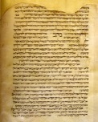



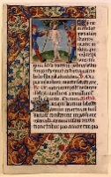

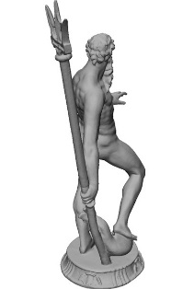
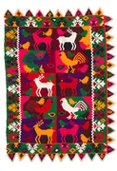
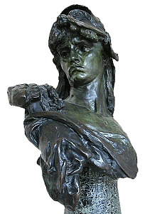
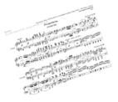
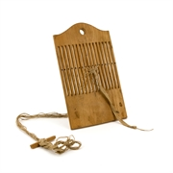
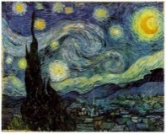
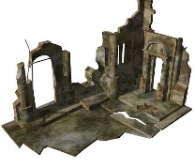
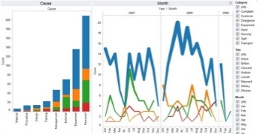
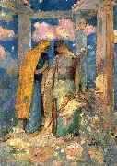
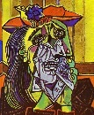
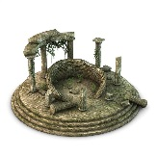
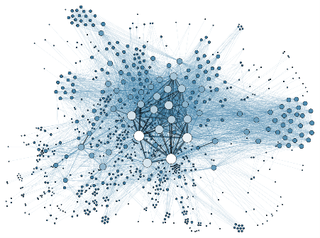
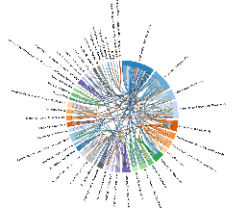

Introduction
Digital Arts and Humanities
Search
Browse
Access
Annotate
Archive
digitalization
storage
analysis

Slide 4
DARIAH in a nutshell
DARIAH, the Digital Research Infrastructure for the Arts and Humanities…
…aims to enhance and support digitally-enabled research and teaching across the humanities and arts.
It is a connected network of tools, information, people and methodologies for investigating, exploring and supporting research across the digital arts and humanities for researchers and humanists.

Slide 5
DARIAH today
Very heterogeneous community:
  numerous research disciplines, applications and tools utilized, types of media objects, format of data,…
Scattered resources:
  Local, institutional, national, public, different access policies,…
Limited usage of the cloud technologies
  National providers (e.g. DARIAH-DE)
  Small number of available cloud-based services/applications

Slide 6






DARIAH Competence Centre
Widen the usage of the Federated (cloud) services for A&H research
Objectives:
  to strengthen the collaboration between EGI and DARIAH
  to increase the number of specific services and applications for A&H running on EGI cloud resources
  to raise awareness of benefits of using e-Infrastructure in A&H
Partners:

Slide 7


DARIAH CC activity
Community
Demonstrators
Outreach, training, user support
Apps.
and
services
Multi-Source Distributed Real-Time Search and Information Retrieval application
Semantic Search Engine
Bavarian dialects dataset
New DARIAH applications and datasets
DARIAH Science Gateways
CDSTAR
WS-PGRADE
Technologies
EGI infrastructure
Federated DARIAH resources
AAI
e-Infrastructure
DARIAH Virtual Organisation
Clouds and grids

Slide 8








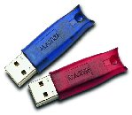
Bavarian Dialects (INFN, AAS)
Based on gLibrary → Digital repository system
  Organize, search, store and retrieve digital assets
  Distributed (grid/cloud) storage resources
Use case → Bavarian dialects datasets
Local DB for repo
SQL and/or NoSQL DBs
Local storage
REST API
glibrary.ct.infn.it
Grid storage
eToken
service
User Tracking DB
Cloud Storage

Slide 9
gLibrary + Bavarian dialects
How existing DH repository can benefit from gLibrary
  Easy sharing and data replication
  Scalability
  Exploit cloud storage capacities
  authN/authZ
  Mobile access
Target users:
  research groups, institutions, service providers
  Respository managers/owners

Slide 10
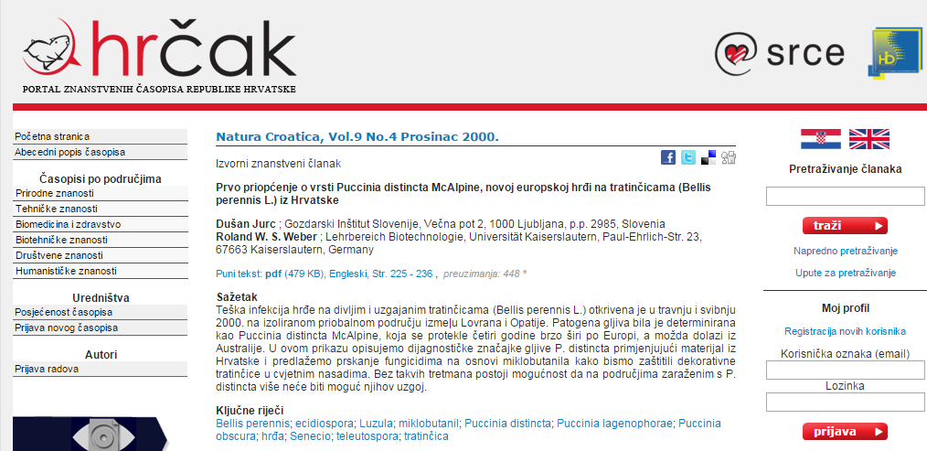
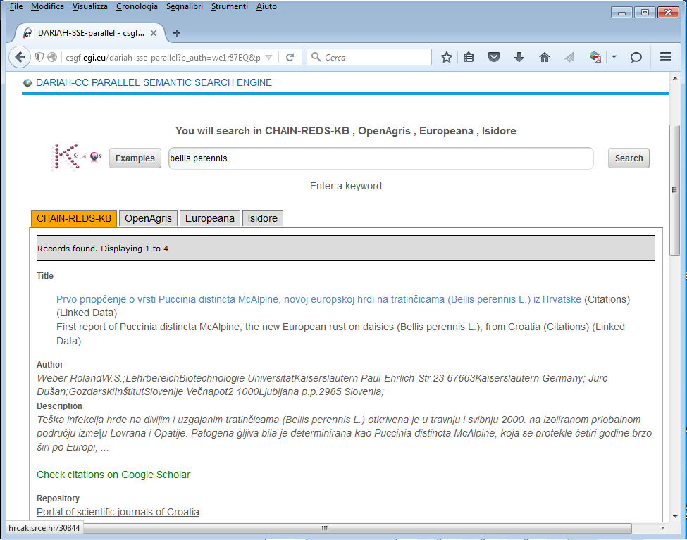
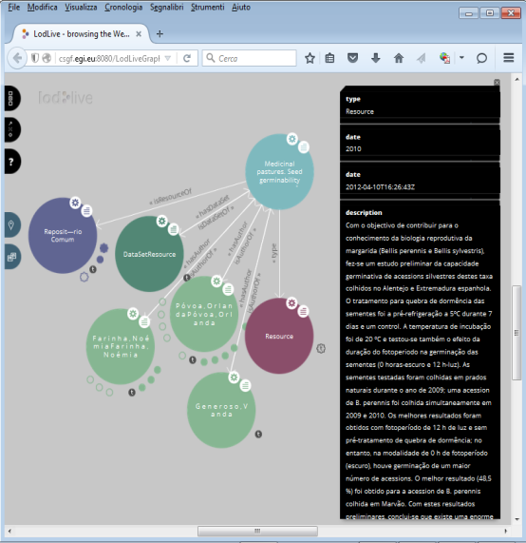
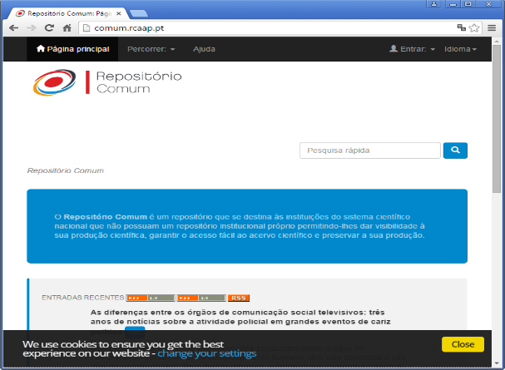
PSSE (INFN)
Parallel Semantic Search Engine:
http://csgf.egi.eu/dariah-sse-parallel

Slide 11
PSSE
Supported repositories
  OpenAgris, Europeana, Cultura Italia, Isidore, Pubmed and DBPEdia
Benefits:
  Search across existing DH repositories
  New knowledge discovery (semantic search)
  Visualization of the search results
Target beneficiaries:
  Lexicographers, COST ENeL, WG Lexical Resources, WG Analyzing and linking biographical data

Slide 12
SIR (GWDG)
Multi-Source Distributed Real-Time Search
and Information Retrieval (SIR)
Use Case: Optical Character Recognition (OCR)
Offers
  Configurable Extract-Transform-Load (ETL) pipeline
  Full text search
  Analytics
  Integration of dynamic data sources
Target users: A&H, social sciences, libraries, …

Slide 13





SIR
SIR (GWDG)
green = to be build for SIR
Web API
Access
Presentation Layer
7
Web API
for third party queries
Advanced Query Hub
6
Component ID is
marked red
2
4
1
OCR
ETL-Ingester
REST interface
Plugin
1
GWDG CDSTAR Engine
Analytics Plattform
(e.g.. Hadoop, InfluxDB)
…
ETL-Ingester
4
3
…
1
ETL-Ingester
ES-Plugin
Direct native highspeed access
search engine
cluster
5
High speed rebuild of search indexes and databases from caches (optional)
CDSTAR storage used as cache for ETL-processed data
Recovery Tool

Slide 14
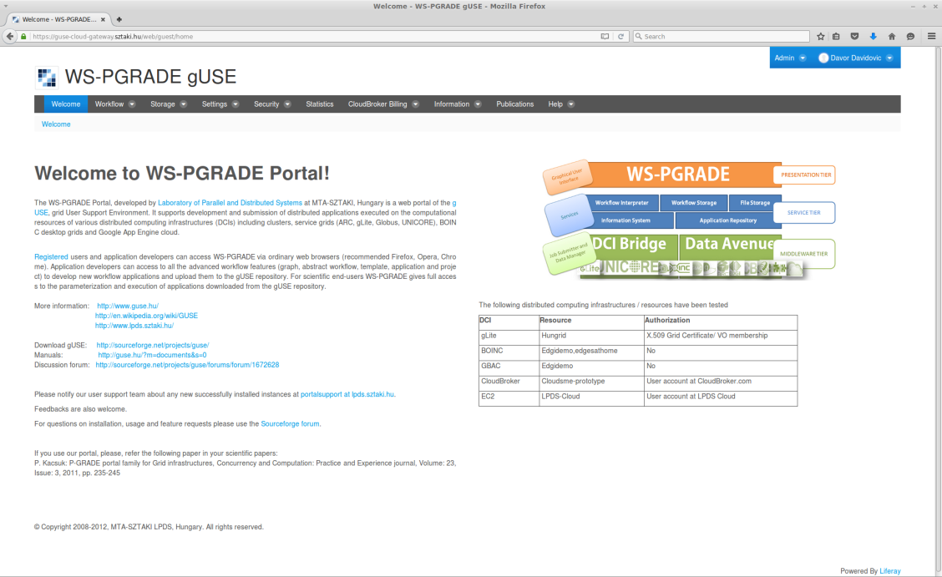
DARIAH Science Gateway (SZTAKI)
Based on WS-PGRADE portal technology
Will serve as a central access point to EGI (cloud) infrastructure for DARIAH users
Service provider inside DARIAH AAI
Offers:
  User-friendly web-based access (portlets)
  Workflow manager
  EGI/cloud access

Slide 15

DARIAH Science Gateway
Working group
Pilot applications
Benefits:
  Existing DH applications
  New/existing portlets
Target users
  DARIAH users
  Working Groups
  DH projects (READ, ARIADNE)
Institute
H2020 READ
Researcher
DARIAH Science Gateway
Portlet
Portlet
Portlet
Portlet
Portlet
PSSE
SIR
gLibrary
APP
APP
DCI Bridge
EGI infrastructure
(storage, compute)

Slide 16
EGI Services
EGI Application Database
  A list of pre-defined images with specific DH applications/services + portlets in DH gateway
  Benefits for DARIAH:
    Reproducibility of research, easy adding of new applications, hiding implementation details
  WG Visual Media for Digital Humanities, WG Text and Data Analysis
EGI Training Marketplace
  Offers training infrastructure and materials
  Benefits:
    East setup of training events (training materials, software, etc…)
    Record and share training event
  WG Training and Education

Slide 17
Exploitation plan
Demonstrate the developed technologies, applications and services to:
SERVICE PROVIDERS
RESEARCHERS
COMMUNITIES
Services and applications
(SIR, Bavarian dialects, PSSE)
DH Science Gateway
Frameworks, engines
(gLibrary, CDSTAR)
Integrate into DARIAH community
Dissemination activities

Slide 18
Exploitation plan
End-user applications and services (SIR, Bavarian dialects, PSSE)
  offer as stand-alone web-based services or within DH science gateway
  Hide underlying technical details, make them as simple as possible
Frameworks and technologies (gLibrary, CDSTAR)
  offer to service providers and application/service developers
The main demonstrator is DH science gateway

Slide 19
Integration into DARIAH community
DARIAH Working Group “Defining Cloud Infrastructure Services for DH”
Actions:
  Help and support DARIAH VCC1 (e-Infrastructure) in defining how DARIAH can exploit cloud resources
  Promote cloud services (demonstrators)
  How to prepare/adopt DH research to benefit from the cloud services and resources
  How to store DH research data and digital collections on the available storage resources (e.g. to start-up their own repository or a digital collection)

Slide 20
Dissemination activities
In PY1 are published/presented on conferences 4 posters and 7 presentations →
PY2/2 – focus on hands-on and workshops
  DARIAH general VCC meeting
    WG presentation
    Workshop/presentation of demonstrators
  DH-related events
    EURALEX – poster + workshop
    Digital Humanities 2016 – poster
  Workshop proposal for DARIAH Theme “Digital Humanities” call – include all demonstrators

