Slide 1
Laboratory medicine, Lund
Hakon Leffler
Barbro Kahl Knutsson
Emma Salomonsson
Michael Carlsson
Adriana Lepur John Stegmayr Gunjan Sharma
Organic chemistry, Lund
Ulf Nilsson et. al.
Biophysical Chemistry etc, Lund Derek Logan, Mikael Akke, Ulf Ryde et al.
Oncology, Lund
Håkan Olsson, Mårten Fernö
Neuroscience, Lund
Tomas Deierborg et al.
Tufts Medical Center, Boston
Noorjahan Panjwani et al.
Kings College, London
Tariq Sethi et al. Galecto Biotech, Lund-Copenhagen
Hans Schambye et al.
Galectins: specificity, function and medical use.
Galectin-4
Galectin-8
Galectin-1
Galectin-12
Galectin-7
Galectin-2
Galectin-9
Galectin-3
Swedish Research Council (VR)
EU-FP7 PANACREAS, KAW , Galecto Biotech AB, and Medical Faculty, Lund

Slide 2
One broad medical problem in older ages is
Limit of regeneration after injuries
One key is poor control of inflammation and scarring – fibrosis
Affects all tissues including skin, lung, liver, heart, eyes, brain etc.

Slide 3
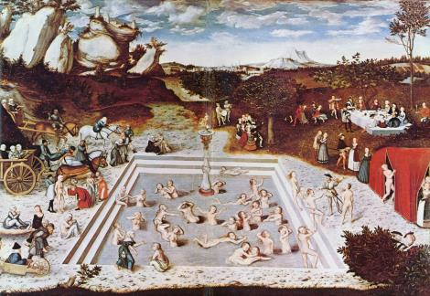
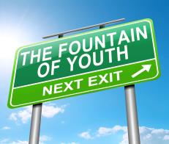
One broad medical problem in older ages is
Limit of regeneration after injuries
One key is poor control of inflammation and scarring – fibrosis
Affects all tissues including skin, lung, liver, heart, eyes, brain etc.

Slide 4
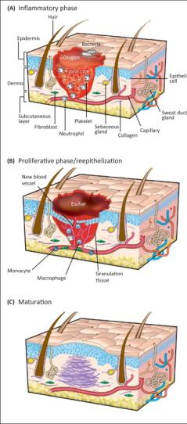
Inflammation Clotting Cytokines call in immune cells
Immune cells kill microbes and remove dead cells and other debris
Rebuilding New tissue cells and collagene
Blood vessels (angiogenesis) Growth factors etc.
Fibrosis, remodelling, scarring
Myofibroblasts make more collagene
Growth factors, TGFβ, MMPs ???
From Gurtner et al. Nature 453, 314-321 (15 May 2008)

Slide 5
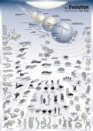
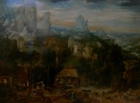
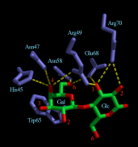
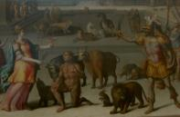
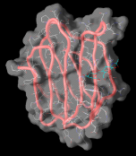
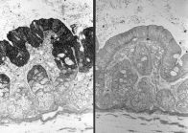
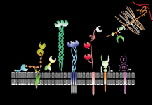
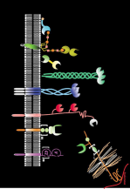

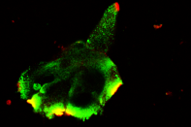
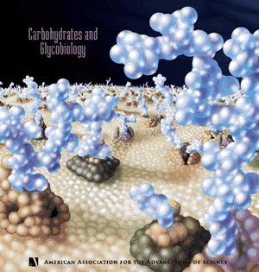
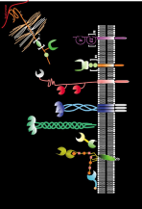

Slide 6


Galectins
Galectin-4
Galectin-8
Galectin-1
Galectin-12
Galectin-7
Galectin-2
Galectin-9
Galectin-3
D
E
C
B
A

Slide 7


How are structural motifs around galactose recognized by galectins?
C
D
E
A
B
Galα1-3 GalNAcα1-3 GlcNAcβ1-3 GalNAcβ1-3 Galβ1-3 Fucα1-2 NeuAcα2-3 SO₃⁻ - 3 NAc
more sugars
peptide
lipid
4Glc-
4GlcNAc-
3GlcNAc-
3GalNAc-
4Xyl-
Galβ1-
more sugars
A
B
C
D
E

Slide 8
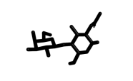
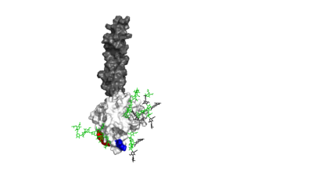
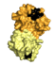
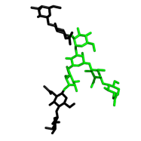
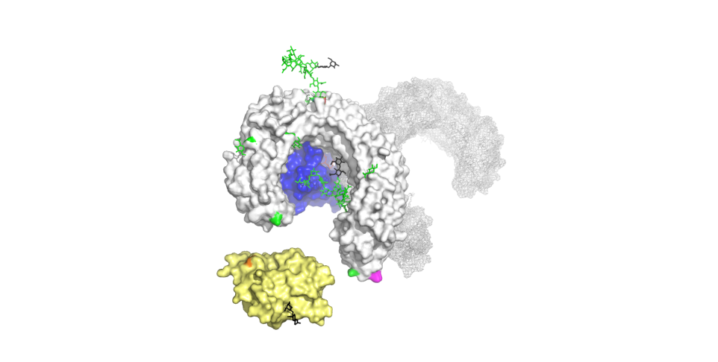
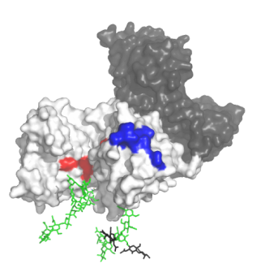
LacNAc K_{d} ~200 μM
Haptoglobin K_{d} ~1 μM
Biantennary N-glycan K_{d} ~100 μM
TLR4 K_{d} ~1 μM
Galectin-1
Transferrin K_{d} ~1 μM
Galectin-3

Slide 9
Glycoproteins with
glycans
Galectins

Slide 10
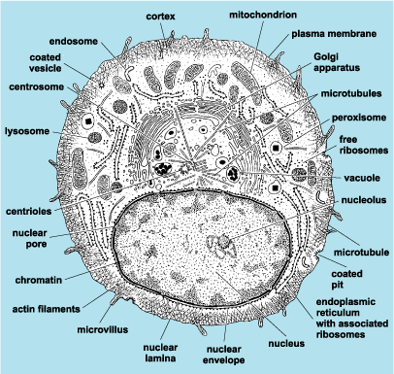
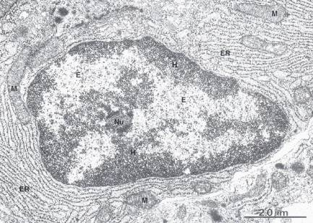

Slide 11
Extracellular
Cytosolic

Slide 12
Extracellular
Cytosolic

Slide 13
Vesicles in vesicles

Slide 16
Some functional contexts
Galectin cell surface binding, signaling and lattices
Galectins as regulators of glycoprotein traffic
Galectin-3 in newly discovered pathway of endocytosis and membrane turnover
Galectins in disrupted vesicles and autophagy
Galectin-3 in centrosomes
Relationship between primary cilia and autophagy
Galectin-3 in cytosol and nucleus

Slide 17
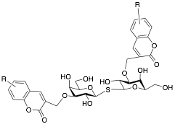
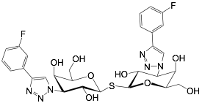
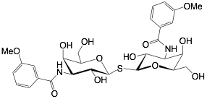
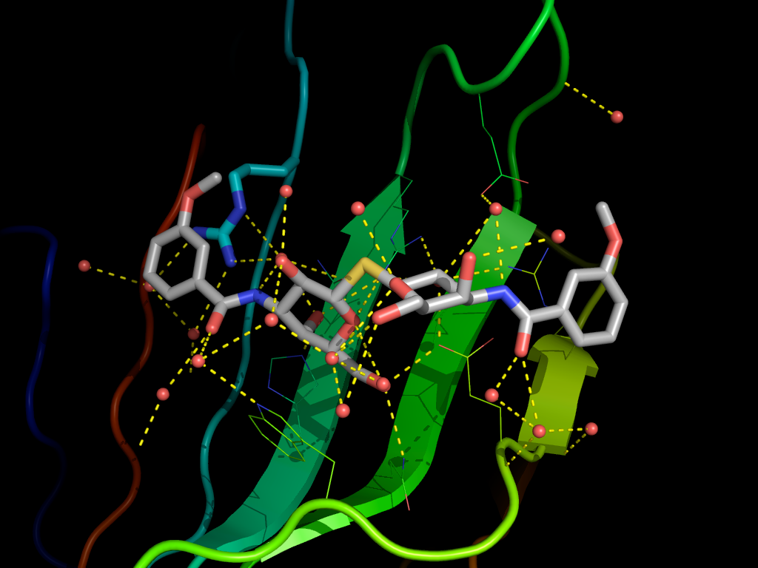
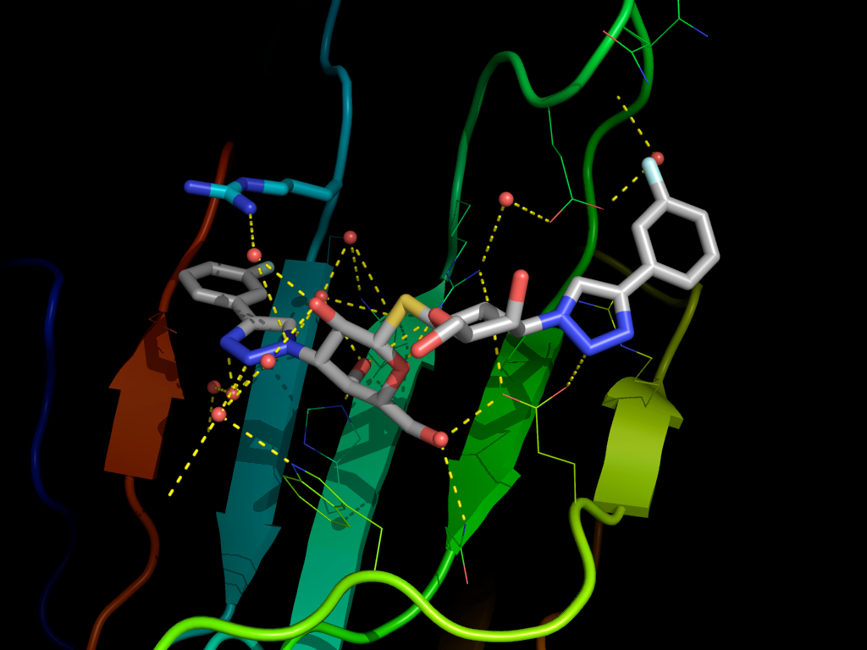
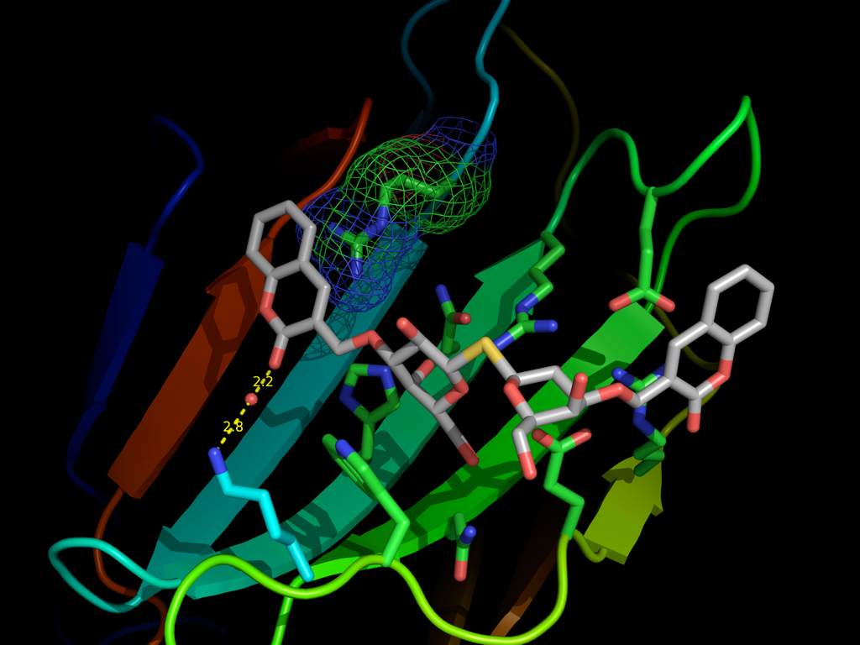
Galectins are drugable
K_{d} ~2 nM

Slide 18
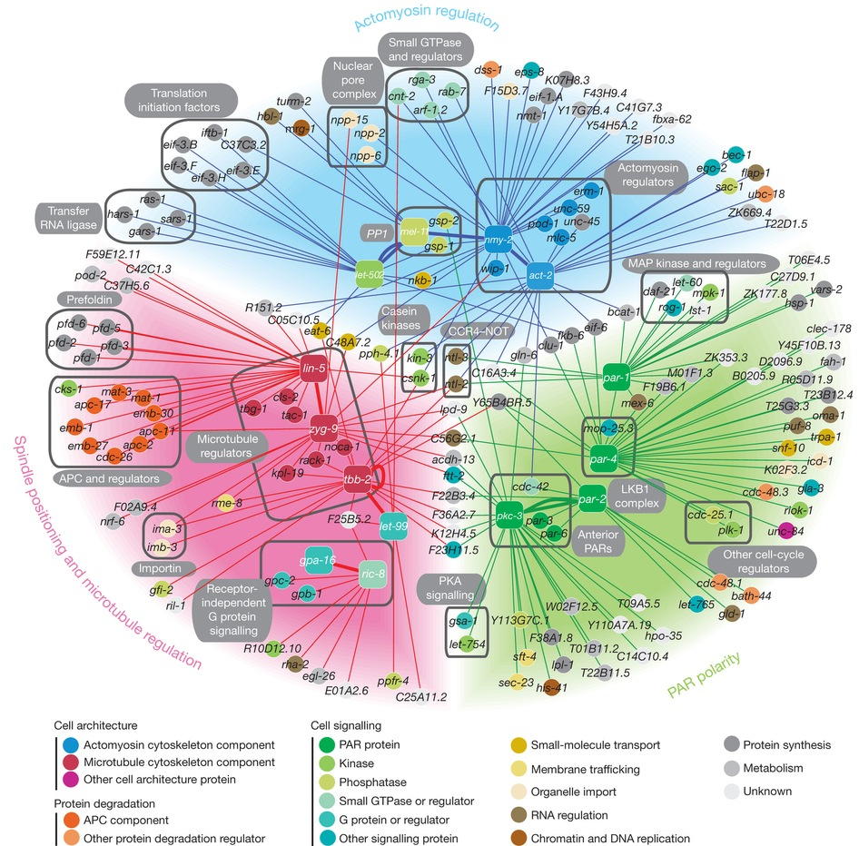


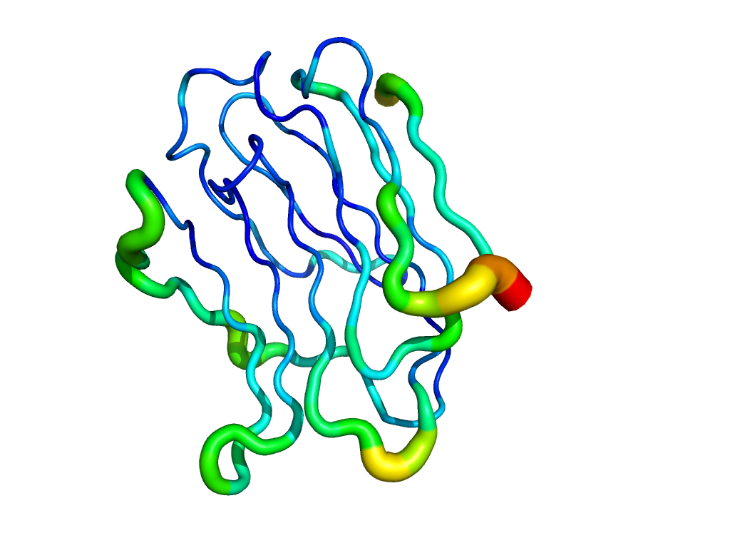

Slide 19

Galectins are drugable
Ulf Nilsson

Slide 20
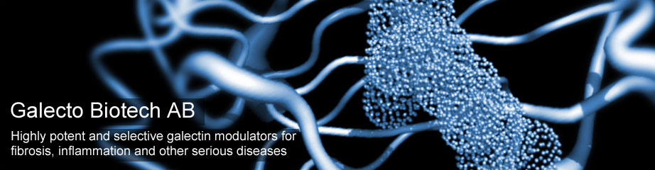

Bristol-Myers Squibb Signs Exclusive Option Agreement to Acquire Galecto Biotech AB …….
and gain worldwide rights to its lead asset TD139, a novel inhaled inhibitor of galectin-3 in Phase 1 development for the treatment of idiopathic pulmonary fibrosis (IPF) and other pulmonary fibrotic condition.
Disclosure – Hakon Leffler is co-founder and co-owner of Galecto Biotech

Slide 21
Glycoproteins with
glycans
Galectins
Glycoprotein | Cell or cell function | Pathophysiological effect | Reference
Non-raft glycoproteins | Epithelial cells | ?? | Delacour, Jacob et al.
EGF-receptor | Cell growth | Cancer growth | Dennis et al
TGF-β-receptor, CD98, Integrin | M2 macrophages etc | Excessive fibrosis in chronic inflammation | Sethi et al.
CD8 | Cytotoxic T-cells | Immunosuppression in cancer | van der Bruggen et al
VEGF-R | Angiogensis | Vascular overgrowth in eye disease | Panjwani et al
Integrins | Cell adhesion | Migration, metastasis in cancer | Kiss et al
Haptoglobin / Transferrin | M2 Macrophages / all cells | ?? | Leffler et al

Slide 22
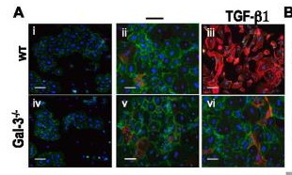
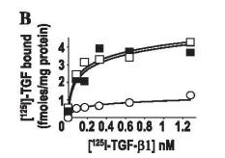
Cellular effect Ept-Mes-transition (EMT)
E-cadherin
α-SMA
Molecular effect Cell surface TGF-β-rec
wt
Gal-3 siRNA + rGal-3
Gal-3 siRNA

Slide 23
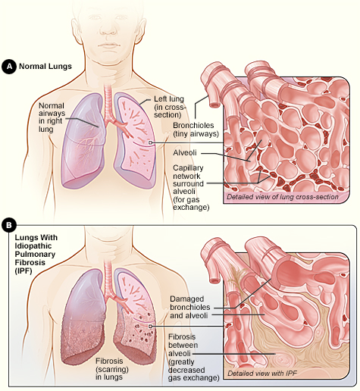
Idiopathic Pulmonary Fibrosis
IPF is a progressive, irreversible, ultimately fatal lung disease characterized by decline in lung function
Lung tissue get scarred and thus non functional
Death caused by respiratory failure
Cause unknown
Most patients are ≥ 50 years-old at diagnosis
US incidence: ~30,000/year
Increasing incidence and IPF-related deaths
Median survival of 2 - 5 years
US prevalence: ~100,000

Slide 24
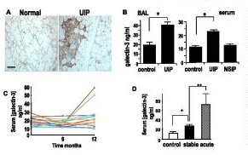
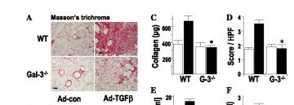
Regulation of transforming growth factor-β1-driven lung fibrosis by galectin-3.
Mackinnon AC, Gibbons MA, Farnworth SL, Leffler H, Nilsson UJ, Delaine T, Simpson AJ, Forbes SJ, Hirani N, Gauldie J, Sethi T.
Am J Respir Crit Care Med. 2012 185:537-546.
Galectin expression
in Idiopathic Lung Fibrosis (IPF)
Galectin null mice
Galectin effect on experimental IPF

Slide 25
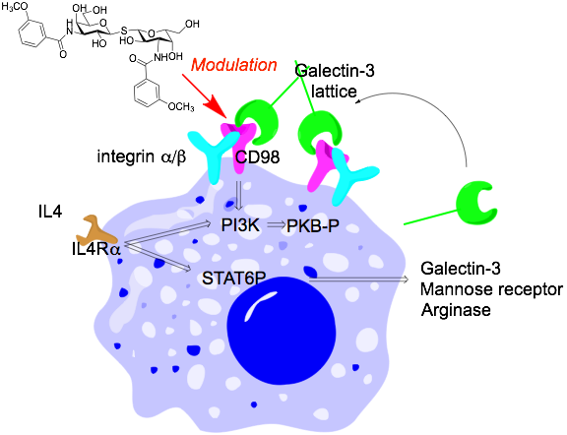
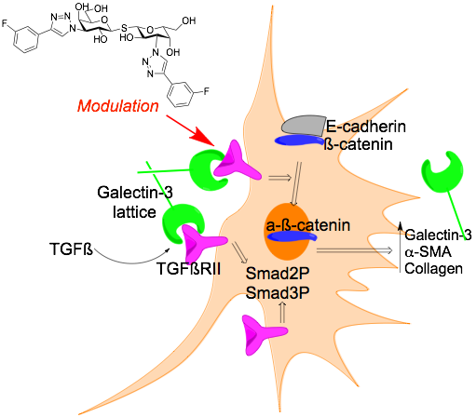
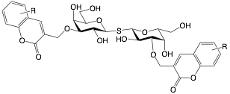
Two pro-fibrotic cell targets
Wynn JEM 208, 2011
Macrophage M2 polarization
MacKinnon et al. J. Immun. 2008, 180, 2650
Myofibroblast activation
MacKinnon et al. Am. J. Resp. Crit. Care Med. 2012, 185, 537

Slide 26
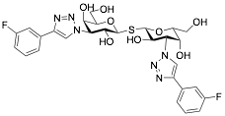
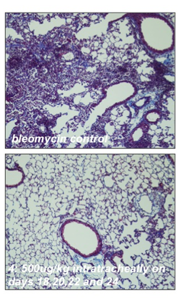
Inhibition of lung fibrosis by TD139
Regulation of transforming growth factor-β1-driven lung fibrosis by galectin-3. Mackinnon AC ….Sethi T. Am J Respir Crit Care Med. 2012 185:537-546.
Collagen (Masson’s trichrome)
Bleomycin model of lung fibrosis in mice
ctrl
Control
TD139 10 μg intr.trach. X 4
Fibrosis
TD139 10 μM
Days

Slide 27
Glycoproteins with
glycans
Galectins
Glycoprotein | Cell or cell function | Pathophysiological effect | Reference
Non-raft glycoproteins | Epithelial cells | ?? | Delacour, Jacob et al.
EGF-receptor | Cell growth | Cancer growth | Dennis et al
TGF-β-receptor, CD98, Integrin | M2 macrophages etc | Excessive fibrosis in chronic inflammation | Sethi et al.
CD8 | Cytotoxic T-cells | Immunosuppression in cancer | van der Bruggen et al
VEGF-R | Angiogensis | Vascular overgrowth in eye disease | Panjwani et al
Integrins | Cell adhesion | Migration, metastasis in cancer | Kiss et al
Haptoglobin / Transferrin | M2 Macrophages / all cells | ?? | Leffler et al

Slide 28
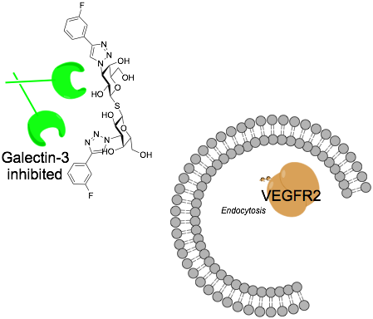
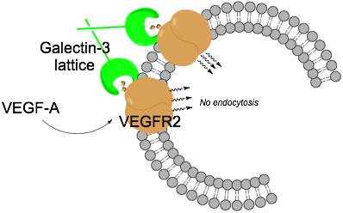

Ocular angiogenesis
Angiogenesis
No angiogenesis
Galectin-3 enhances VEGFR2 and bFGF signalling and angiogenesis
Blocking galectin-3 CRD decreases VEGFR2 and bFGF signalling and angiogenesis
W.-S. Chen et al. FASEB J., 2013, 27, 828.1

Slide 29
Galectins may induce signal and endocytosis from cell surface

Slide 30
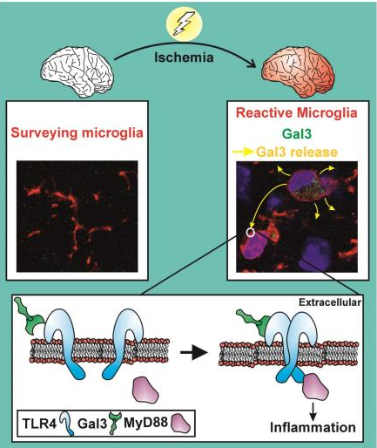
Microglia-Secreted Galectin-3 Acts as a Toll-like Receptor 4 Ligand and Contributes to Microglial Activation. Burguillos MA, …Leffler H, Venero JL, Joseph B, Deierborg T. Cell Rep. 2015 Mar 4. [Epub ahead of print]

Slide 31
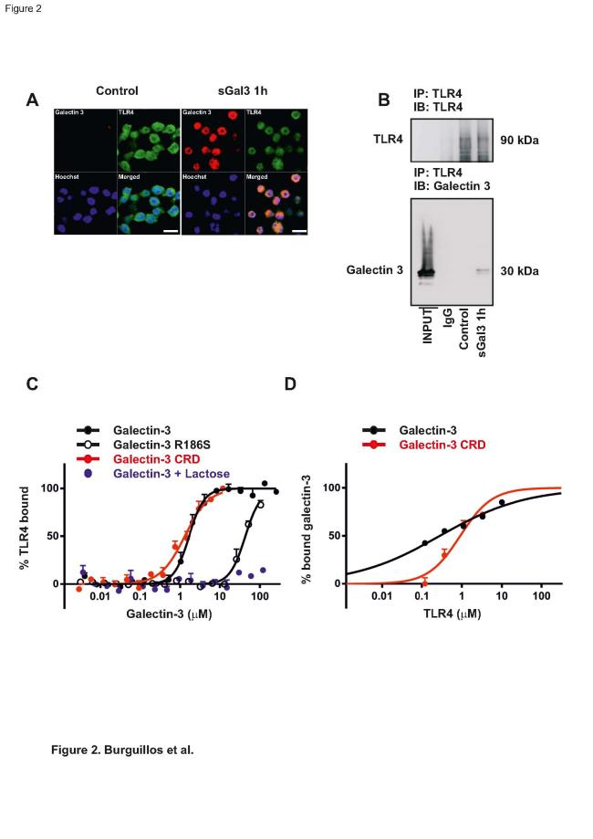

Galectin-3 binding TLR4 in solution
by microscale thermophoresis (MST)
by fluorescence anisotropy FA)

Slide 32
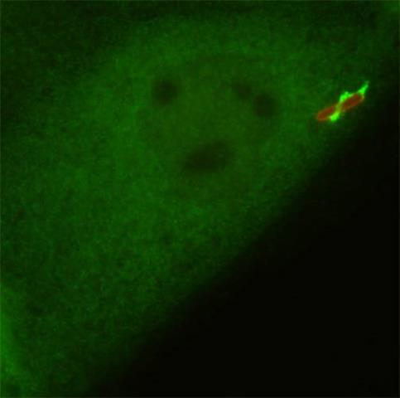
Paz, I., Sachse, M., Dupont, N., Mounier, J., Cederfur, C., Enninga, J., Leffler, H., Poirier, F., Prevost, M.C., Lafont, F. & Sansonetti, P. Galectin-3, a marker for vacuole lysis by invasive pathogens. Cell Microbiol 12, 530-544 (2010).
Galectins accumulate around disrupting vesicles.
This depends on interaction between galectin carbohydrate recognition site and host glycans of the disrupted vesicle
This can be triggered by bacteria, virus, protein or chemicals
Maier … Wiethoff (2012) Spatiotemporal Dynamics of Adenovirus Membrane Rupture and Endosomal Escape J. Virol. 86(19):10821.
Freeman …. Campbell, Alpha-Synuclein Induces Lysosomal Rupture and Cathepsin Dependent Reactive Oxygen Species Following Endocytosis PLOS One, 2013 Thurston TL, Wandel MP, von Muhlinen N, Foeglein A, Randow F (2012) Galectin 8 targets damaged vesicles for autophagy to defend cells against bacterial invasion. Nature 482: 414-418.

Slide 33
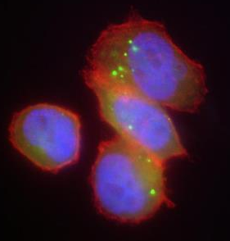
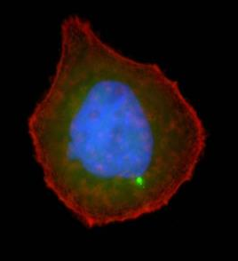
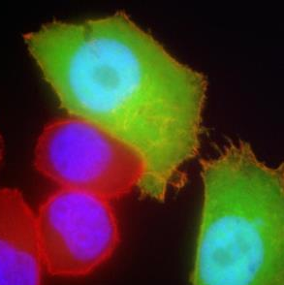
GFP-galectin-3 in SkBr3-cells
wt
G182A
R186S
10
number of cells
5
0
1-2
3-4
5-6
>6
1-2
3-4
5-6
>6
1-2
3-4
5-6
>6
vesicles/cell
vesicles/cell
vesicles/cell

Slide 34
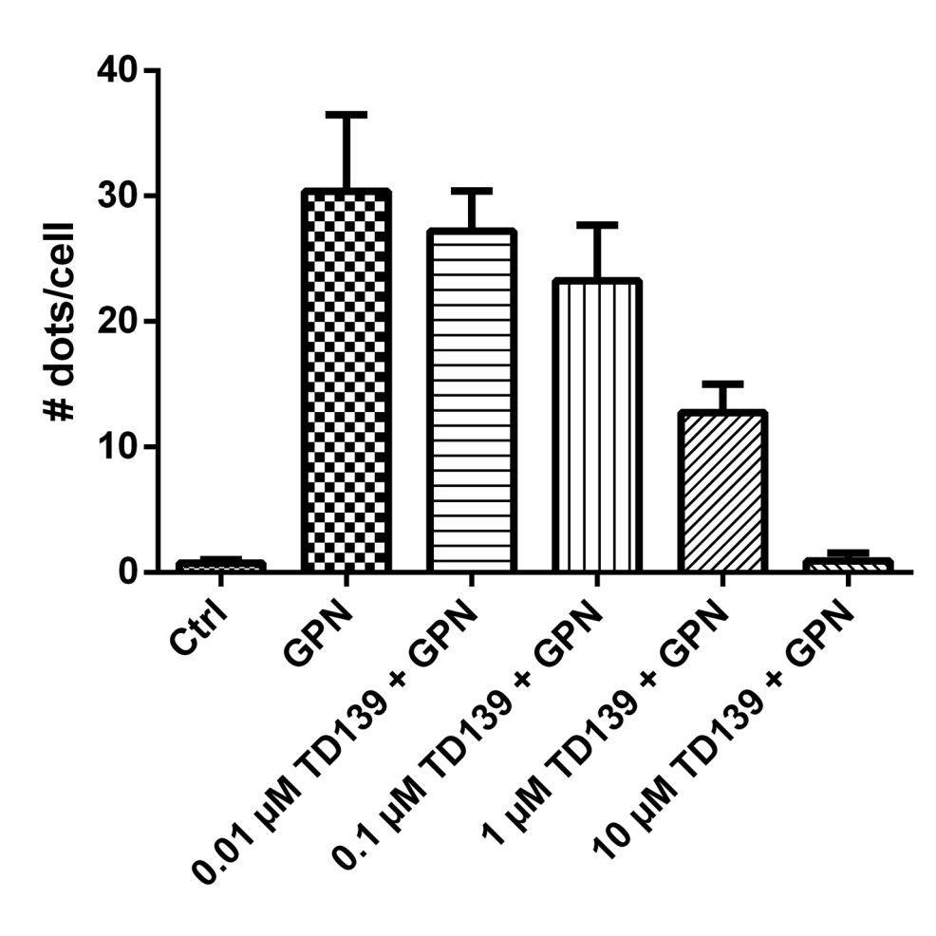

Gunjan Sharma and John Stegmayr, ASCB-2014
Control (0.1% DMSO 4h)
GPN 10 min to disrupts lysomes
Drug (10 uM) 4 h followed by GPN 10 min

Slide 35


Cell-cell transfer
Cherry-galectin-3
Cherry-galectin-3
Alpha-synuclein
Freeman …. Campbell, Alpha-Synuclein Induces Lysosomal Rupture and Cathepsin Dependent Reactive Oxygen Species Following Endocytosis PLOS One, 2013

Slide 36

The role of Galectin-3 in α-synuclein-induced microglial activation. Boza-Serrano et al. Acta Neuropathologica Communications 2014, 2:156

Slide 37
2 types of Virus
Cytosolic

Slide 38


Glycans, galectins, and HIV-1 infection
Sato, Ouellet, St-Pierre, Tremblay AnnNYAcSci 2012
GP120
Gal-1
Galectin-1 enhances HIV infection
by enhancing cell surface attachment
CD4
Galectin-1

Slide 39
Galectins work in a different way compared to classical extracellular signaling molecules
Cytokines: one or a few receptors.
Receptor binding induces one or two specific signaling pathways inside cells
Galectins: many different receptors, sharing common carbohydrate .
Regulates signaling induced by other molecules.
May also induce own signaling in but different in different cell types.
Galectins: outcome depends on a match between galectin specificity and
the particular carbohydrates a cell expresses.

Slide 41
How are structural motifs around galactose recognized by galectins?
C
D
E
A
B
Galα1-3 GalNAcα1-3 GlcNAcβ1-3 GalNAcβ1-3 Galβ1-3 Fucα1-2 NeuAcα2-3 SO₃⁻ - 3 NAc
more sugars
peptide
lipid
4Glc-
4GlcNAc-
3GlcNAc-
3GalNAc-
4Xyl-
Galβ1-
more sugars
A
B
C
D
E

Slide 42

GalNAcα1-3 GlcNAcβ1-3 NeuAcα2-3
Galβ1-
more sugars
peptide
lipid
more sugars
4GlcNAc-
4Glc-
A
B
C
D
E
Endocytosis (30 min) of galectin-3 wt and mutant

Slide 43
How are structural motifs around galactose recognized by galectins?
C
D
E
A
B
Galα1-3 GalNAcα1-3 GlcNAcβ1-3 GalNAcβ1-3 Galβ1-3 Fucα1-2 NeuAcα2-3 SO₃⁻ - 3 NAc
more sugars
peptide
lipid
4Glc-
4GlcNAc-
3GlcNAc-
3GalNAc-
4Xyl-
Galβ1-
more sugars
A
B
C
D
E

Slide 44


Affinity chromatography -Galectin-3 and transferrin

Slide 45


with Carlo Unverzagt et al., University Bayreuth, Germany

Slide 47
Paz, I., Sachse, M., Dupont, N., Mounier, J., Cederfur, C., Enninga, J., Leffler, H., Poirier, F., Prevost, M.C., Lafont, F. & Sansonetti, P. Galectin-3, a marker for vacuole lysis by invasive pathogens. Cell Microbiol 12, 530-544 (2010).
Galectins accumulate around disrupting vesicles.
This depends on interaction between galectin carbohydrate recognition site and host glycans of the disrupted vesicle
This can be triggered by bacteria, virus, protein or chemicals
Maier … Wiethoff (2012) Spatiotemporal Dynamics of Adenovirus Membrane Rupture and Endosomal Escape J. Virol. 86(19):10821.
Freeman …. Campbell, Alpha-Synuclein Induces Lysosomal Rupture and Cathepsin Dependent Reactive Oxygen Species Following Endocytosis PLOS One, 2013 Thurston TL, Wandel MP, von Muhlinen N, Foeglein A, Randow F (2012) Galectin 8 targets damaged vesicles for autophagy to defend cells against bacterial invasion. Nature 482: 414-418.

Slide 48




Ligand induced galectin-3 self-association.Lepur et al. J Biol Chem. 2012
Type-N
old model
Type-C
new model
FA-assay demonstrates large excess (grey area in panel C) binding to a model glycoprotein (ASF) for galectin-3 (C) but not for galectin-1 (D).
Precipitaion of ASF with galectin-3 measured by turbidity

Slide 49

Gal-8-N
Gal-8-C
Gal-8-N
NDP52
Thurston, Randow et al., Nature 2012 Kim, Song et al., Nature Comm 2013
Nishi et al.

Slide 50


Effects of galectins and antibodies in HIV infection
Novel assays
Enas Sheik-khalil
Doctoral Dissertation (April 17, 2015)
Notes:
Thank you Sigvard for the introduction
Hello everyone,
Welcome to my PhD thesis defense where I will present to you the research and results mainly done on the effects of galectins and antibodies in HIV infection

Slide 51
Notes:
Thank you Sigvard for the introduction
Hello everyone,
Welcome to my PhD thesis defense where I will present to you the research and results mainly done on the effects of galectins and antibodies in HIV infection

Slide 52

Intracellular sorting of galectin-8 based on carbohydrate fine specificity
Different specificity
Different sorting

Slide 53
Some functional contexts
Galectin cell surface binding, signaling and lattices
Galectins as regulators of glycoprotein traffic
Galectin-3 in newly discovered pathway of endocytosis and membrane turnover
Galectins in disrupted vesicles and autophagy
Galectin-3 in centrosomes
Relationship between primary cilia and autophagy
Galectin-3 in cytosol and nucleus

Slide 54
Laboratory medicine, Lund
Hakon Leffler
Barbro Kahl Knutsson
Emma Salomonsson
Michael Carlsson
Adriana Lepur John Stegmayr Gunjan Sharma
Enas Sheik-Khalil
Organic chemistry, Lund
Ulf Nilsson et. al.
Biophysical Chemistry etc, Lund Derek Logan, Mikael Akke, Ulf Ryde et al.
Biochemistry, Bayreuth Carlo Unverzagt et al.
Oncology, Lund
Håkan Olsson, Mårten Fernö
Tufts Medical Center, Boston
Noorjahan Panjwani et al.
Kings College, London
Tariq Sethi et al. Galecto Biotech, Lund-Copenhagen
Hans Schambye et al.
Galectin Specificity, Functions, and Medical use.
Galectin-4
Galectin-8
Galectin-1
Galectin-12
Galectin-7
Galectin-2
Galectin-9
Galectin-3
Swedish Research Council (VR)
EU-FP7 PANACREAS and other Medical Faculty, Lund Galecto Biotech, Lund-Copenhagen

Slide 55


Enas Sheik-Khalil
Michael Carlsson
John Stegmayr
Gunjan Sharma
Barbro Kahl-Knutson

Slide 56

Emma Salomonsson
Barbro Kahl-Knutson

Slide 57


Acknowledgements
Lund University
(CAS)
Pernilla Sörme
Johan Tejler
Bader Salameh
Ian Cumpstey
Christopher Öberg
Anders Sundin
Ann-Louise Noresson
Tamara Delaine
Henrik von Wachenfeldt
Vishal Rajput
Santanu Mandal
Prashant Verma
Priya Verma
Tuft’s University
Wei-Sheng
Noorjahan Panjwani
University of Edinburgh
Alison Mackinnon
King’s College, London
Tariq Sethi
Hans Schambye
Anders Pedersen
Fredrik Zetterberg
Paul Ford
Lise Gravelle
Susan Tantawi
(Inst. Laboratory Medicine)
Hakon Leffler
Barbro Kahl Knutsson
John Stegmayr
Gunjan Verma
(Center for Molecular Protein Science)
Mikael Akke
Carl Diehl
Derek Logan
(Theoretical chemistry)
Ulf Ryde
Samuel Genheden
Lund University
Swedish Research Council
Swedish Strategic Research Foundation Programs “Glycoconjugates in Biological Systems” (GLIBS) and “Chemistry for Life Sciences” sponsored by the Swedish Strategic Research Foundation
“Olle Engqvist Byggmästare” Foundation
Craaford Foundation
Royal Physiographic Society in Lund
EU-FP7 programme “PANACREAS”
Galecto Biotech AB
$$$

Slide 58

Bristol-Myers Squibb Signs Exclusive Option Agreement to Acquire Galecto Biotech AB …….
and gain worldwide rights to its lead asset TD139, a novel inhaled inhibitor of galectin-3 in Phase 1 development for the treatment of idiopathic pulmonary fibrosis (IPF) and other pulmonary fibrotic condition.
Disclosure – Hakon Leffler is co-founder and co-owner of Galecto Biotech

Slide 59


