Slide 2
Content
Ruđer Bošković Institute overview
Ruđer Bošković Institute Library overview
Short history of SEND
Online presentation
Challenges
Questions

Slide 3
Ruđer Bošković Institute overview
founded in 1950
largest Croatian research institute in the field of science
funded by the Ministry of Science, Education and Sports
2 locations: Zagreb and Rovinj
11 divisions, 3 centres, 82research laboratories, Library
≈ 900 employees,
>550 scientists and researchers

Slide 4
Ruđer Bošković Institute Library overview (http://lib.irb.hr)
largest scientific library in Croatia
2 locations: Zagreb and Rovinj
10 staff members
holdings: > 24000 monograph publications; > 1000 M.A. and Ph.D. Thesis, 1200 titles of printed journals (300 titles of current subscription), access to ≈15000 e-journal access, 40 databases
member of: LIBER, EURASLIC/IAMSLIC
projects: OpenAIREplus; FOSTER; CROSBI; Hrčak, Who is Who in Croatian Science...

Slide 5
SEND 1.0
RBI library has well established ILL service with Croatian libraries, EURASLIC/IAMSLIC libraries, British library, Slovenian libraries, Subito document delivery service...
before 2002 - Requests were accepted and sent by phone, mail, e-mail, fax (time consuming, request tracking was incoherent, statistics was inconsistent ...)
from 2002 – SEND (Electronic Document Acquiring System) Informix database, PHP Programming language, Sun Solaris 7 operating system
RBI library only

Slide 6
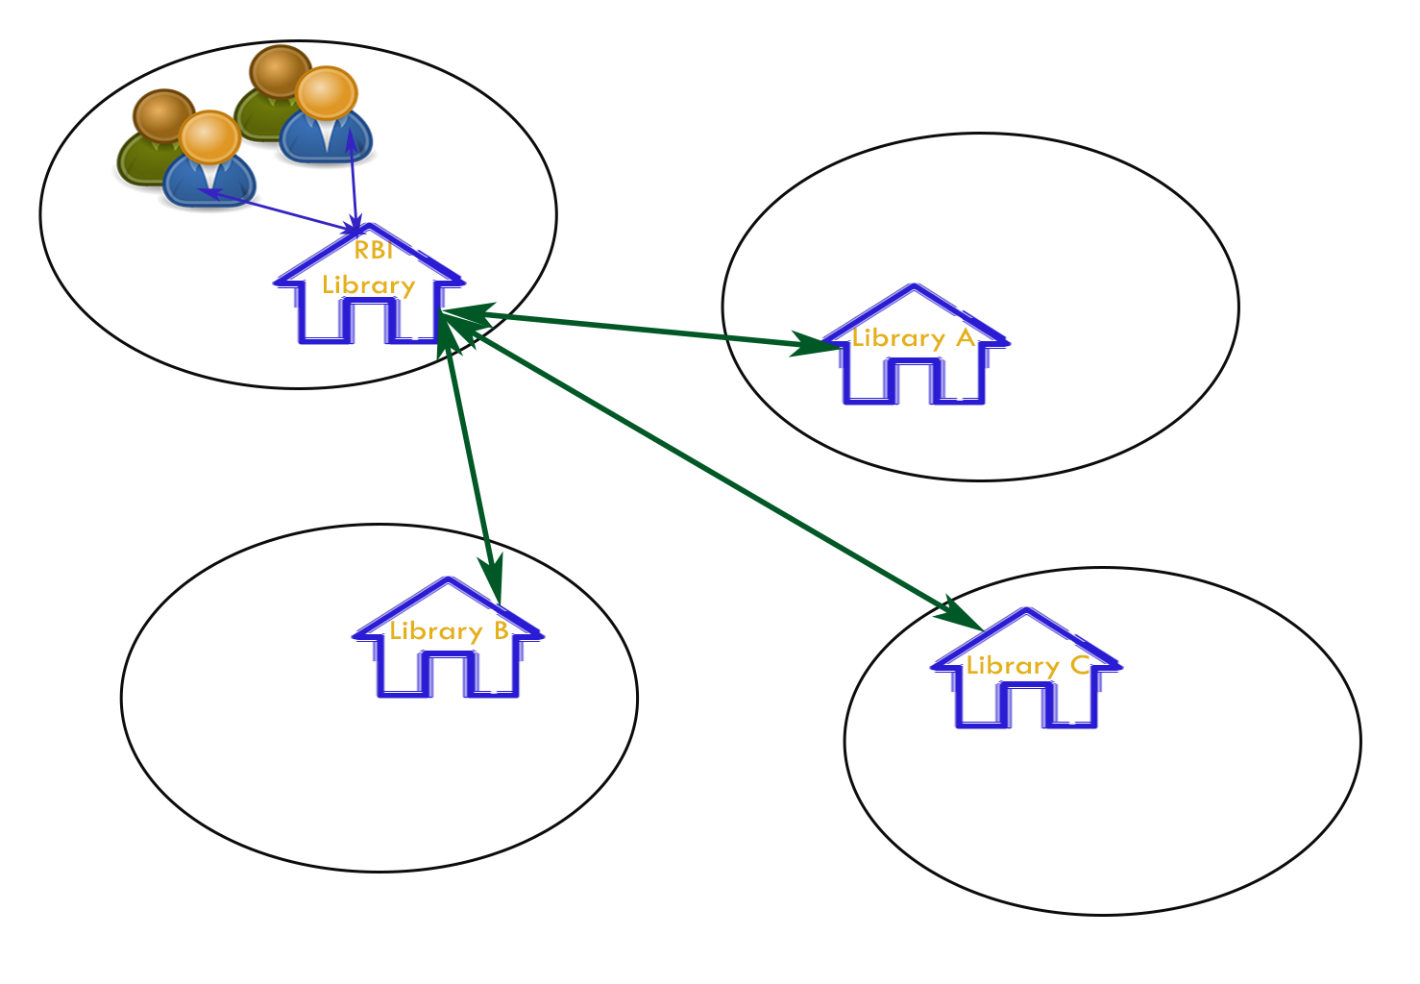
SEND 1.0

Slide 7
SEND 1.0
400 registered users, RBI employees - request of documents from Croatian libraries or from libraries abroad 80 registered libraries - request documents owned by the RBI Library
9500 request from RBI users, 5600 request from Croatian libraries
presented by Marina Mayer at 9th ILDS Conference, Tallin, 2005
Macan, Bojan; Sofija Konjević. A survey of Interlibrary Loans at Ruder Boškovic Institute Library, Croatia, 2003-2008. // Interlending & Document Supply 39, Vol. 39 Iss: 1, pp.45 – 52

Slide 8
SEND 2.0
released - 3 March 2014
developed by RBI library team, application is built by using open code technologies, PHP program language and MySQL database, installed on Linux server
access to the service is enabled through unique user identifier for Croatian academic community AAI@EduHr.
users without unique user identifier have to register first through online registration form

Slide 9
SEND 2.0
presented to the public at RBI Library Colloquia (2 April 2014)
Library educational seminars – KEKS (11 December 2014)
39th Croatian Library Association General Conference and Assembly – Split, 15-18 October 2014
14th Days of Special and Academic Libraries – Lovran, 13-16 May 2015
The 41st IAMSLIC Annual Conference & 16th EURASLIC Biennial Meeting, 7-11 September, 2015, FAO, Rome

Slide 10
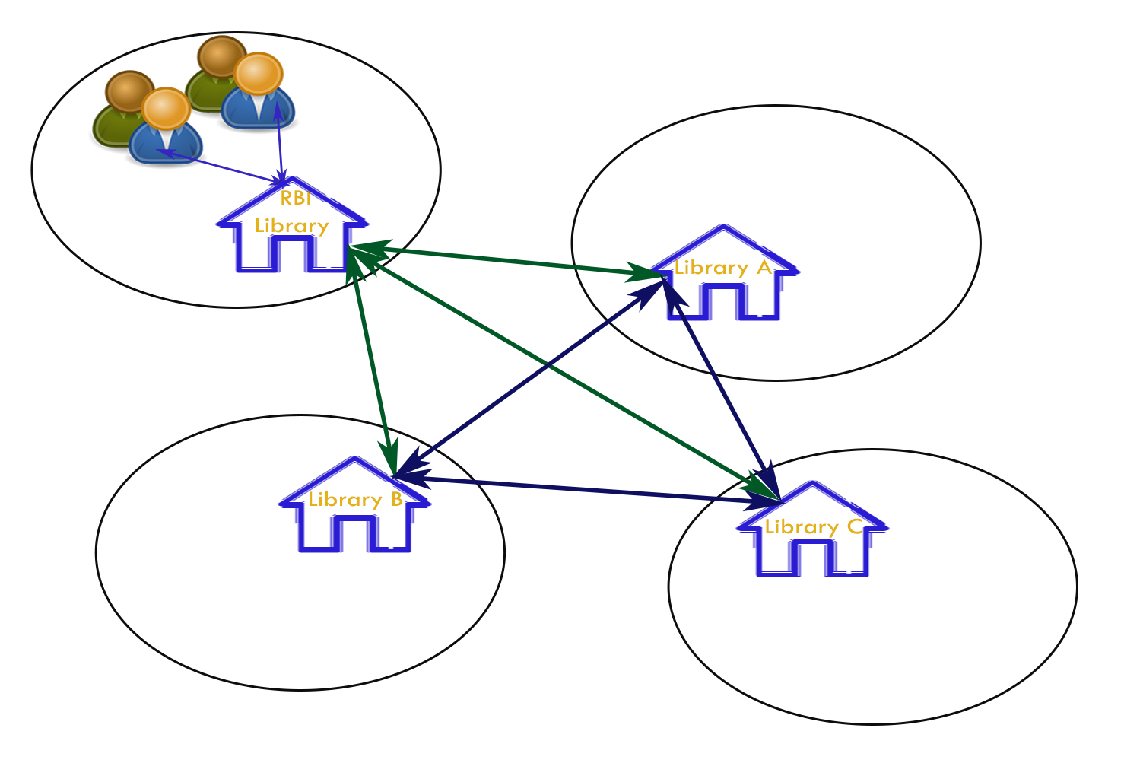
SEND 2.0

Slide 11
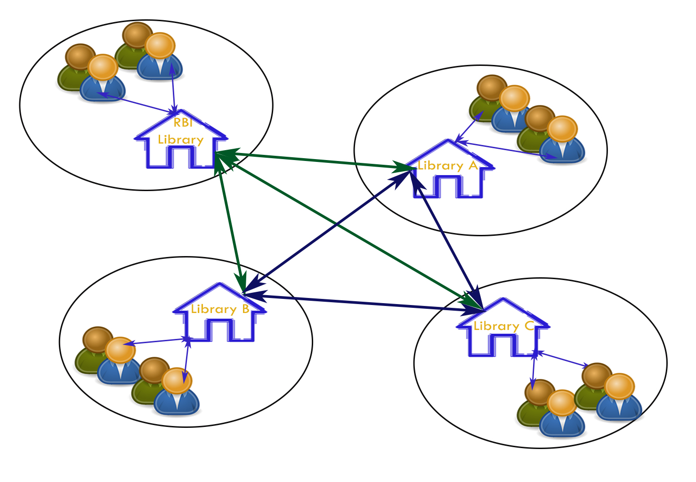
SEND 2.0

Slide 12
Challenges
further development of statistical analysis module
connection to library catalogues and web resources

Slide 13
Questions
send@lib.irb.hr
Thank you for your attention!

