Slide 1


SYNTHESIS OF MACROCYCLIC COMPOUNDS VIA CONSECUTIVE sONOGASHIRA-uGI-SONOGASHIRA REACTIONS
Mladena Glavaš, PhD student
Supervisor: Dr. Ivanka Jerić
Ruđer Bošković Institute
Division of Organic Chemistry and Biochemistry
Laboratory for biomimetic chemistry

Slide 2
Enedyine motif
antibacterial and anticancer activity
K. C. Nicolau, G. Zuccarello, C. Reimer, V. A. Estevez, W. – M. Dai, J. Am. Chem. Soc. 114 (1992) 7360 – 7371.; R. G. Bergman, Acc. Chem. Res. 6 (1973) 25 – 31.

Slide 3
A. Basak, K. Rani, Rudra, S. Sekhar Bag, A. Basak, J. Chem. Soc., Perkin Trans. 1 (2002) 1805 – 1809.; M. Gredičak, N. Bregović, D. Carić, I. Jerić, J. Inorg. Biochem. 116 (2012) 45 – 52.; Z. Kokan, Z. Glasovac, M. Majerić Elenkov, M. Gredičak, I. Jerić, S. I. Kirin, Organometallics 33 (2014) 4005 – 4015.

Slide 4
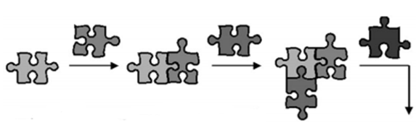

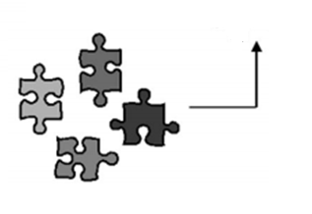
Multicomponent reactions (MCRs)
one-pot transformations
three or more substrates
one product
structural diversity
high complex structures
Isocyanide-based multicomponent reactions (IMCRs)
synthesis of peptidomimetics
Passerini and Ugi reaction
S. Brauch, S. S. van Berkel, B. Westermann, Chem. Soc. Rev., 42 (2013) 4948 – 4962.; G. Koopmanschap, E. Ruijter, R. V. A. Orru, Beilstein J. Org. Chem. 10 (2014) 544 – 598.

Slide 5
Ugi reaction
four component
one product → α-acylamino amides
polar solvent, rt
G. Koopmanschap, E. Ruijter, R. V. A. Orru, Beilstein J. Org. Chem. 10 (2014) 544 – 598.; I. Ugi, R. Meyer, U. Fetzer, C. Steinbrücker, Angew. Chem. 71 (1959) 386.

Slide 6
Sonogashira coupling
new C-C bond
palladium catalyst – Pd(PPh₃)₄, PdCl₂(PPh₃)₂, PPh₃, PdCl₂
cocatalyst – CuI
organic base – TEA
anhydrous and anaerobic conditions
B. Liang, M. Dai, J. Chen, Z. Yang, J. Org. Chem. 70 (2005) 391 – 393.; K. Sonogashira, J. Organometallic Chem. 653 (2002) 46 – 49.

Slide 8
i. Pd(PPh₃)₄ (3 mol%), CuI (3 mol%), TEA, tert-butyl prop-2-yn-1-ylcarbamate
(1.1 eq.), Ar, rt, 1 50%;
ii. PdCl₂(PPh₃)₂ (3 mol%), CuI (3 mol%), pent-4-yn-1-ol (2 eq.)/prop-2-yn-1-ol
(2 eq.), TEA, Ar, rt, 2 87 % / 3 98 %
iii. DMP (2 eq.), DCM, 4 80 %; 5 78 %
iv. Pd(PPh₃)₄ (3 mol%), CuI (3 mol%), pent-4-yn-1-ol (2 eq.)/prop-2-yn-1-ol (2
eq.), TEA, Ar, rt, 6 44 % / 7 38 %
v. DMP (2 eq.), DCM, 8 88 %, 9 96 %
vi. H₂NPheOtBu (2 eq.), R₂CO₂H (2 eq.), R₃NC (2 eq.), MeOH (0.1 M), Ar, rt
vii. H₂NR₁OtBu (2 eq.) R₁ = Val, Phe, Leu; R₂CO₂H (2 eq.), R₃NC (2 eq.),
MeOH (0.1 M), Ar, rt
viii. PdCl₂(PPh₃)₂ (3 mol%), CuI (3 mol%), prop-2-yn-1-ol (2 eq.), TEA, Ar, rt
unpublished results

Slide 10
ªdr determined from mass of isolated and separated compounds
^{b}dr determined from ¹H NMR spectrum
unpublished results

Slide 11
^{b}dr determined from ¹H NMR spectrum
unpublished results

Slide 12
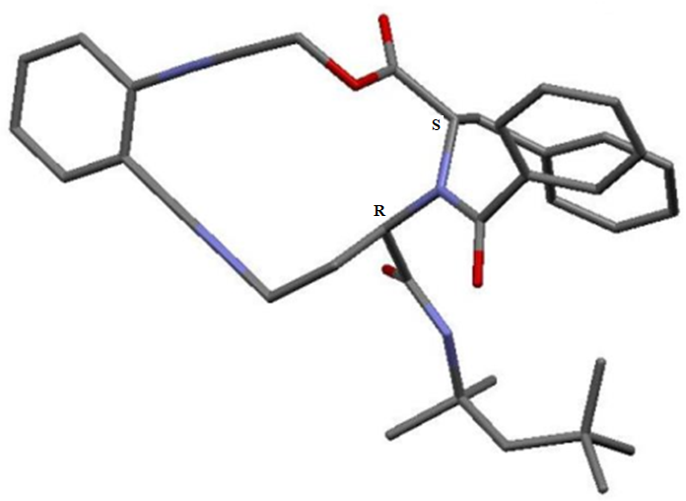
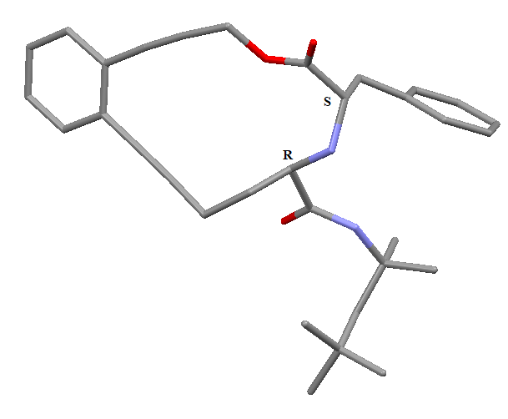

Slide 13
biological conditions pH ≈ 7, t ≈ 35 ºC – 40 ºC √
Bergman cyclization X
cancer cells √

Slide 14
Thank you for your attention!

